Slide 1
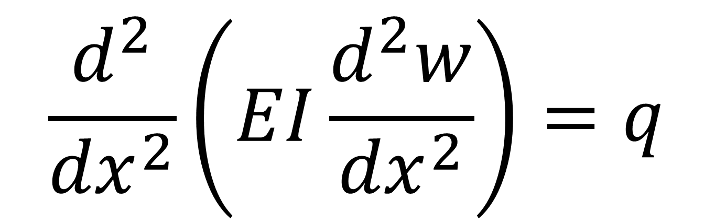
0
What is this equation, who developed it and when ?
Why is it important ?

Slide 2
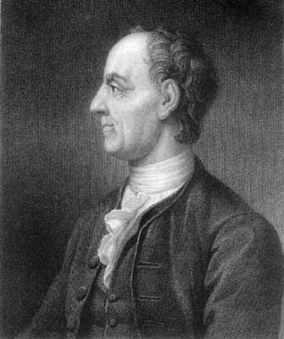
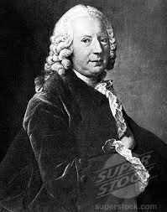
Who are these two 18th Century Swiss Mathematicians ?

Slide 3

Leonard Euler 1707 - 1783
Daniel Bernoulli
1700 - 1782
$$\frac{d^{2}}{{dx}^{2}}\left(EI\frac{d^{2}w}{{dx}^{2}}\right)=q$$
The Euler Bernoulli Beam Theory 1750

Slide 4
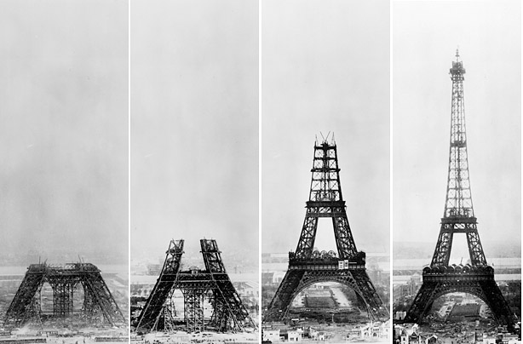
Eiffel Tower under construction 1887-1889

Slide 5
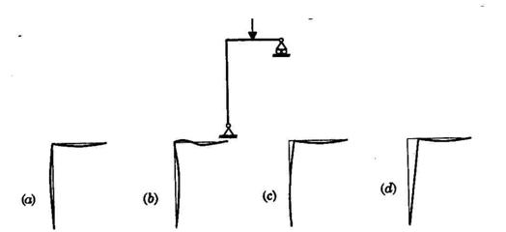
Applied Force
Hinge
Joint assumed
rigid
Roller
Hinge
How does this structure deform ?
Is the correct deflected shape (a), (b), (c) or (d)

