Slide 1
Why do a capella singers go flat…?
The mathematics of tuning systems in music
Colin Graham
@ColinTGraham

Slide 2

Some points to consider
Division of the octave

Slide 3
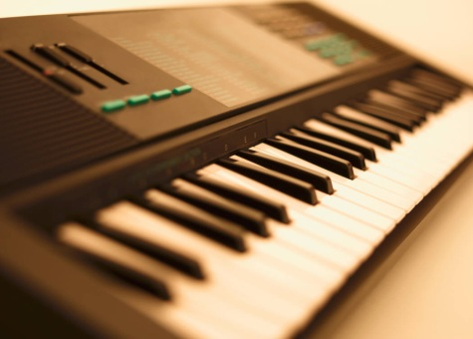
Some points to consider
Division of the octave
Number of pitches to be used

Slide 4

Some points to consider
Division of the octave
Number of pitches to be used
Tuning of the pitches

Slide 5
Western tuning systems
Equal temperament
Based on dividing into 12 equal parts

Slide 6
Western tuning systems
Equal temperament
Pythagorean tuning
Based on dividing into 12 equal parts
Based on ‘perfect fourths’ and ‘fifths’

Slide 7
Western tuning systems
Equal temperament
Pythagorean tuning
Just intonation
Based on dividing into 12 equal parts
Based on ‘perfect fourths’ and ‘fifths’
Based on whole-number ratios

Slide 8
Fundamentally harmonic…

Slide 9
A matter of ratios…
5/12 = 5/6 = 5/3 = 10/3 = 20/3

Slide 10
A matter of ratios…
5/12 = 5/6 = 5/3 = 10/3 = 20/3
Get used to it, if you want to read about tuning theories!

Slide 11
A matter of ratios…
5/12 = 5/6 = 5/3 = 10/3 = 20/3
Get used to it, if you want to read about tuning theories!

Slide 12
What to choose?
Equal Tempered | Just intoned | Pythagorean tuning
466.2 | 7/4 = 457.8 | 16/9 = 465.1
392.0 | 3/2= 392.4
329.6 | 5/4 = 327.1 | 81/64 = 331.1
261.6
Frequencies in Hertz based on A = 440Hz

Slide 13
Now the fun begins!

Slide 14

Now the fun begins!
$$\frac{5}{4}×\frac{81}{80}=\frac{81}{64}$$

