Slide 1

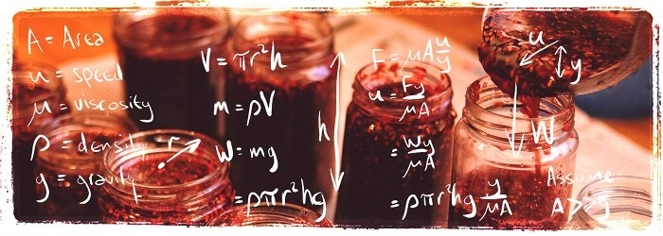
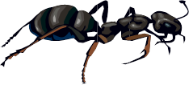
The Ant and the Rubber Band
David Bedford

Slide 2
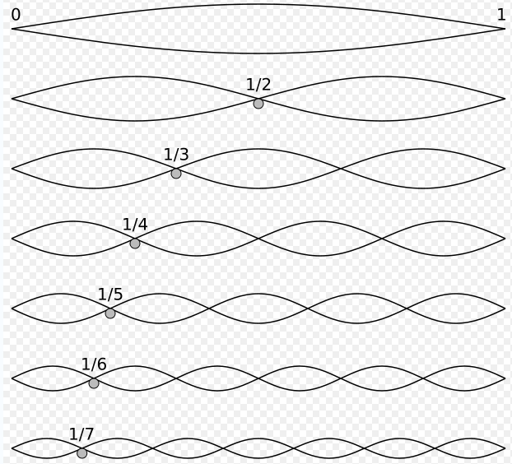
The Harmonic Series

Slide 3
(
)
(
)
(
)

Slide 4

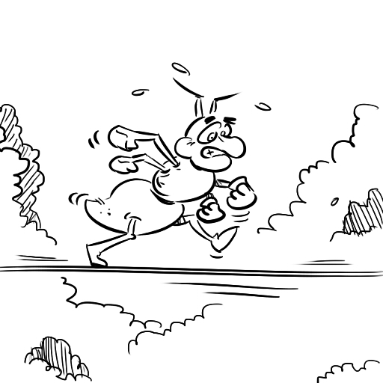
The (persistent) ant and the (very stretchy) rubber band
An ant starts at one end of a metre-long rubber band and crawls at 1cm per second towards the other end. At the end of each second the ant’s nemesis stretches the band by one metre.
Does the ant ever reach the end?

Slide 5
Start
1cm
Notes:
Animations on each click

Slide 6
1cm
2cm
Notes:
Animations on each click

Slide 7
2cm
3cm
Notes:
Animations on each click

Slide 8
3cm
4.5cm
Notes:
Animations on each click

Slide 9
5.5cm
4.5cm
Notes:
Animations on each click

Slide 10

Start
1cm
After 1 second the ant has covered 1/100th of the band.
Notes:
Animations on each click

Slide 11
1cm
2cm
After 1 second the ant has covered 1/100th of the distance
After the band has been stretched the ant has still covered 1/100th of the band
and covers a further 1/200th in the next second.
Notes:
Animations on each click

Slide 12
2cm
3cm
After 1 second the ant has covered 1/100th of the distance
After the band has been stretched the ant has still covered 1/100th of the distance
and covers a further 1/200th in the next second.
So after 2 seconds the ant has covered 1/100+1/200=3/200 of the band.
Notes:
Animations on each click

Slide 13
3cm
4.5cm
After 1 second the ant has covered 1/100th of the band.
After the band has been stretched the ant has still covered 1/100th of the band
and covers a further 1/200th in the next second.
So after 2 seconds the ant has covered 1/100+1/200=3/200 of the band.
The band is then stretched but it has still covered 1/100+1/200 of the band.
Notes:
Animations on each click

Slide 14
5.5cm
4.5cm
After 1 second the ant has covered 1/100th of the band.
After the band has been stretched the ant has still covered 1/100th of the band
and covers a further 1/200th in the next second.
So after 2 seconds the ant has covered 1/100+1/200=3/200 of the band.
The band is then stretched but it has still covered 1/100+1/200 of the band.
After 3 seconds the ant has covered 1/100+1/200+1/300 0f the band.
Notes:
Animations on each click

Slide 15
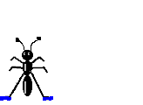
5.5cm
After 1 second the ant has covered 1/100th of the band.
After the band has been stretched the ant has still covered 1/100th of the band
and covers a further 1/200th in the next second.
So after 2 seconds the ant has covered 1/100+1/200=3/200 of the band.
The band is then stretched but it has still covered 1/100+1/200 of the band.
After 3 seconds the ant has covered 1/100+1/200+1/300 0f the band.
In the nth second the ant crawls 1/100n of the distance, and has covered
(1+1/2+1/3+…+1/n)/100 as a proportion of the band..
The ant will reach the end (but it will take a while)!
Notes:
Animations on each click

