Slide 1
Turning Needle Cars
Francis Hunt
fhhunt@glam.ac.uk

Slide 2
A Vision of the Future
Area swept out = π(½)² = π/4

Slide 3
Turning round in π/8

Slide 4

Turning round in π/8

Slide 5
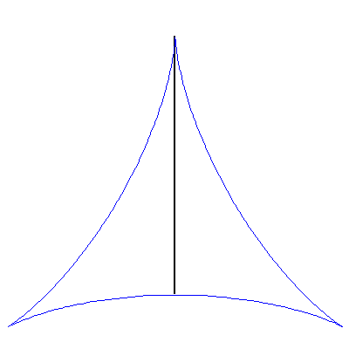
Turning round in π/8

Slide 6
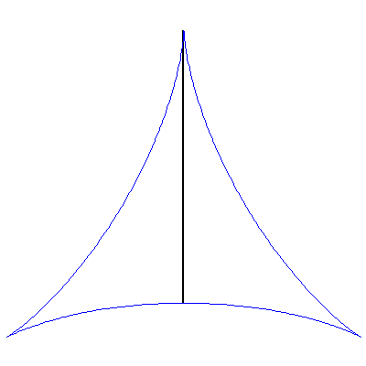
Turning round in π/8
What is the least possible area?

Slide 7
Turning round in ε
Idea 1
The area swept out in parallel parking can be made arbitrarily small
Besicovitch’s Solution

Slide 8
Turning round in ε
Idea 2

Slide 9
Turning round in ε
Divide base into 2^{m} equal segments (here m = 3)

Slide 10
Turning round in ε
Divide base into 2^{m} equal segments (here m = 3)

Slide 11
Turning round in ε
Divide height into m + 2 equal bands

Slide 12
Turning round in ε

Slide 13
Turning round in ε

Slide 14
Turning round in ε
area of shape has been reduced by a factor of 2/(m+2)
By choosing m large enough
we can make this arbitrarily small

Slide 15
Conclusion
the area of the spikagon can be made arbitrarily small
(by choosing m large enough)
the area of the 2^{m} parallel parks can be made arbitrarily small (by driving far enough)
the total area needed to turn our needle car round
can therefore be made arbitrarily small

