Slide 1
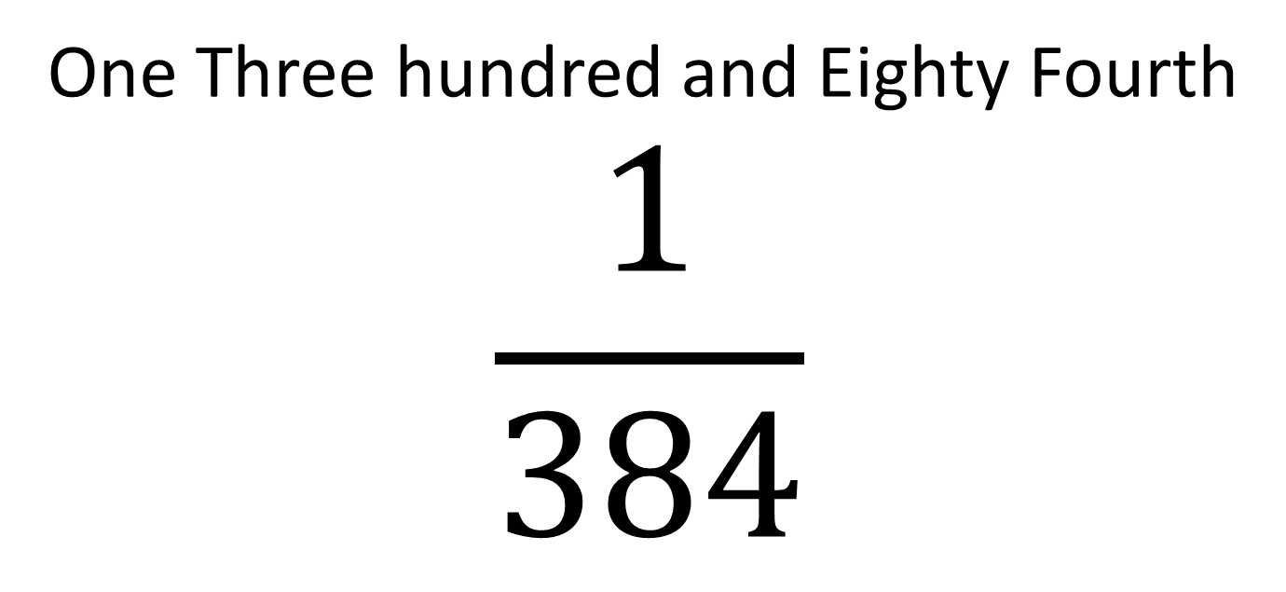
One Three hundred and Eighty Fourth
$$\frac{1}{384}$$
John Read
@johndavidread

Slide 2
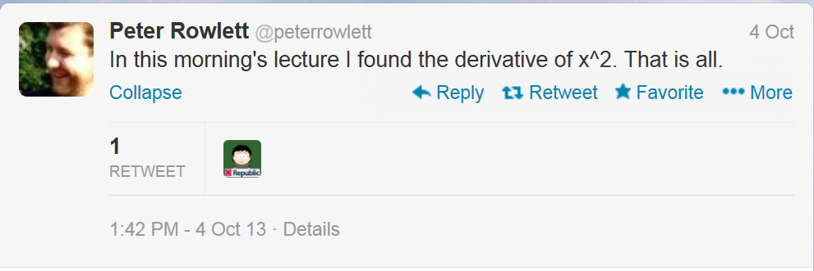
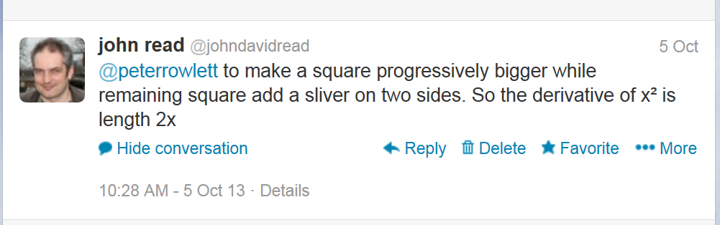

Slide 3




$x+ ∆x$
$$x$$
$x+ ∆x$
$$x$$

Slide 4

$x+ ∆x$
$$x$$
$A= x$²
$x+ ∆x$
$$x$$

Slide 5


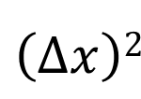
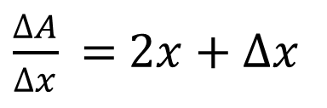
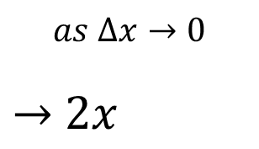


+
=
$x+ ∆x$
+
=
$∆x$
$x ∆x$
=
$\left(∆x\right)2$
=
$$x$$
$A= x$²
$x+ ∆x$
$∆A=2x ∆x$+ $\left(∆x\right)2$
$\frac{∆A}{∆x}$ = $2x$+ $∆x$
$$as ∆x→0$$
$→$ $2x$
$$x$$
$∆x$

Slide 6
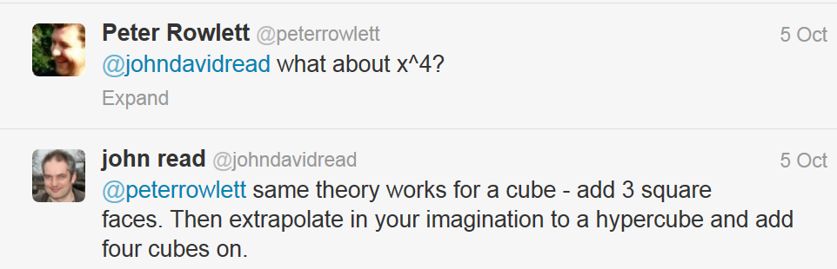

Slide 7
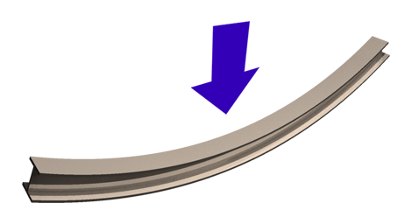
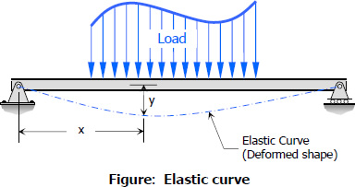
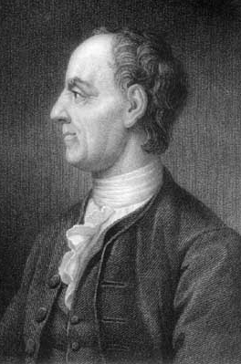
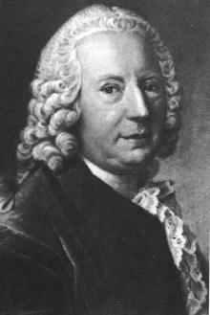
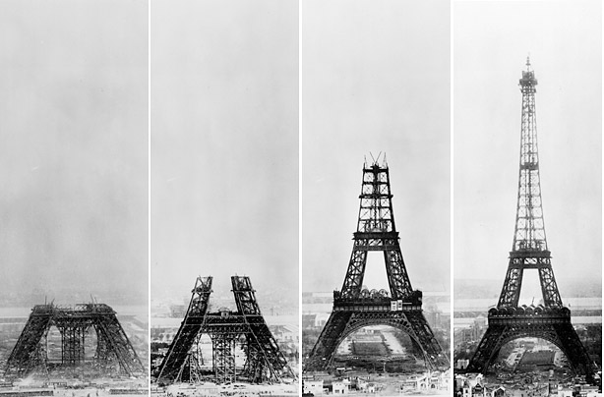
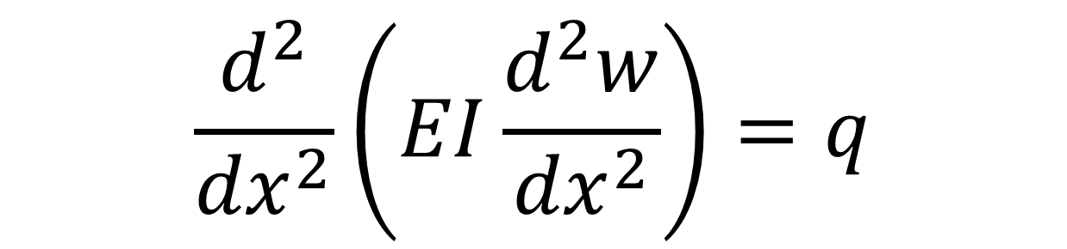
$$\frac{d^{2}}{{dx}^{2}}\left(EI\frac{d^{2}w}{{dx}^{2}}\right)=q$$
q
q
Leonard Euler 1707 - 1783
Daniel Bernoulli
1700 - 1782
x
w
Eiffel Tower under construction 1887-1889
The Euler Bernoulli Beam Theory 1750

Slide 8
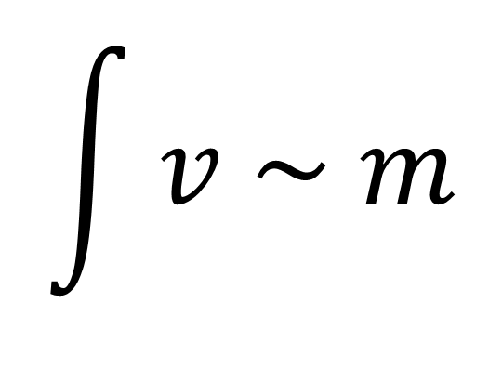
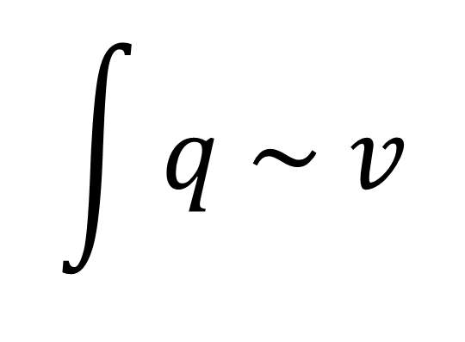
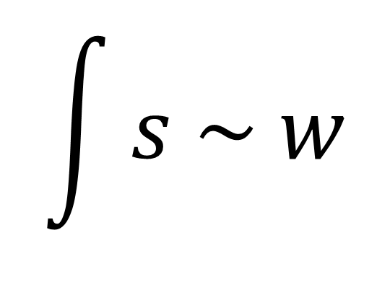
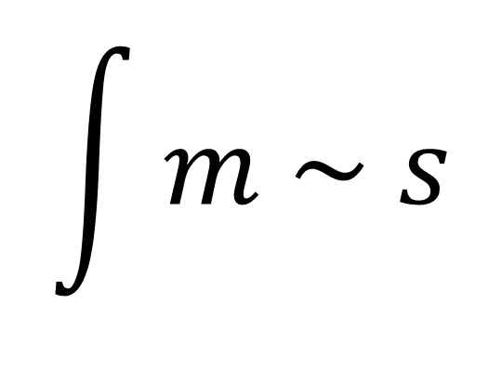
$$\int{q \sim v}$$
$$\int{v \sim m}$$
Shear force
Bending moment
$$\int{m \sim s}$$
$$\int{s \sim w}$$
slope
deflection

Slide 9
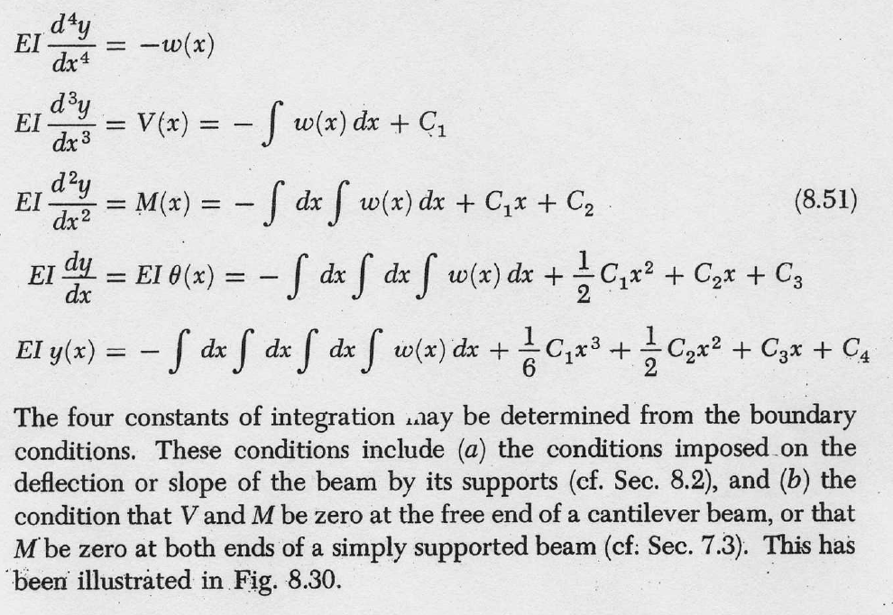
w
q
w
q
w
q
w
q
w
q

Slide 10
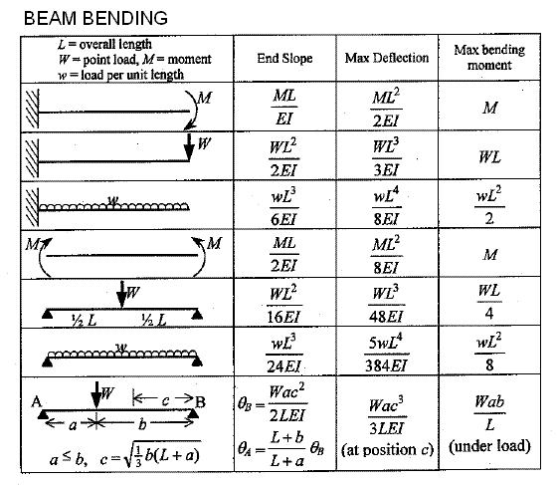

Slide 11
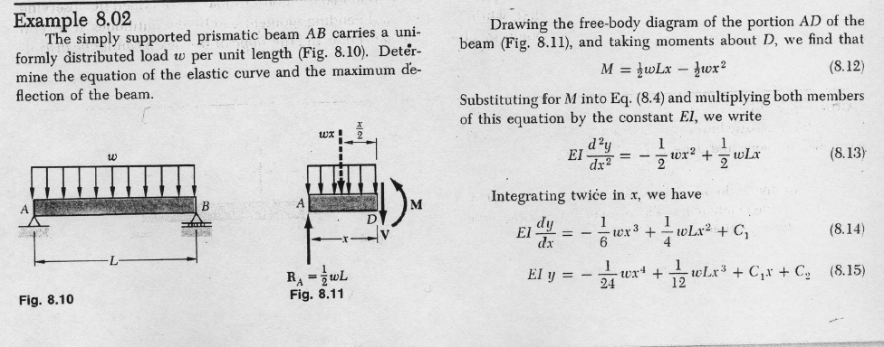
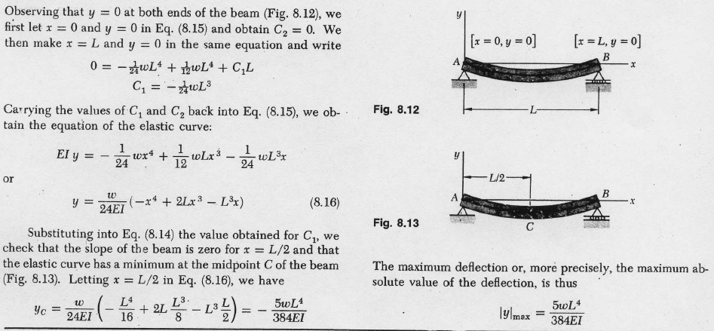

Slide 12
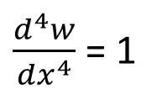
For q(x) = a constant, setting q = 1 , and setting both E = 1 and I = 1 and for a unit length beam l = 1
$\frac{d^{4}w}{dx^{4}}$ = 1

Slide 13

For q(x) = a constant, setting q = 1 , and setting both E = 1 and I = 1 and for a unit length beam l = 1
$\frac{d^{4}w}{dx^{4}}$ = 1
$$w=\frac{1}{24} x^{4}+\frac{1}{6}{c_{1}x}^{3}+\frac{1}{2}c_{2}x^{2}+c_{3}x+c_{4}$$

Slide 14
For q(x) = a constant, setting q = 1 , and setting both E = 1 and I = 1 and for a unit length beam l = 1
$\frac{d^{4}w}{dx^{4}}$ = 1
$$w=\frac{1}{24} x^{4}+\frac{1}{6}{c_{1}x}^{3}+\frac{1}{2}c_{2}x^{2}+c_{3}x+c_{4}$$
$$w=\frac{1}{4!} x^{4}+\frac{1}{3!}{c_{1}x}^{3}+\frac{1}{2!}c_{2}x^{2}+\frac{1}{1!}c_{3}x^{1}+\frac{1}{0!}c_{4}x^{0}$$

Slide 15
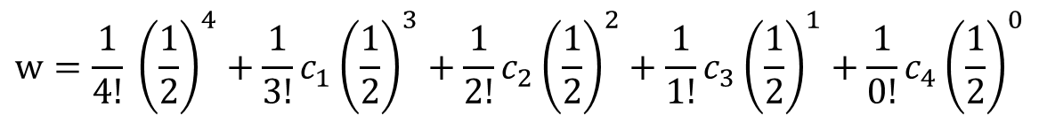
At the centre of the beam where x = ½
$$w=\frac{1}{4!} {\left(\frac{1}{2}\right)}^{4}+\frac{1}{3!}{c_{1}\left(\frac{1}{2}\right)}^{3}+\frac{1}{2!}c_{2}{\left(\frac{1}{2}\right)}^{2}+\frac{1}{1!}c_{3}{\left(\frac{1}{2}\right)}^{1}+\frac{1}{0!}c_{4}{\left(\frac{1}{2}\right)}^{0}$$

Slide 16
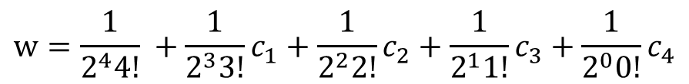
At the centre of the beam where x = ½
$$w=\frac{1}{4!} {\left(\frac{1}{2}\right)}^{4}+\frac{1}{3!}{c_{1}\left(\frac{1}{2}\right)}^{3}+\frac{1}{2!}c_{2}{\left(\frac{1}{2}\right)}^{2}+\frac{1}{1!}c_{3}{\left(\frac{1}{2}\right)}^{1}+\frac{1}{0!}c_{4}{\left(\frac{1}{2}\right)}^{0}$$
$$w=\frac{1}{2^{4}4!} +\frac{1}{2^{3}3!}c_{1}+\frac{1}{2^{2}2!}c_{2}+\frac{1}{2^{1}1!}c_{3}+\frac{1}{2^{0}0!}c_{4}$$

Slide 17
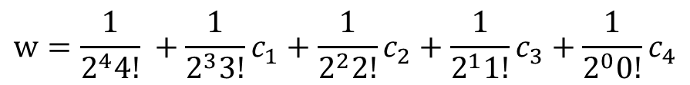
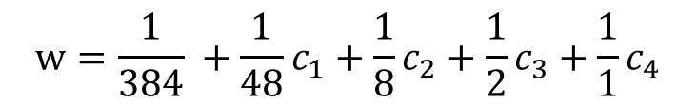
At the centre of the beam where x = ½
$$w=\frac{1}{4!} {\left(\frac{1}{2}\right)}^{4}+\frac{1}{3!}{c_{1}\left(\frac{1}{2}\right)}^{3}+\frac{1}{2!}c_{2}{\left(\frac{1}{2}\right)}^{2}+\frac{1}{1!}c_{3}{\left(\frac{1}{2}\right)}^{1}+\frac{1}{0!}c_{4}{\left(\frac{1}{2}\right)}^{0}$$
$$w=\frac{1}{2^{4}4!} +\frac{1}{2^{3}3!}c_{1}+\frac{1}{2^{2}2!}c_{2}+\frac{1}{2^{1}1!}c_{3}+\frac{1}{2^{0}0!}c_{4}$$
$$w=\frac{1}{384} +\frac{1}{48}c_{1}+\frac{1}{8}c_{2}+\frac{1}{2}c_{3}+\frac{1}{1}c_{4}$$

Slide 18
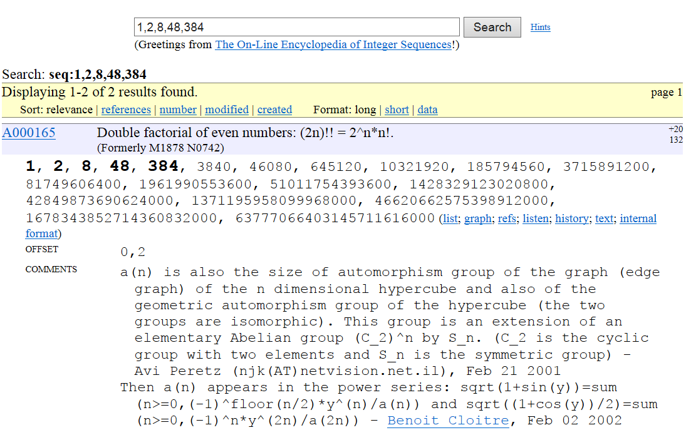
The coefficients are the reciprocals of the double factorials !! of n, for n = 0 to 4

Slide 19
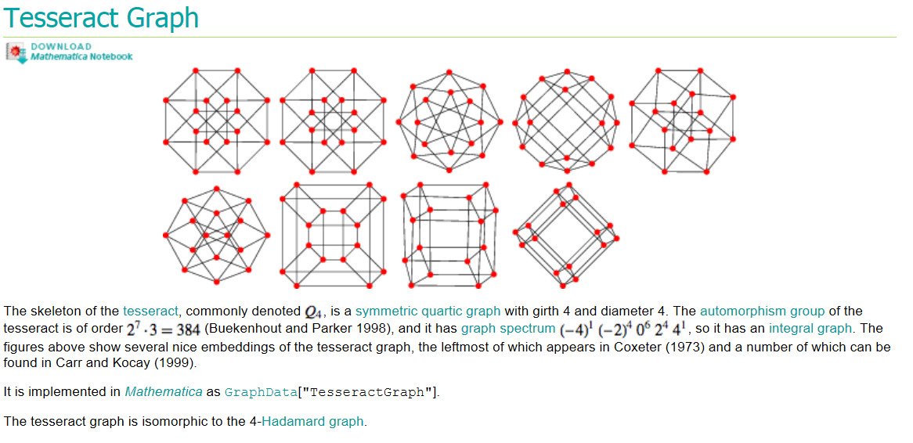

Slide 21

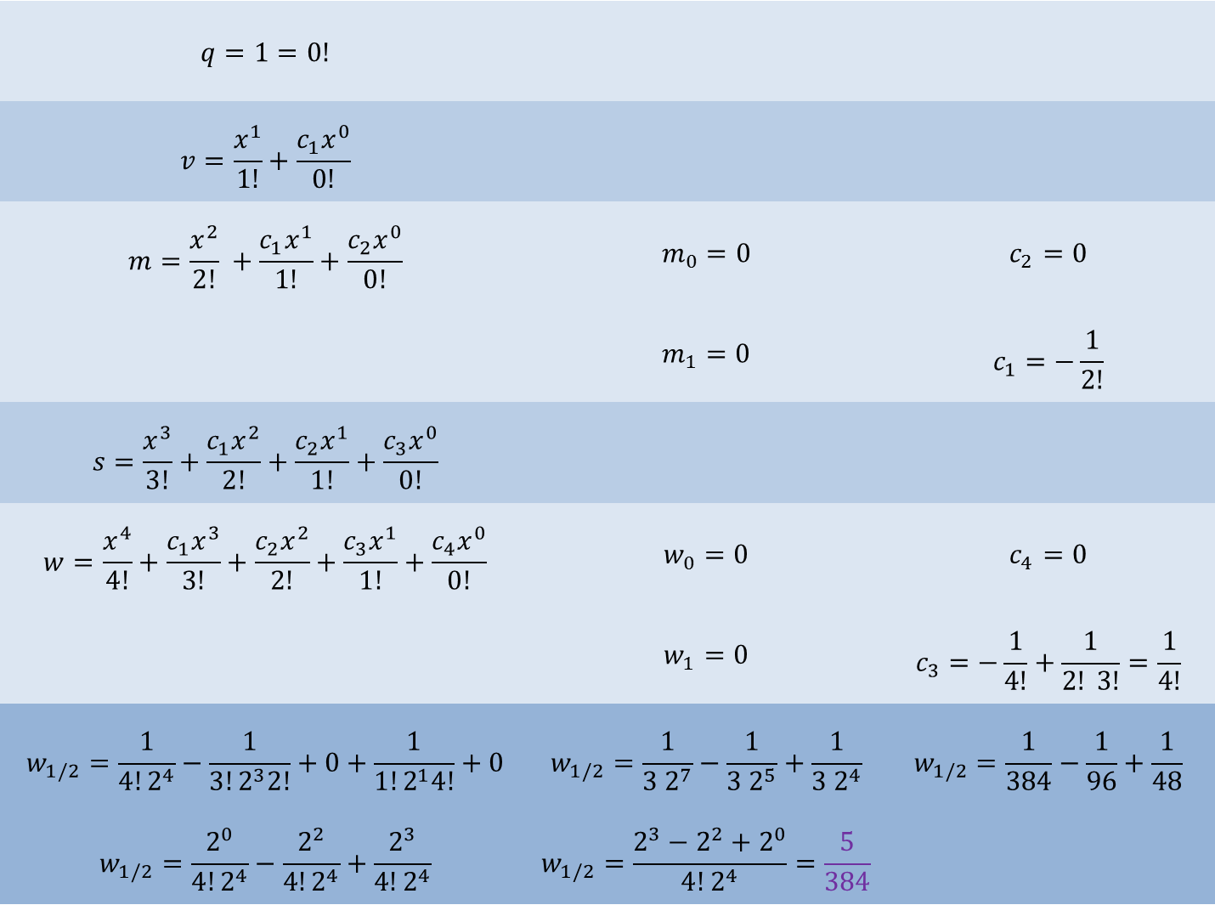
$$q=1=0!$$
$$v=\frac{x^{1}}{1!}+\frac{c_{1}x^{0}}{0!}$$
$$m=\frac{x^{2}}{2!} +\frac{c_{1}x^{1}}{1!}+\frac{c_{2}x^{0}}{0!}$$ | $$m_{0}=0$$ | $$c_{2}=0$$
 | $$m_{1}=0$$ | $$c_{1}=−\frac{1}{2!}$$
$$s=\frac{x^{3}}{3!}+\frac{c_{1}x^{2}}{2!}+\frac{c_{2}x^{1}}{1!}+\frac{c_{3}x^{0}}{0!}$$
$$w=\frac{x^{4}}{4!}+\frac{c_{1}x^{3}}{3!}+\frac{c_{2}x^{2}}{2!}+\frac{c_{3}x^{1}}{1!}+\frac{c_{4}x^{0}}{0!}$$ | $$w_{0}=0$$ | $$c_{4}=0$$
 | $$w_{1}=0$$ | $$c_{3}=−\frac{1}{4!}+\frac{1}{2! 3!}=\frac{1}{4!}$$
$$w_{1/2}=\frac{1}{4!2^{4}}−\frac{1}{3!2^{3}2!}+0+\frac{1}{1!2^{1}4!}+0$$ | $$w_{1/2}=\frac{1}{3 2^{7}}−\frac{1}{3 2^{5}}+\frac{1}{3 2^{4}}$$ | $$w_{1/2}=\frac{1}{384}−\frac{1}{96}+\frac{1}{48}$$
$$w_{1/2}=\frac{2^{0}}{4!2^{4}}−\frac{2^{2}}{4!2^{4}}+\frac{2^{3}}{4!2^{4}}$$ | $$w_{1/2}=\frac{2^{3}−2^{2}+2^{0}}{4!2^{4}}=\frac{5}{384}$$

