Slide 1
Fun with 2D Glasses and a Sprinkling of Special Relativity
Michael Gibson

Slide 2
How to make “2D glasses”
Take two pairs of 3D glasses.
Cut them each in half.
Join together halves of the same colour.
The result is a pair of binocular colour filters, 1 for red, one for cyan.
I call these “2D glasses” because if you view a 3D picture though them it will look flat.
The same technique can be used with polarised glasses if you don’t like watching films in 3D! (Cardboard frames required).

Slide 3
What you can do with them
Many situations can be understood better by viewing them from more than one point of view.
2D glasses allow you to overlay two different scales/coordinate systems, but see just one or the other at any one time.
Any information displayed will be visible from both points of view, allowing easy translation between the two, and assurance of logical consistency.

Slide 4
Example I: Exponential Variation

Slide 5


Test whether data fits the exponential form $y=ab^{x}$ and establish the values of both $a$ and $b$.

Slide 6

x | y
0 | 25
1 | 67
2 | 180
3 | 490
4 | 1300
5 | 3500
6 | 9500
7 | 26000
8 | 69000
9 | 190000
10 | 500000
×
×
×
×
×
×
×
×
×
×
×

Slide 7


$$gradient≈\frac{4.3}{10}=0.43$$
$≈25×{2.7}^{x}$
×
×
×
×
×
×
×
×
×
×
×

Slide 8
$$gradient≈\frac{4.3}{10}=0.43$$
$≈25×{2.7}^{x}$
×
×
×
×
×
×
×
×
×
×
×

Slide 9
Example II: Power Laws

Slide 10

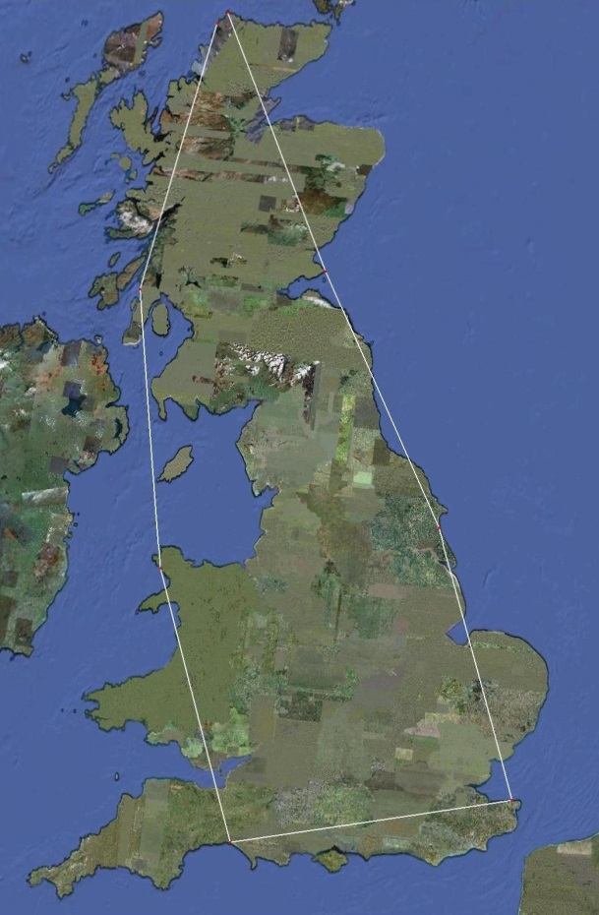
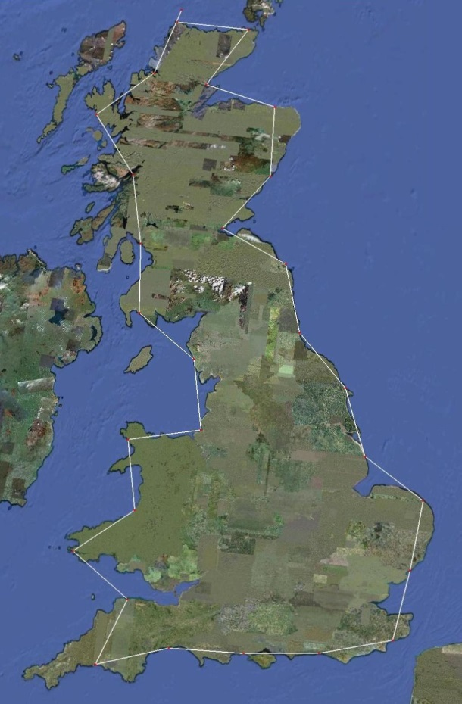
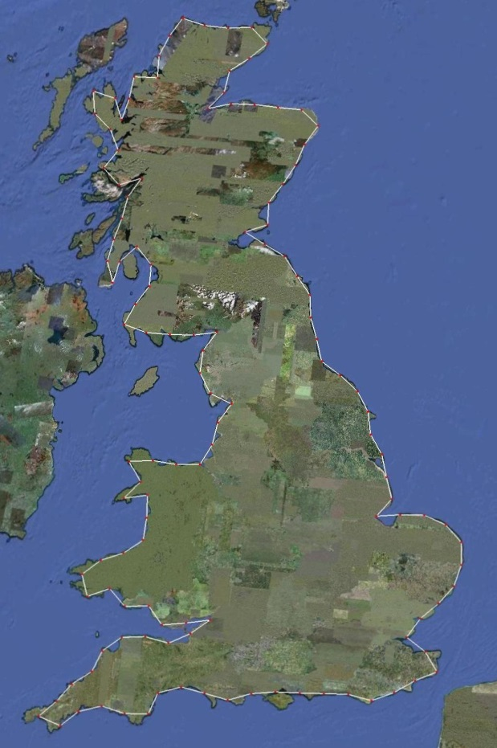

Test whether data fits the $form y={ax}^{b}$.
length ≈ 7 x 300 km
≈ 2100 km
length ≈ 28 x 100 km
≈ 2800 km
length ≈ 136 x 30 km
≈ 3780 km

Slide 11

×
×
×

Slide 12
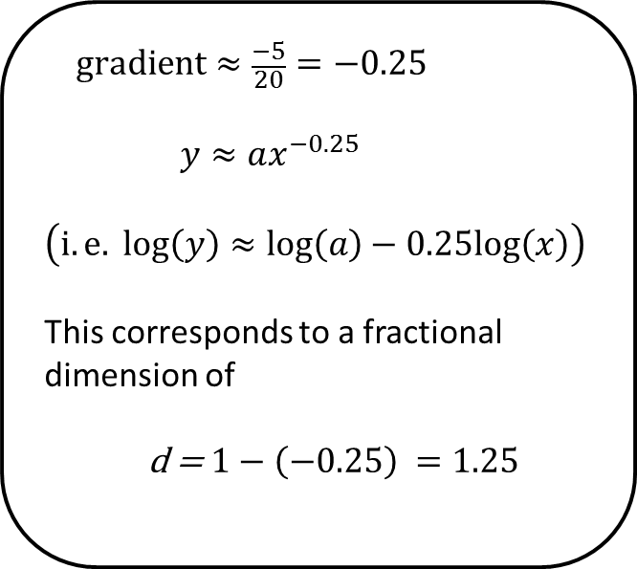
$$gradient≈\frac{−5}{20}=−0.25$$
$\left(i.e. log\left(y\right)≈log\left(a\right)−0.25log\left(x\right)\right)$
This corresponds to a fractional dimension of
d = $1−\left(−0.25\right) =1.25$
×
×
×

Slide 13
$$gradient≈\frac{−5}{20}=−0.25$$
$\left(i.e. log\left(y\right)≈log\left(a\right)−0.25log\left(x\right)\right)$
This corresponds to a fractional dimension of
d = $1−\left(−0.25\right) =1.25$
×
×
×

Slide 14
Example III: Galilean Relativity

Slide 15
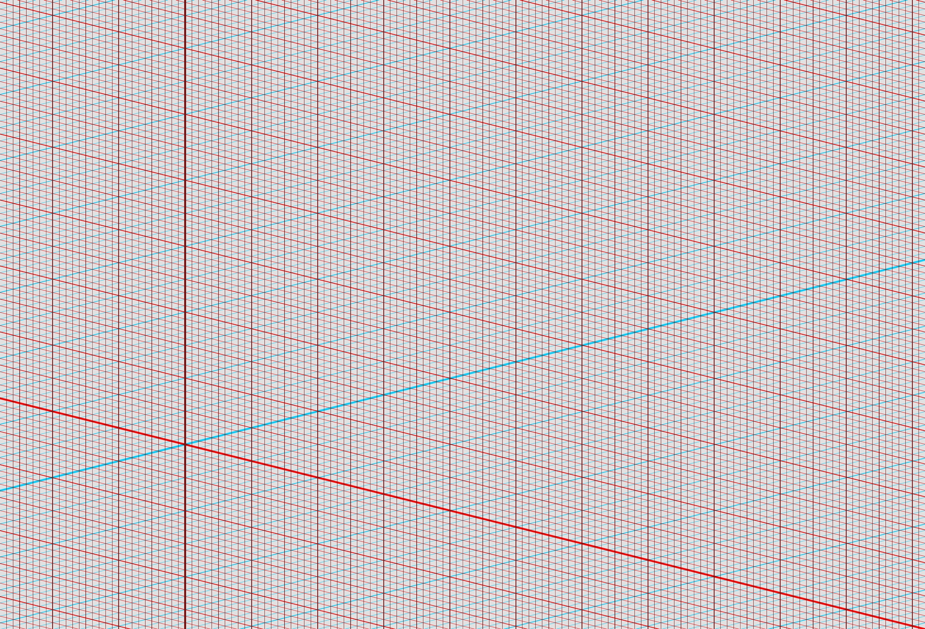
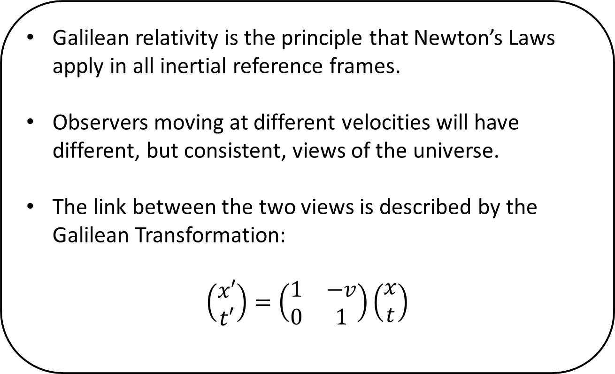
Galilean relativity is the principle that Newton’s Laws apply in all inertial reference frames.
Observers moving at different velocities will have different, but consistent, views of the universe.
The link between the two views is described by the Galilean Transformation:
$$\left(\begin{matrix}x′ \\ t′\end{matrix}\right)=\left(\begin{matrix}1 & −v \\ 0 & 1\end{matrix}\right)\left(\begin{matrix}x \\ t\end{matrix}\right)$$

Slide 16

Ball
Wall

Slide 17

Ball
Bat

Slide 19
Example IV: Special Relativity

Slide 20
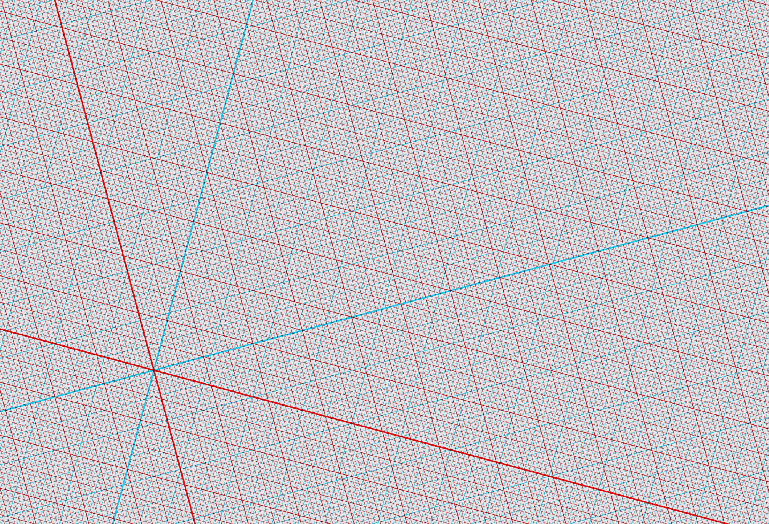
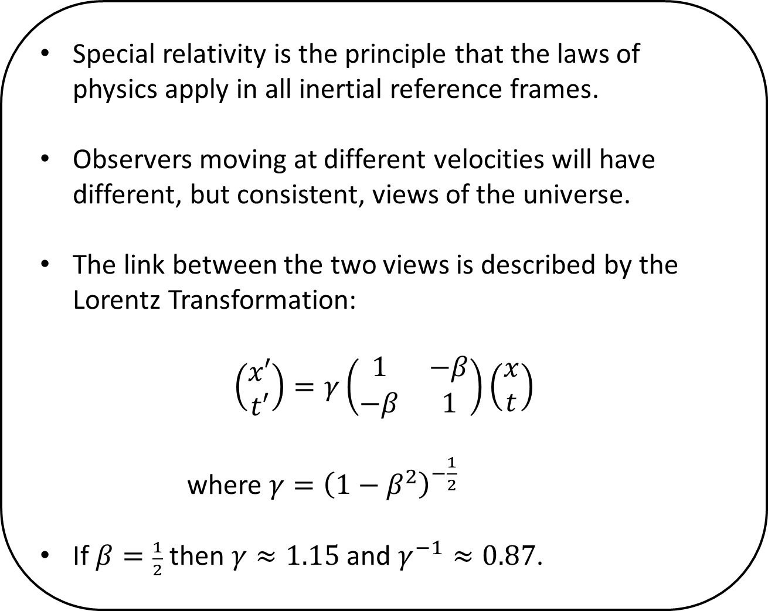
Special relativity is the principle that the laws of physics apply in all inertial reference frames.
Observers moving at different velocities will have different, but consistent, views of the universe.
The link between the two views is described by the Lorentz Transformation:
$$\left(\begin{matrix}x′ \\ t′\end{matrix}\right)=γ\left(\begin{matrix}1 & −β \\ −β & 1\end{matrix}\right)\left(\begin{matrix}x \\ t\end{matrix}\right)$$
where $γ={\left(1−β^{2}\right)}^{−\frac{1}{2}}$
If $β=\frac{1}{2}$ then $γ≈1.15$ and $γ^{−1}≈0.87$.

Slide 21

1 tick = 1 second
Stationary clock

Slide 22

1 tick = 1.15 second s
Moving clock
Stationary clock
1 tick = 1 second

Slide 23
length = 1 light second
Stationary rod
Moving clock
1 tick = 1.15 seconds

Slide 24
length = 0.87 light second s
Moving rod
Stationary rod
length = 1 light second

Slide 25
Moving rod
length = 0.87 light second s

