Slide 1

Optimal Finger Counting
By Michael Gibson
mikegibson2010@gmail.com

Slide 2
What is “out there” already?
The obvious way! (Limited range).
Counting finger bones (base 12).
Place value systems (requires dexterity!)
(I am aware that this is not an exhaustive list!)

Slide 3
What is required?
Decent range (e.g. in the hundreds).
Easily “compatible” with base 10.
Physically easy.
Beneficial to children’s mathematical development.

Slide 4
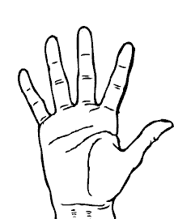
Right Hand: Fives and Units
14
9
19
13
8
18
4
12
7
17
3
11
2
6
16
1
10
5
15
0

Slide 5
What number is this?
?
17

Slide 6
Make Number 9
9

Slide 7
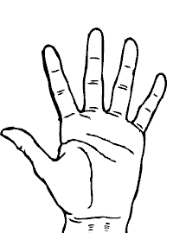
Left Hand: Twenties and Hundreds
280
180
380
260
360
160
80
240
140
340
60
220
120
320
40
200
20
300
100
0

Slide 8
What Number is this?
?
360

Slide 9
Make 220
220

Slide 10
What Number is this?
45

Slide 11
What Number is this?
296

Slide 12
Make 87

Slide 13
Make 399

Slide 14
Addition and Subtraction
+40
+2
+20
+1
+100
+5
+200
+10
-20
-100
-5
-1
-40
-2

Slide 15
Example: 132 + 244
Partition +244 as +200 + 40 + 5 - 1
376

Slide 16
Meets Requirements?
Decent range (e.g. in the hundreds)? YES.
Easily “compatible” with base 10? YES.
Physically easy? It is for me!
Beneficial to children’s mathematical development?
My son is 2½. This experiment will commence very soon!

Slide 17
Thank you for listening!

Slide 18
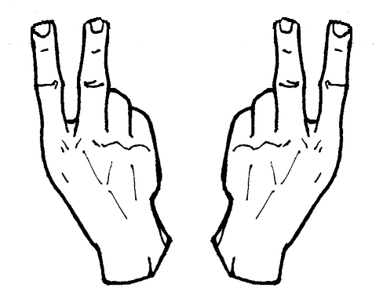
Dear Rick Astley…

