Slide 1
Maths and the London Underground
Yuen Ng

Slide 2
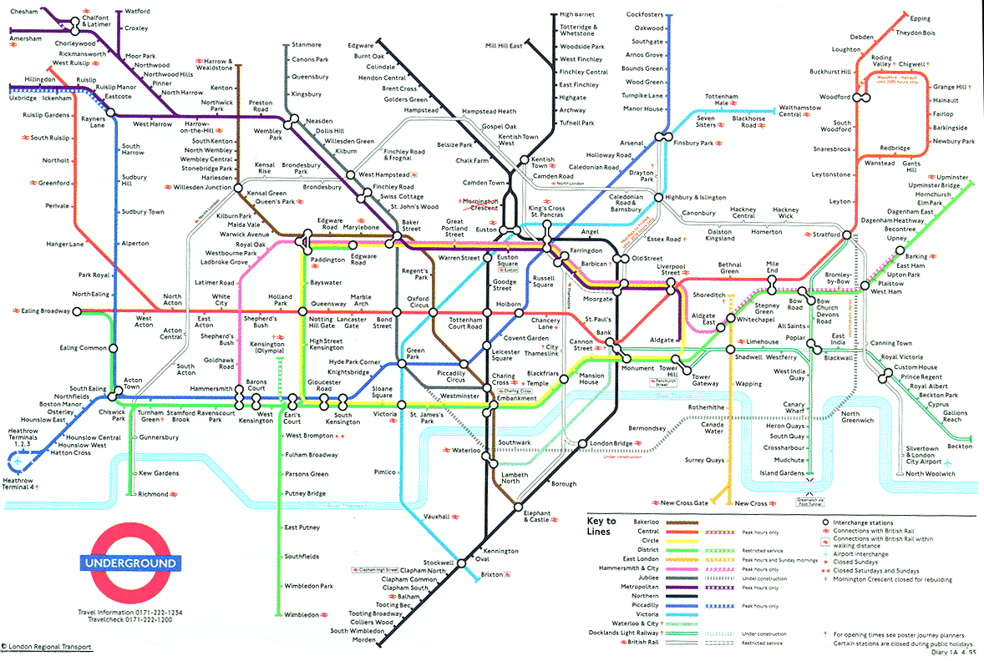
My favourite map…

Slide 3
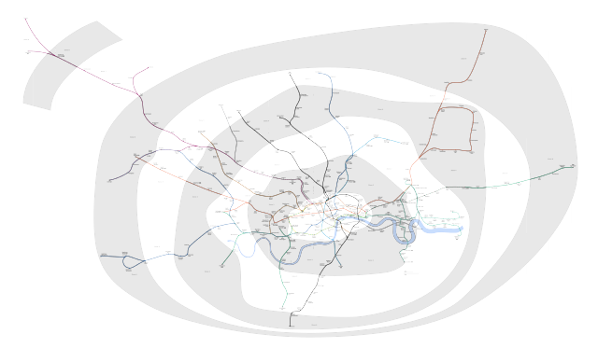
The reality

Slide 4
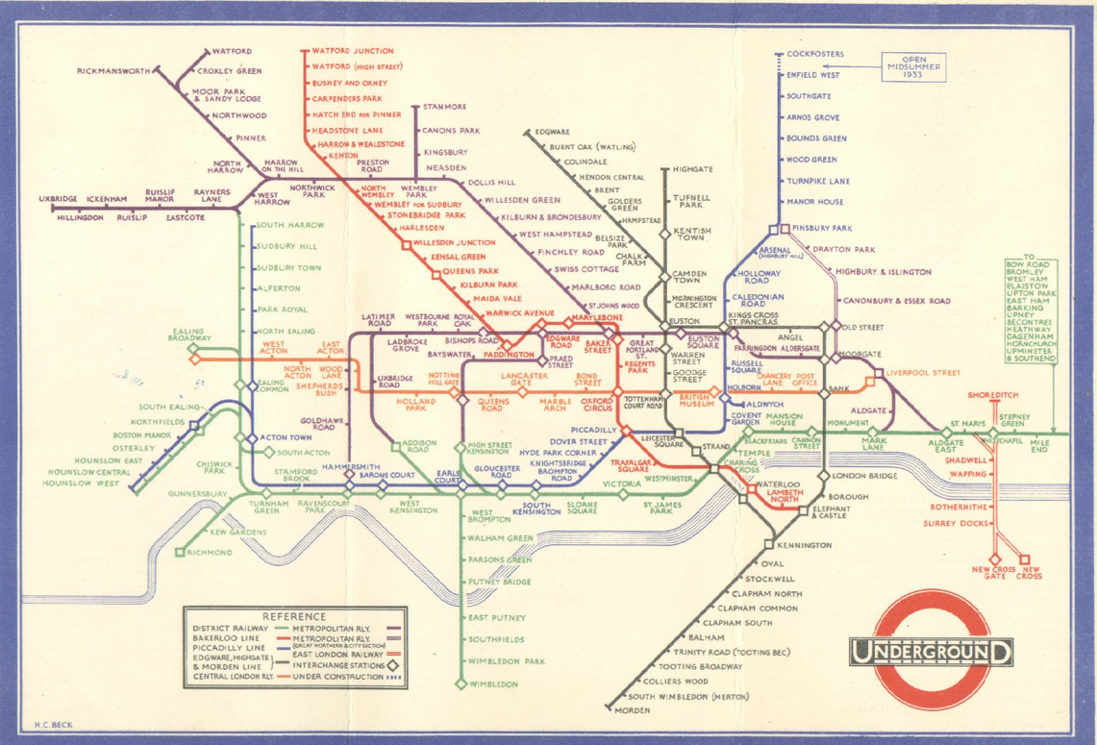
Henry Beck’s solution

Slide 5
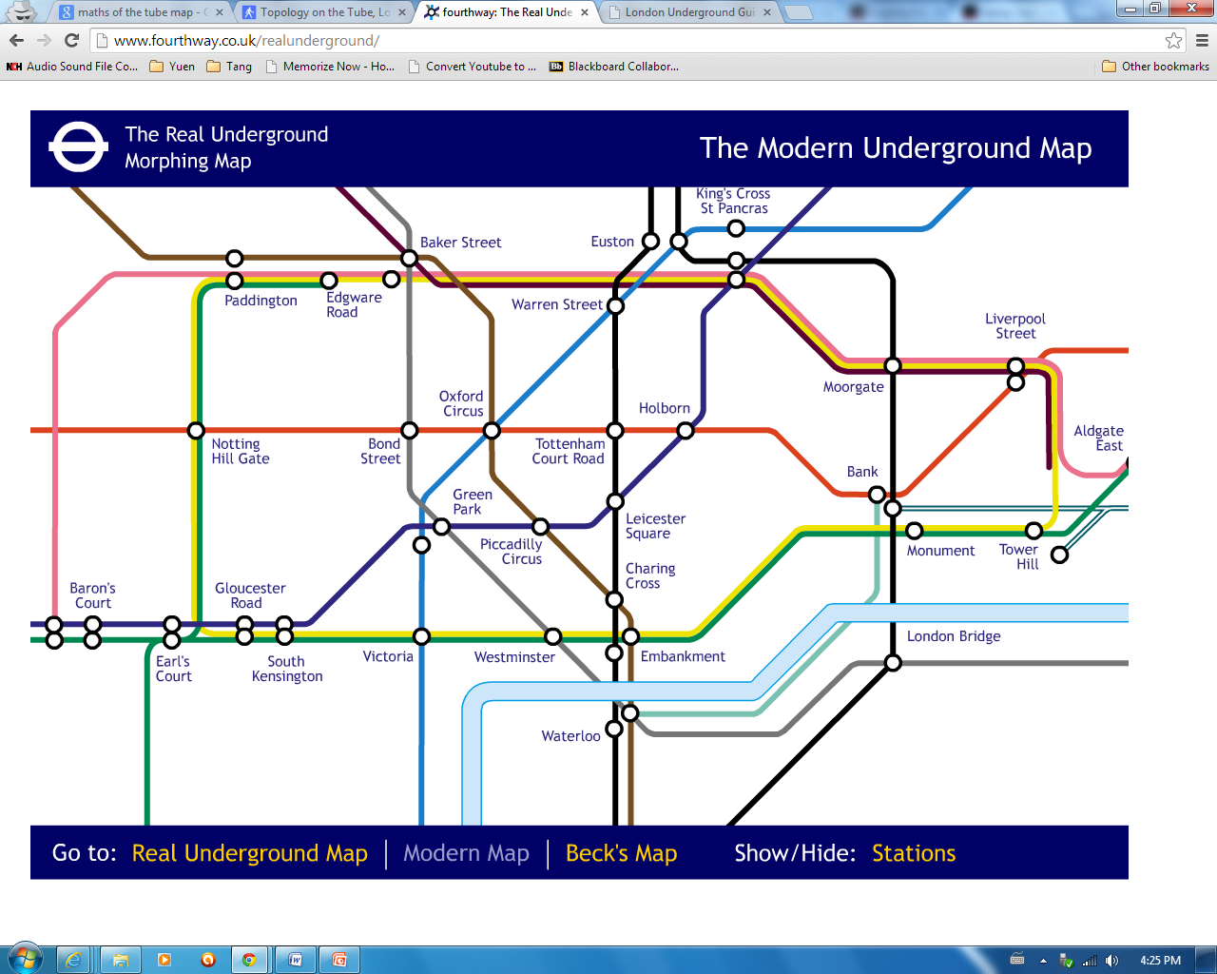
Fourthway’s Morph of the Tube

Slide 6
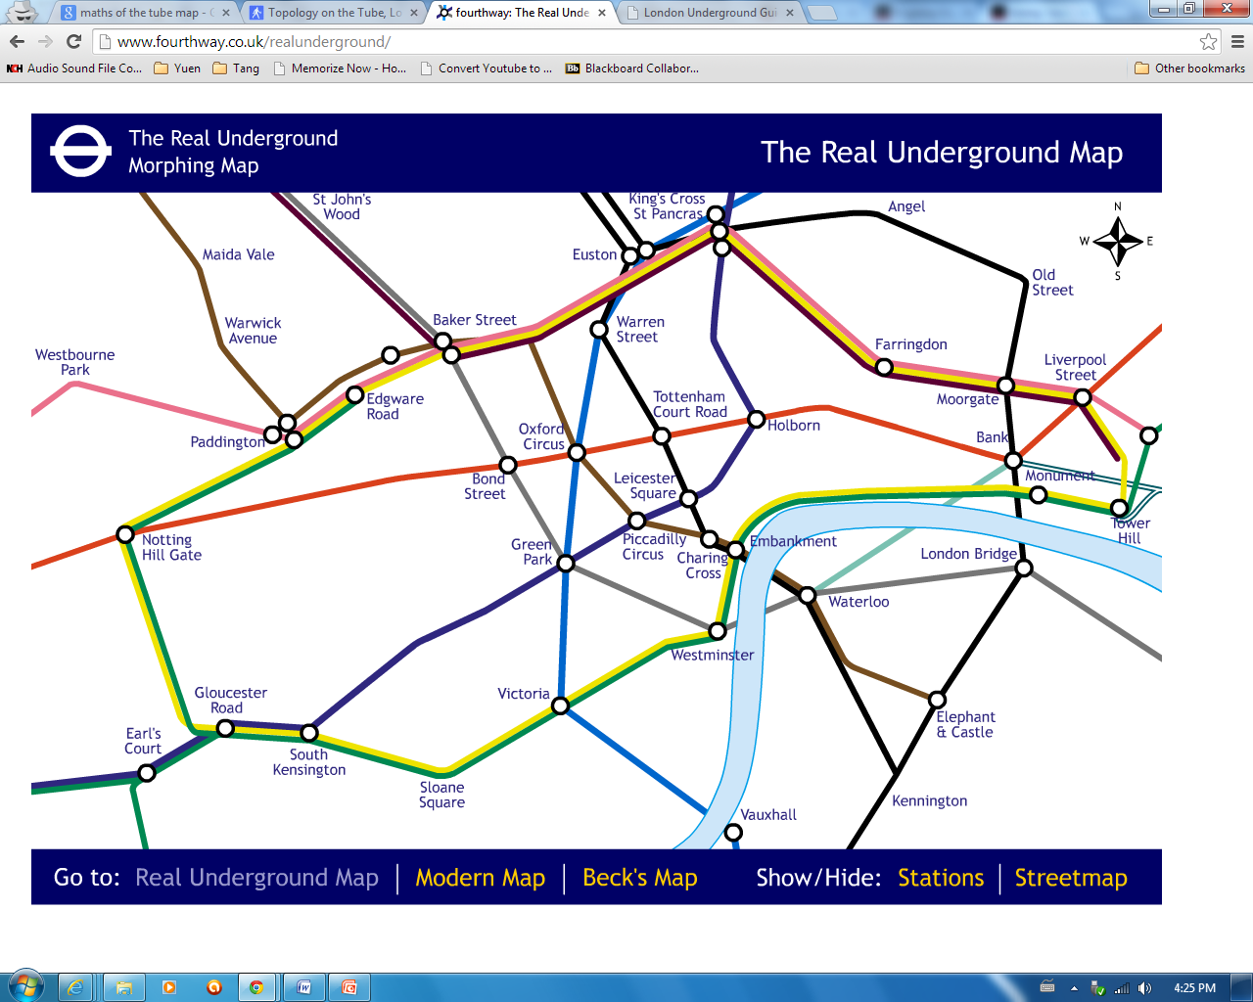
Fourthway’s Morph of the Tube

Slide 7
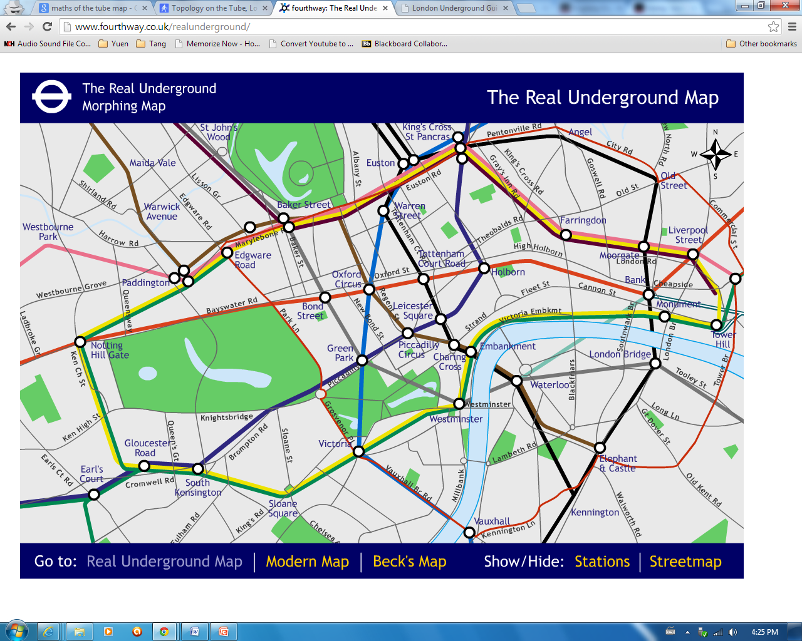
Fourthway’s Morph of the Tube

Slide 8
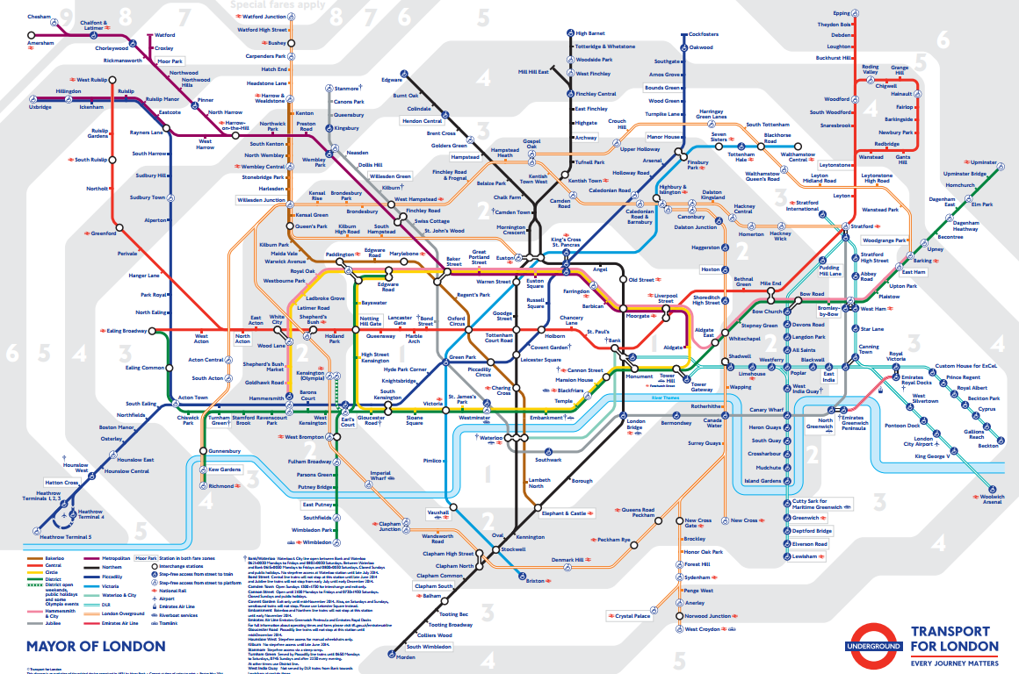
Today’s version

Slide 9
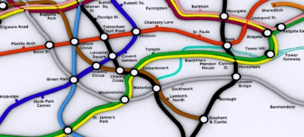
Simple, Useable, Connections, Graphs
Notes:
http://www.barcodesinc.com/articles/math-logic-problems.htm

Slide 10
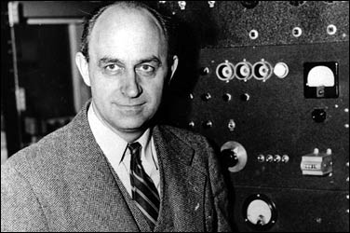
Enrico Fermi, 1901-1954
Notes:
http://www.particleadventure.org/index.html

Slide 11
Good estimation
Accurate Answer
Little Data

Slide 12
How many passengers used the Tube in the year 2013?
Notes:
facts of the tube, http://www.londoncouncils.gov.uk/londonfacts/default.htm?category=12, http://www.ons.gov.uk/ons/dcp171776_227904.pdf

Slide 13
How many passengers used the Tube in the year 2013?
London: population 8.3 million
17 million visitors to London last year
Notes:
http://www.tubemapcentral.com/myths.html

Slide 14
How many passengers used the Tube in the year 2013?
Someone using the Underground is a passenger for each journey they make
Workers living in and out of London using the Tube for their commute
Londoners travelling around London
Notes:
fermi problem, http://www.physics.uwo.ca/science_olympics/events/puzzles/fermi_questions.html, http://www.vendian.org/envelope/dir0/fermi_questions.html

Slide 15
Thank you for listening!
(And one more thing…)
Notes:
https://www.illustrativemathematics.org/standards/hs, http://www.physics.umd.edu/perg/fermi/fermi.htm

