Slide 1
A Pointless Talk
Phil Ramsden

Slide 2
A Pointless Talk

Slide 3

A Pointless Talk

Slide 4
If you don’t know the show…
Four pairs of contestants, four rounds.
One pair eliminated in each of the first three rounds.
In the fourth round, the remaining pair compete for the Jackpot.

Slide 5
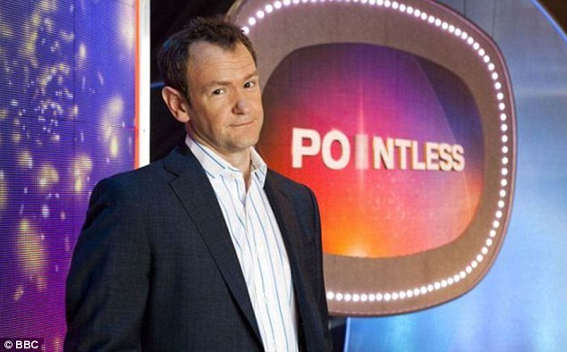
“Everyone gets two chances to get to the Pointless final”

Slide 6
“Everyone gets two chances to get to the Pointless final”
If you weren’t on the last show…
… and you don’t get to the final on this show…
… you’re invited back next show to have another go.

Slide 7
“Everyone gets two chances to get to the Pointless final”
If you were on the last show…
… or you do get to the final on this show…
… you’re not invited back.

Slide 8
First show
Lily and Tia (first time pair)
Elliot and Lucas (first time pair)
Georgia and Louis (first time pair)
Gabriel and Sam (first time pair)
Number of returning pairs: 0

Slide 9
First show
Lily and Tia (first time pair)
Elliot and Lucas (first time pair)
Georgia and Louis (first time pair)
Gabriel and Sam (first time pair)

Slide 10
Second show
Elliot and Lucas (returning pair)
Max and Holly (first time pair)
Lily and Tia (returning pair)
Gabriel and Sam (returning pair)
Number of returning pairs: 3

Slide 11
Second show
Elliot and Lucas (returning pair)
Max and Holly (first time pair)
Lily and Tia (returning pair)
Gabriel and Sam (returning pair)

Slide 12
Third show
Max and Holly (returning pair)
Logan and Henry (first time pair)
George and Hannah (first time pair)
Shannon and Abigail (first time pair)
Number of returning pairs: 1

Slide 13
Third show
Max and Holly (returning pair)
Logan and Henry (first time pair)
George and Hannah (first time pair)
Shannon and Abigail (first time pair)

Slide 14
Fourth show
Shannon and Abigail (returning pair)
George and Hannah (returning pair)
Harry and Tom (first time pair)
Isabel and Adam (first time pair)
Number of returning pairs: 2

Slide 15
Number of returning pairs each show
0, 3, 1, 2, …

Slide 16
Number of returning pairs each show

Slide 17
Number of returning pairs each show

Slide 18
Number of returning pairs each show

Slide 19
Number of returning pairs each show

Slide 20
Number of returning pairs each show

Slide 21
Number of returning pairs each show

Slide 22
Number of returning pairs each show

Slide 23
Number of returning pairs each show

Slide 24
Number of returning pairs each show

Slide 25
Number of returning pairs each show

Slide 26
Number of returning pairs each show

Slide 27
Number of returning pairs each show

Slide 28
Number of returning pairs each show

Slide 29
Number of returning pairs each show

Slide 30
Number of returning pairs each show

Slide 31
Number of returning pairs each show

Slide 32
Number of returning pairs each show

Slide 33
Number of returning pairs each show

Slide 34
Number of returning pairs each show

Slide 35
Number of returning pairs each show

Slide 36
Number of returning pairs each show

Slide 37
Number of returning pairs each show

Slide 38
Number of returning pairs each show

Slide 39
Number of returning pairs each show

Slide 40
Number of returning pairs each show

Slide 41
Number of returning pairs each show

Slide 42
Number of returning pairs each show

Slide 43
Number of returning pairs each show
Let’s assume who gets to the final is entirely random…

Slide 44
Number of returning pairs each show

Slide 45
Number of returning pairs each show

Slide 46
Number of returning pairs each show

Slide 47
Number of returning pairs each show

Slide 48
Number of returning pairs each show

Slide 49
Number of returning pairs each show

Slide 50
Number of returning pairs each show
A Markov chain!

Slide 51
Probabilities

Slide 52
Probabilities

Slide 53
Probabilities

Slide 54
Probabilities

Slide 55
Probabilities

Slide 56
Probabilities

Slide 57
Probabilities

Slide 58
Long-term Probabilities

Slide 59
But…
Are our assumptions correct?
Is the pair that gets to the final random?
If not, what difference would it make?

Slide 60
Pure trial of strength
Each pair has a certain strength.
  Randomly assigned
  Never mind what distribution (uniform will do)
The strongest pair always gets to the final.
(Assign each pair a random real number, and make the highest-ranked pair get to the final every time.)
Then brute-force simulate it.

Slide 61
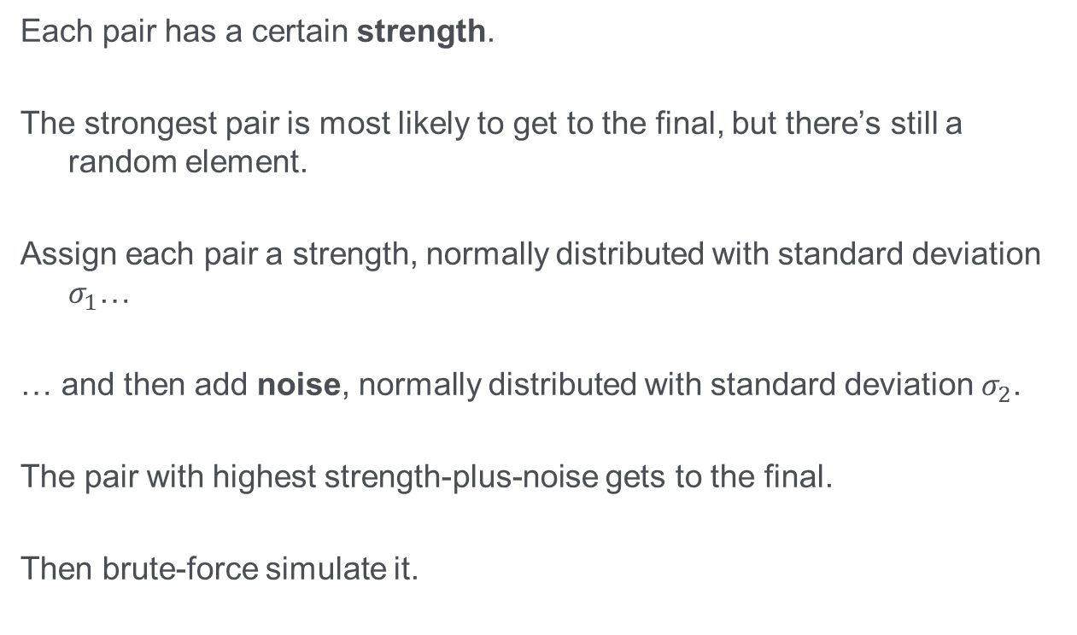
‘Strength plus noise
Each pair has a certain strength.
The strongest pair is most likely to get to the final, but there’s still a random element.
Assign each pair a strength, normally distributed with standard deviation $σ_{1}$…
… and then add noise, normally distributed with standard deviation $σ_{2}$.
The pair with highest strength-plus-noise gets to the final.
Then brute-force simulate it.

Slide 62

Strength plus noise
$$\frac{σ_{1}}{σ_{2}}≪1$$
Noise outweighs strength.
Approximated by the Markov chain.

Slide 63

Strength plus noise
$$\frac{σ_{1}}{σ_{2}}≫1$$
Strength outweighs noise.
Approximated by the “best pair” model.

Slide 64

One million shows
Markov chain
  (didn’t bother simulating, just used calculated probabilities)
Strength plus noise
$$\frac{σ_{1}}{σ_{2}}=1.$$
Pure trial of strength

Slide 65
One million shows
What do we expect, as regards the long term probabilities of the four states?
In what ways will the “pure luck” and “pure strength” ones differ?
How much will they differ?

Slide 66
One million shows

