Slide 1
If I am Telling the Truth, then I am King
Tony Mann
University of Greenwich
A.Mann@gre.ac.uk
@Tony_Mann

Slide 2
If I am Telling the Truth, then I am King
(This is Curry’s Paradox)

Slide 3
One envelope contains a prize

Slide 4
At least one of the statements on these envelopes is false
This envelope contains the prize

Slide 5
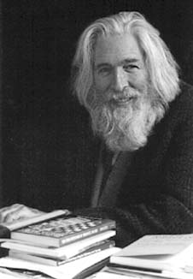
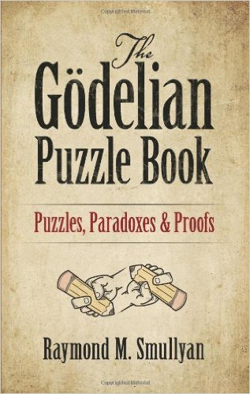
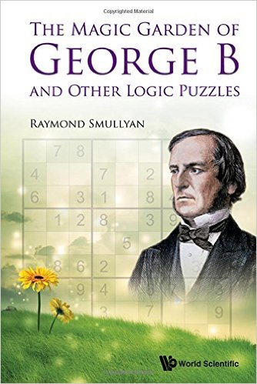
Thank you!
And thanks to Raymond Smullyan

