Slide 1
On the Chalkdust Crossnumber, straight lines, and projective geometry
Colin Beveridge
MathsJam, 13th November 2016

Slide 2
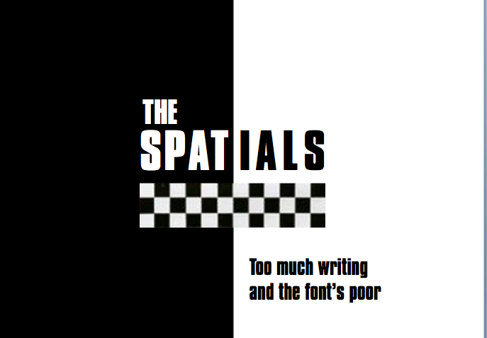

SPAT
t
THE
IALS
Too much writing and the font’s poor

Slide 3
You’ve done too much, too much C1
Consider a line of the form:
… and notice:
(a, b, c) looks a lot like a vector.

Slide 4
Abstract Jungle
Natural question:
  Given line
  and line
  Is there a simple link between vectors (a, b, c), (A, B, C) and the point where the lines cross?

Slide 5
A message to you, 2D
Proof by MathsJam.
IT’S ONLY THE CROSS PRODUCT!
  (scaled so the z-coordinate is 1)

Slide 6
It’s working for the rat race
Zeke scampers at 10m/s
Monty scampers at 8m/s
Zeke gives Monty a 10 metre head start
Where does Zeke catch up with Monty?
Scaled: (50, 5, 1)
Zeke catches up 50 metres away after 5 seconds.

Slide 7
You’re wondering now
What to do
Now you know this is the end
How about the line through two points?
How about lines through the origin?
Why does it work?
Notes:
3D vectors correspond to 2D lines
Lines cross at the cross-product of the lines’ vectors

Slide 8
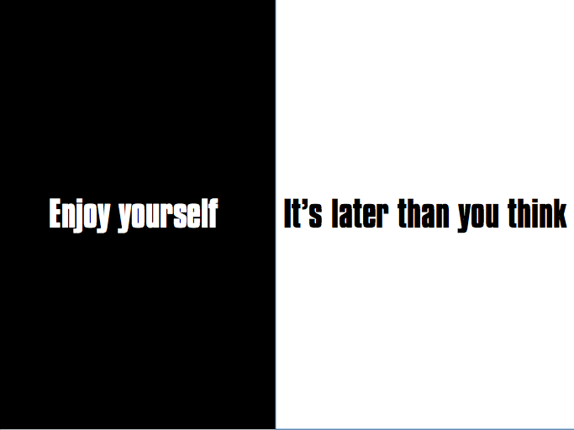
It’s later than you think
Enjoy yourself

