Slide 1
Body
Index
Representation
On/off
Midleages
Signlanguage

Slide 2


Slide 3
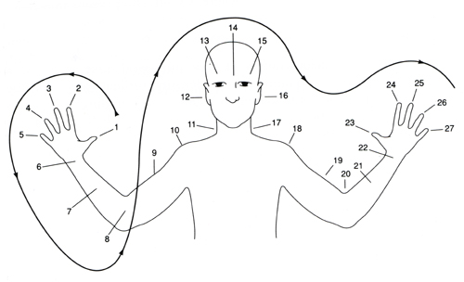

Slide 4
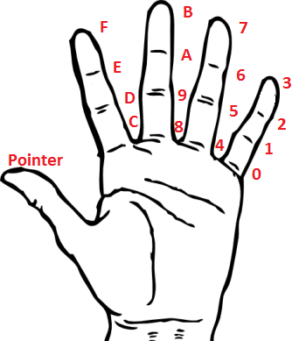

Slide 5
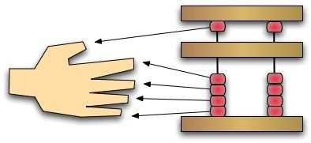
지산법
Chi = finger
sanpŏp = calculation
猜拳

Slide 6
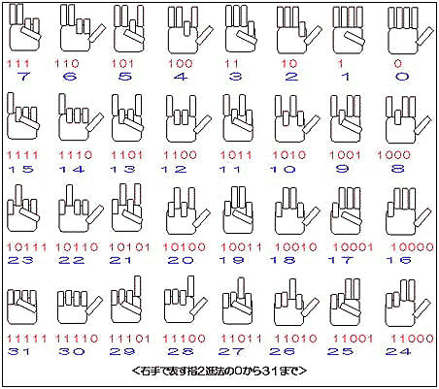

Slide 7
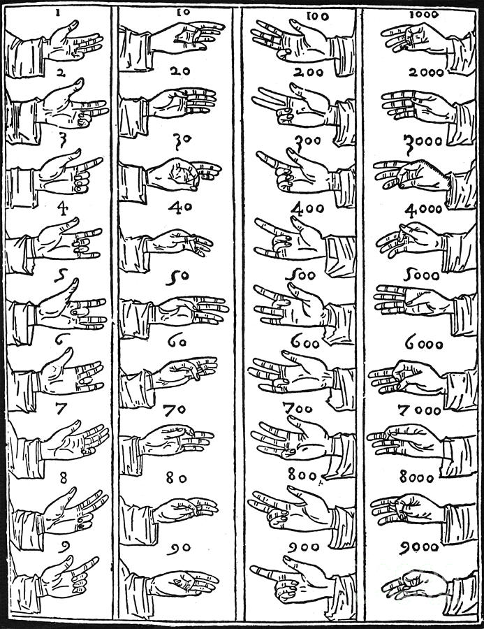

Slide 8
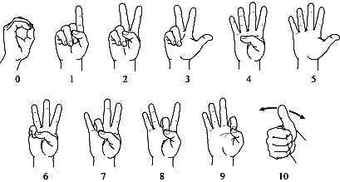

Slide 9
Ranking
3State: Positional + Motion (19683 or 177147)
Bede: Positional + Index + Figurative (9999)
Binary-State: Positional (1023 or 4095)
Base16: Index (255)
Chinsenbob: Pictorial/Representative (99)
Oksapmin: Part Respective (27)
Base10: Part Respective/Representative (10)

Slide 10
The Internet
Numbers from 1 to 10 in 5000 languages: http://www.zompist.com/numbers.shtml
Numbersystems around the world: http://www.sf.airnet.ne.jp/ts/language/number.html

Slide 11
Dactylonomy
Δάκτυλος (dáktulos, “finger”)
+ νόμος ‎(nómos, “law, custom”)

