Slide 1
83038

Slide 2
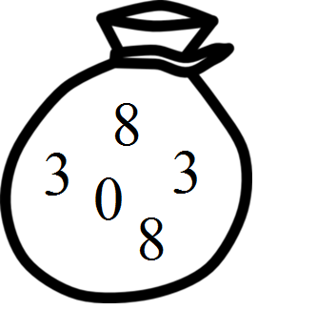

Slide 3
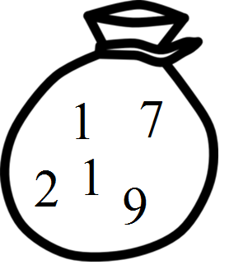
✘
✔

Slide 4
30388
30838
30883
33088
33808
33880
38038
38083
38308
38380
38803
38830
80338
80383
80833
83038
83083
83308
83380
83803
83830
88033
88303
88330
03388
03838
03883
08338
08383
08833

Slide 5

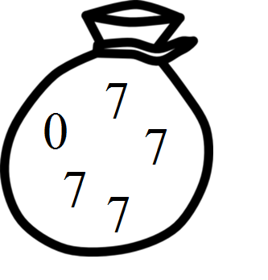
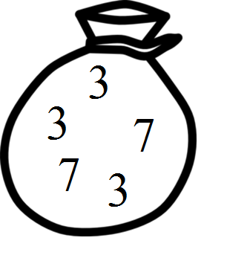
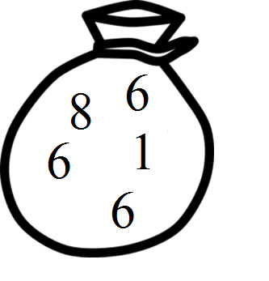
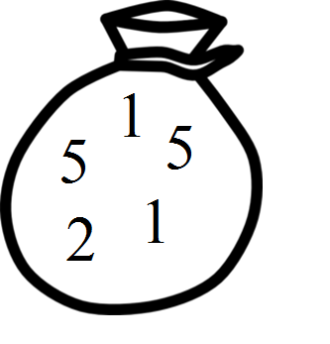
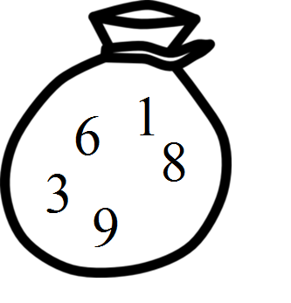
Description | Palindromic? | Mathematical Representation | Count | Example
Five of a kind | ✔ | {{a, a, a, a, a} | a ∈ [0, 9]} | 10
Four of a kind | ✔ | {{a, a, a, a, b} | a, b ∈ [0, 9], a ≠ b} | 90
Full House | ✔ | {{a, a, a, b, b} | a, b ∈ [0, 9], a ≠ b} | 90
Three of a kind | ✘ | {{a, a, a, b, c} | a, b, c ∈ [0, 9], a ≠ b ≠ c } | 360
Two pair | ✔ | {{a, a, b, b, c} | a, b, c ∈ [0, 9], a ≠ b ≠ c } | 360
Pair | ✘ | {{a, a, b, c, d} | a, b, c, d ∈ [0, 9], a ≠ b ≠ c ≠ d } | 840
Nothing | ✘ | {{a, b, c, d, e} | a, b, c, d, e ∈ [0, 9], a ≠ b ≠ c ≠ d ≠ e} | 252

Slide 6
Alphabet:
{0, 1, 2, 3, 4, 5, 6, 7, 8, 9}
Bag Size:
5

Slide 7
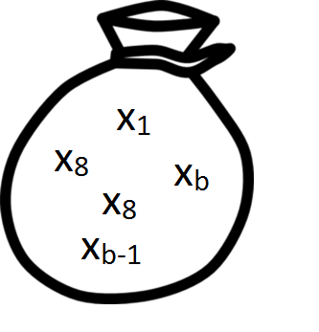
Alphabet:
X_{b} := {x₁, x₂, …, x_{b}}
Bag Size:
5

Slide 8
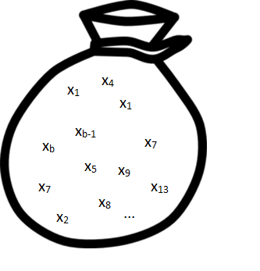
Alphabet:
X_{b} := {x₁, x₂, …, x_{b}}
Bag Size:
n

Slide 9
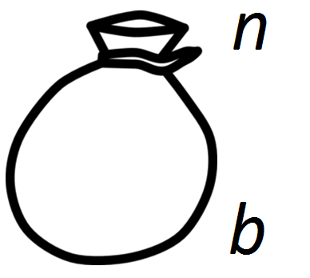
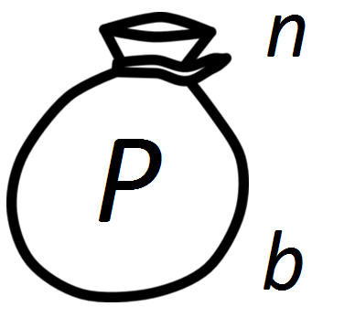
:= {All bags of size n over an alphabet of b letters}
:= {All bags from the above space which are palindromic}

Slide 10
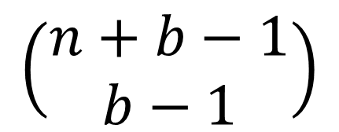
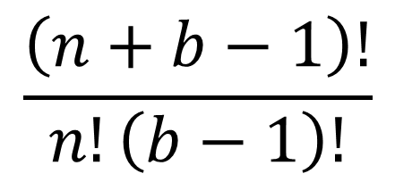
Multinomial Coefficient
=
=
$$\left(\begin{matrix}n+b−1 \\ b−1\end{matrix}\right)$$
$$\frac{\left(n+b−1\right)!}{n!\left(b−1\right)!}$$

Slide 11
= ?

Slide 12
Odd / Even relationship
Results for b = 10
n | 2 | 3 | 4 | 5 | 6 | 7 | 8 | 9
# Palindromic sets | 10 | 100 | 55 | 550 | 220 | 2200 | 715 | 7150

Slide 13
Odd / Even relationship
Results for b = 10
n | 2 | 3 | 4 | 5 | 6 | 7 | 8 | 9
# Palindromic sets | 10 | 100 | 55 | 550 | 220 | 2200 | 715 | 7150

Slide 14

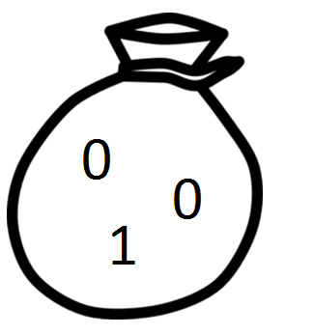

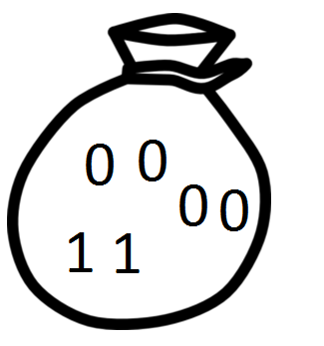
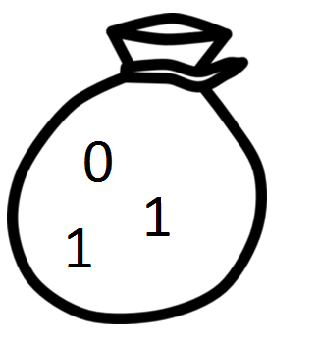
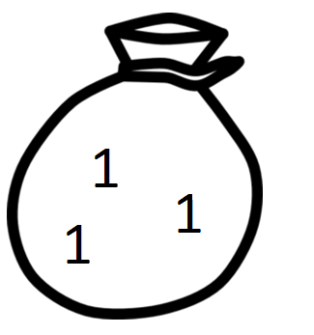

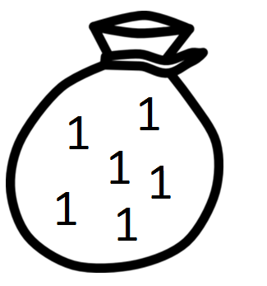
Even Case
Let b = 2
All bags for n = 3
All palindromic bags for n = 6
Duplicate
Halve

Slide 15
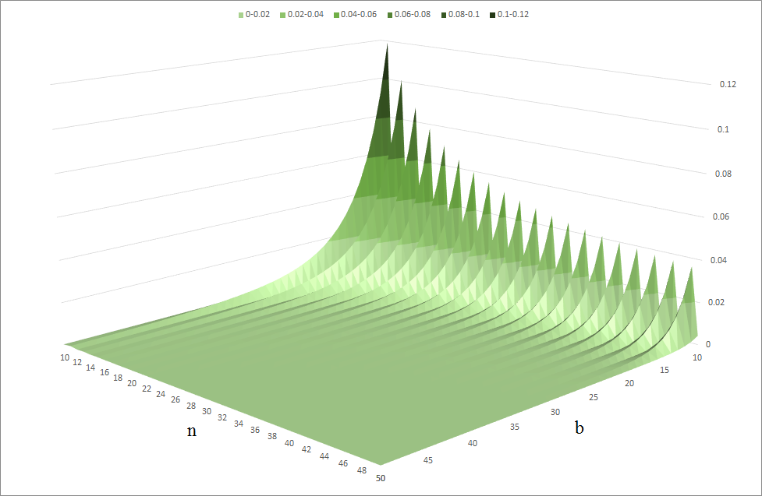

Slide 16
