Slide 1
“A Little Ado about Nothing”
Ken McKelvie – University of Liverpool
“Maths Outreach”
mckelvie@liverpool.ac.uk
The “Nothing” in our title refers to the digit ‘0’.
The “Ado” is the investigation of the incidence or otherwise of ‘0’ (other than leading ‘0’s) amongst the sequences of digits generated in the decimal expansions of some “familiar” and some “less familiar” quantities .

Slide 2
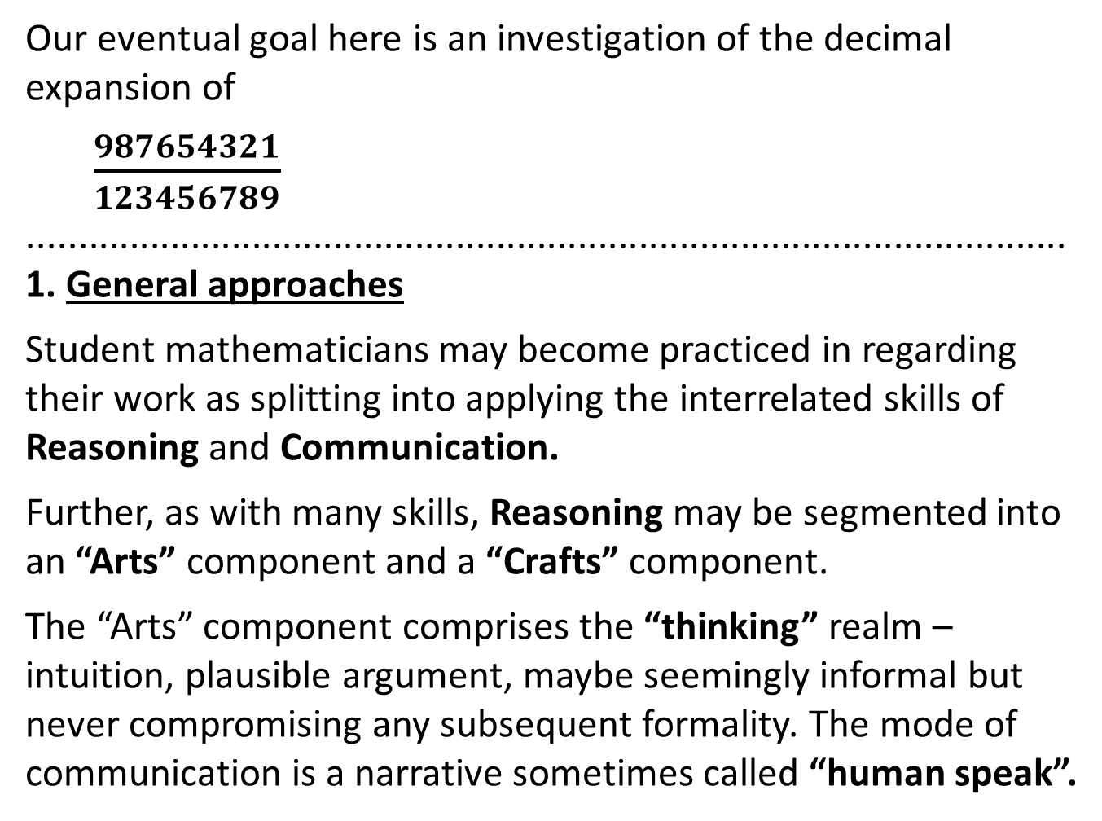
Our eventual goal here is an investigation of the decimal expansion of
$\frac{987654321}{123456789}$
......................................................................................................
1. General approaches
Student mathematicians may become practiced in regarding their work as splitting into applying the interrelated skills of Reasoning and Communication.
Further, as with many skills, Reasoning may be segmented into an “Arts” component and a “Crafts” component.
The “Arts” component comprises the “thinking” realm – intuition, plausible argument, maybe seemingly informal but never compromising any subsequent formality. The mode of communication is a narrative sometimes called “human speak”.

Slide 3
The “Crafts” component comprises the “doing” realm – formal theory, application of routine learned and practised techniques, rigorous argument, ‘proper maths’. Communication may, on occasion, sadly be confined to a narrative in “maths speak”.
[A third mode of exposition, sometimes encountered, is “parrot speak”. Students are recommended to avoid this at all costs.]
.......................................................................................................
Ideas developed in the Arts realm can sometimes provide direction for subsequent formal development in the Crafts realm. Also post hoc, explanation drawn from the Arts realm can illuminate ways round difficulties encountered in the Craft realm
.......................................................................................................

Slide 4
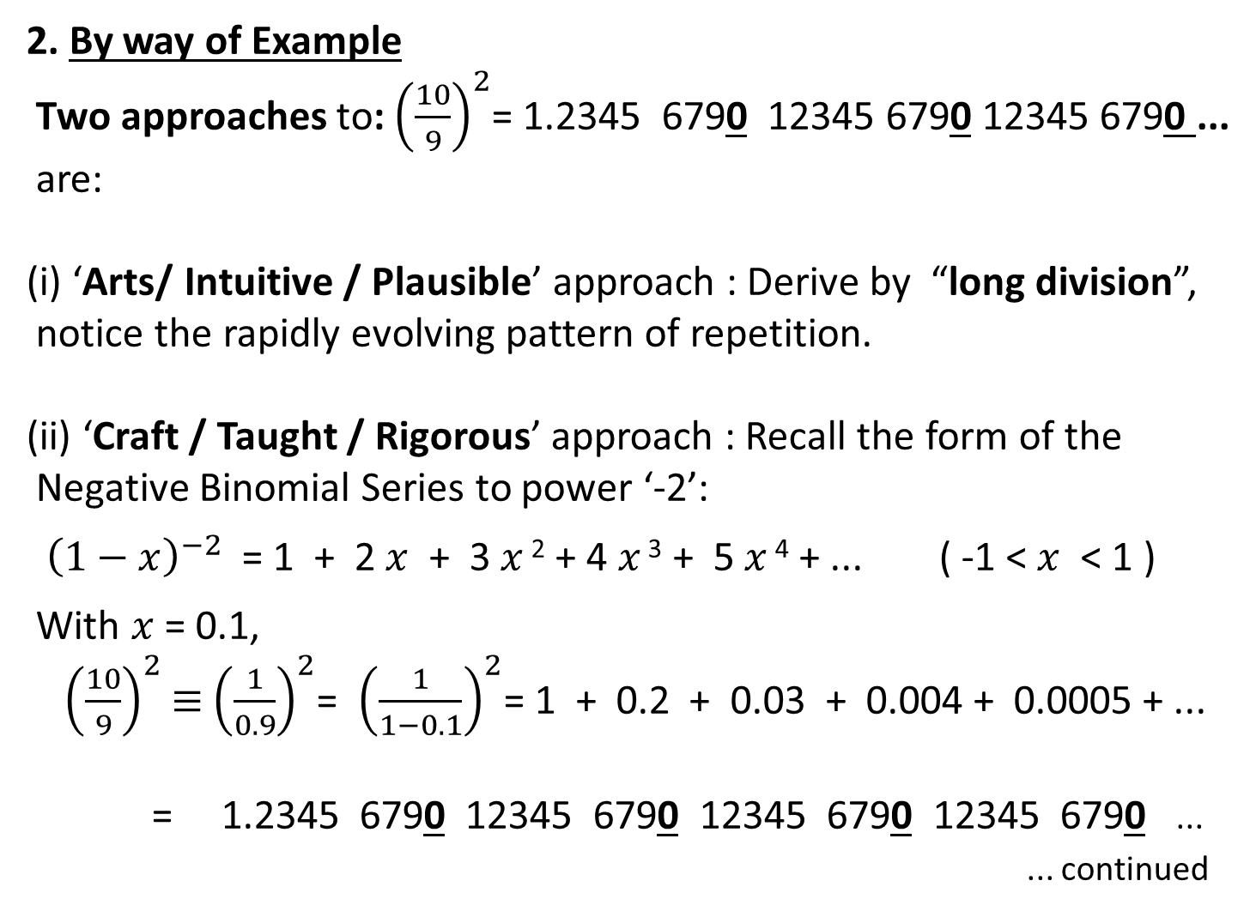
2. By way of Example
Two approaches to: ${\left(\frac{10}{9}\right)}^{2}$= 1.2345 6790 12345 6790 12345 6790 ...
are:
(i) ‘Arts/ Intuitive / Plausible’ approach : Derive by “long division”,
notice the rapidly evolving pattern of repetition.
(ii) ‘Craft / Taught / Rigorous’ approach : Recall the form of the
Negative Binomial Series to power ‘-2’:
${\left(1−x\right)}^{−2}$ = 1 + 2$x$ + 3$x$ ² + 4 $x$ ³ + 5$x$ ⁴ + ... ( -1 < $x$ < 1 )
With $x$ = 0.1,
${ \left(\frac{10}{9}\right)}^{2}$ $≡$ ${\left(\frac{1}{0.9}\right)}^{2}$= ${\left(\frac{1}{1−0.1}\right)}^{2}$= 1 + 0.2 + 0.03 + 0.004 + 0.0005 + ...
= 1.2345 6790 12345 6790 12345 6790 12345 6790 ...
... continued

Slide 5
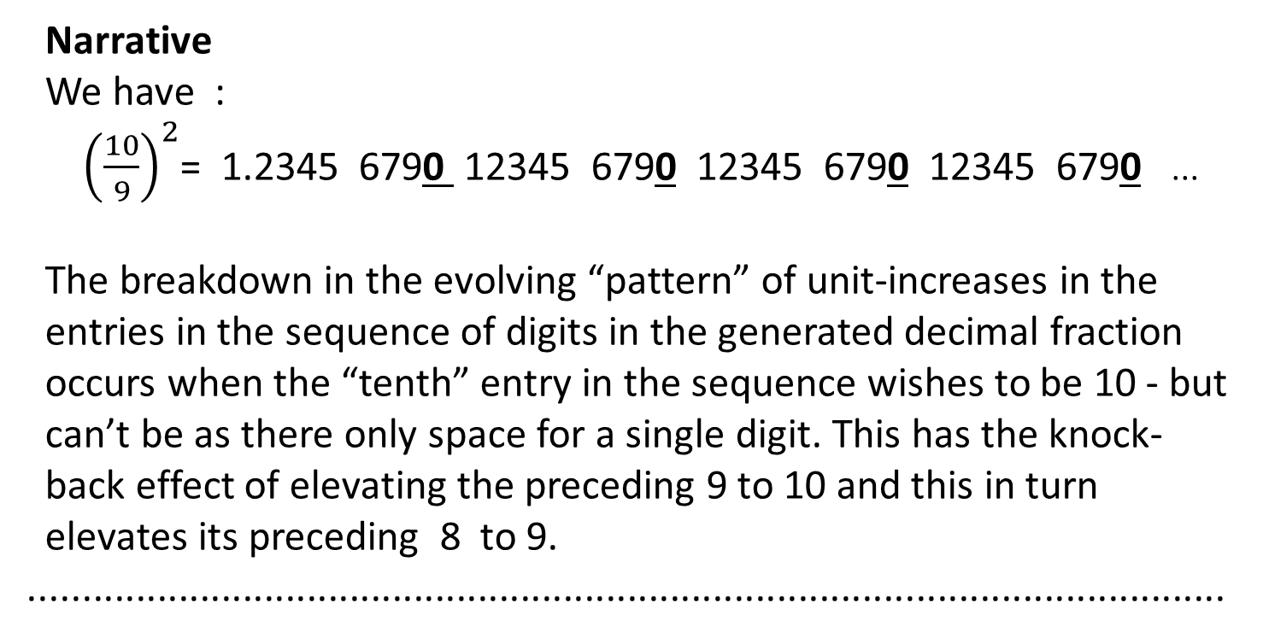
Narrative
We have :
${ \left(\frac{10}{9}\right)}^{2}$= 1.2345 6790 12345 6790 12345 6790 12345 6790 ...
The breakdown in the evolving “pattern” of unit-increases in the
entries in the sequence of digits in the generated decimal fraction
occurs when the “tenth” entry in the sequence wishes to be 10 - but
can’t be as there only space for a single digit. This has the knock-
back effect of elevating the preceding 9 to 10 and this in turn
elevates its preceding 8 to 9.
................................................................................................................

Slide 6
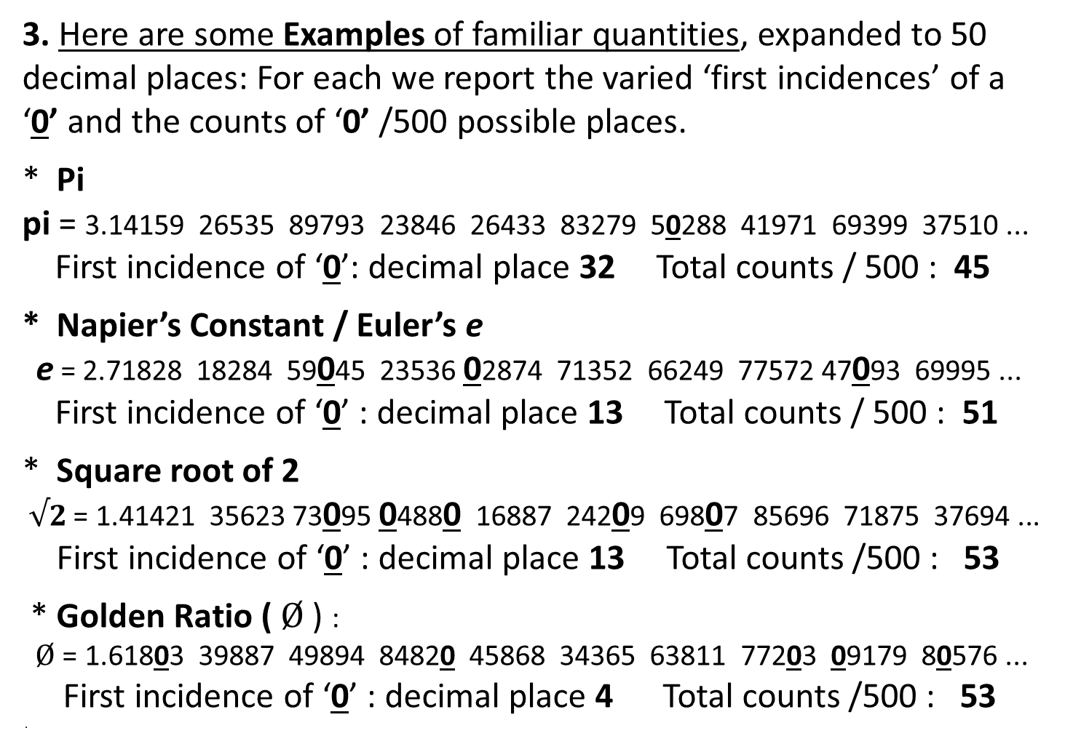
3. Here are some Examples of familiar quantities, expanded to 50 decimal places: For each we report the varied ‘first incidences’ of a ‘0’ and the counts of ‘0’ /500 possible places.
* Pi
pi = 3.14159 26535 89793 23846 26433 83279 50288 41971 69399 37510 ...
First incidence of ‘0’: decimal place 32 Total counts / 500 : 45
* Napier’s Constant / Euler’s e
e = 2.71828 18284 59045 23536 02874 71352 66249 77572 47093 69995 ...
First incidence of ‘0’ : decimal place 13 Total counts / 500 : 51
* Square root of 2
$√2$ = 1.41421 35623 73095 04880 16887 24209 69807 85696 71875 37694 ...
First incidence of ‘0’ : decimal place 13 Total counts /500 : 53
* Golden Ratio ( $Ø$) :
$Ø$ = 1.61803 39887 49894 84820 45868 34365 63811 77203 09179 80576 ...
First incidence of ‘0’ : decimal place 4 Total counts /500 : 53
.

Slide 7
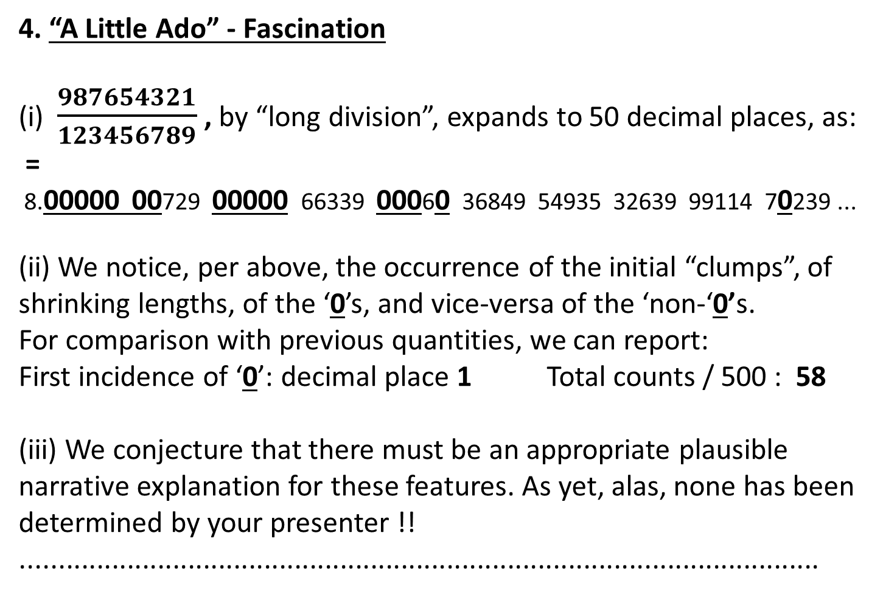
4. “A Little Ado” - Fascination
(i) $\frac{987654321}{123456789}$ , by “long division”, expands to 50 decimal places, as:
=
8.00000 00729 00000 66339 00060 36849 54935 32639 99114 70239 ...
(ii) We notice, per above, the occurrence of the initial “clumps”, of shrinking lengths, of the ‘0’s, and vice-versa of the ‘non-‘0’s.
For comparison with previous quantities, we can report:
First incidence of ‘0’: decimal place 1 Total counts / 500 : 58
(iii) We conjecture that there must be an appropriate plausible narrative explanation for these features. As yet, alas, none has been determined by your presenter !!
.........................................................................................................

