Slide 1
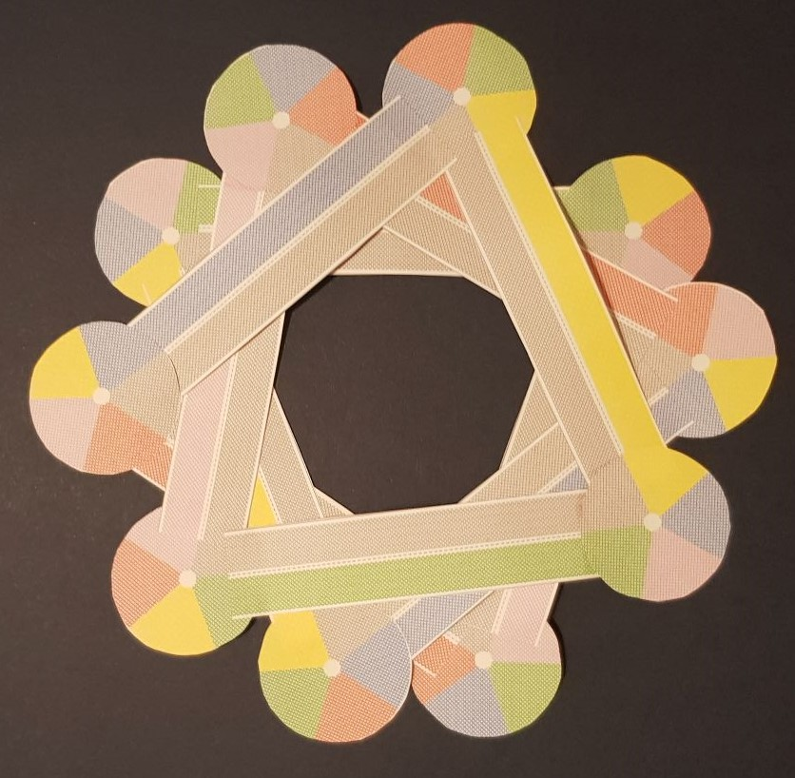
Platonic Möboids
As presented to MathsJam 2018

Slide 2
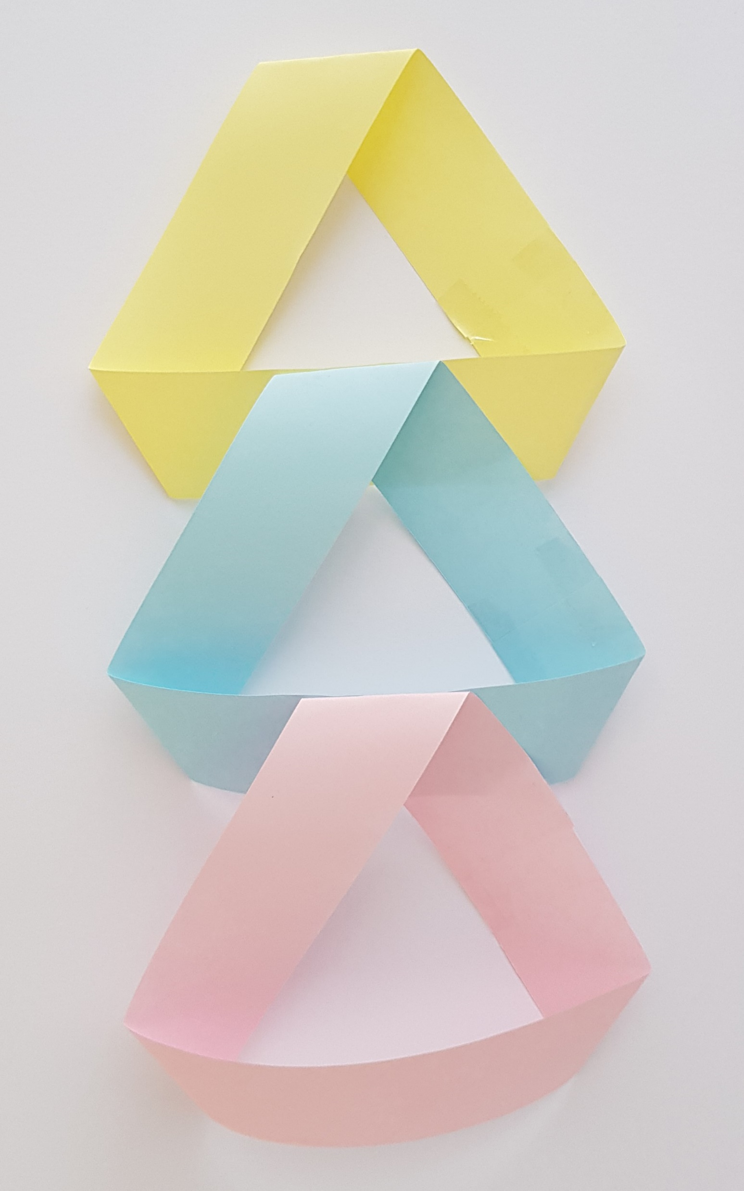
Loop of three Möbius strips

Slide 3
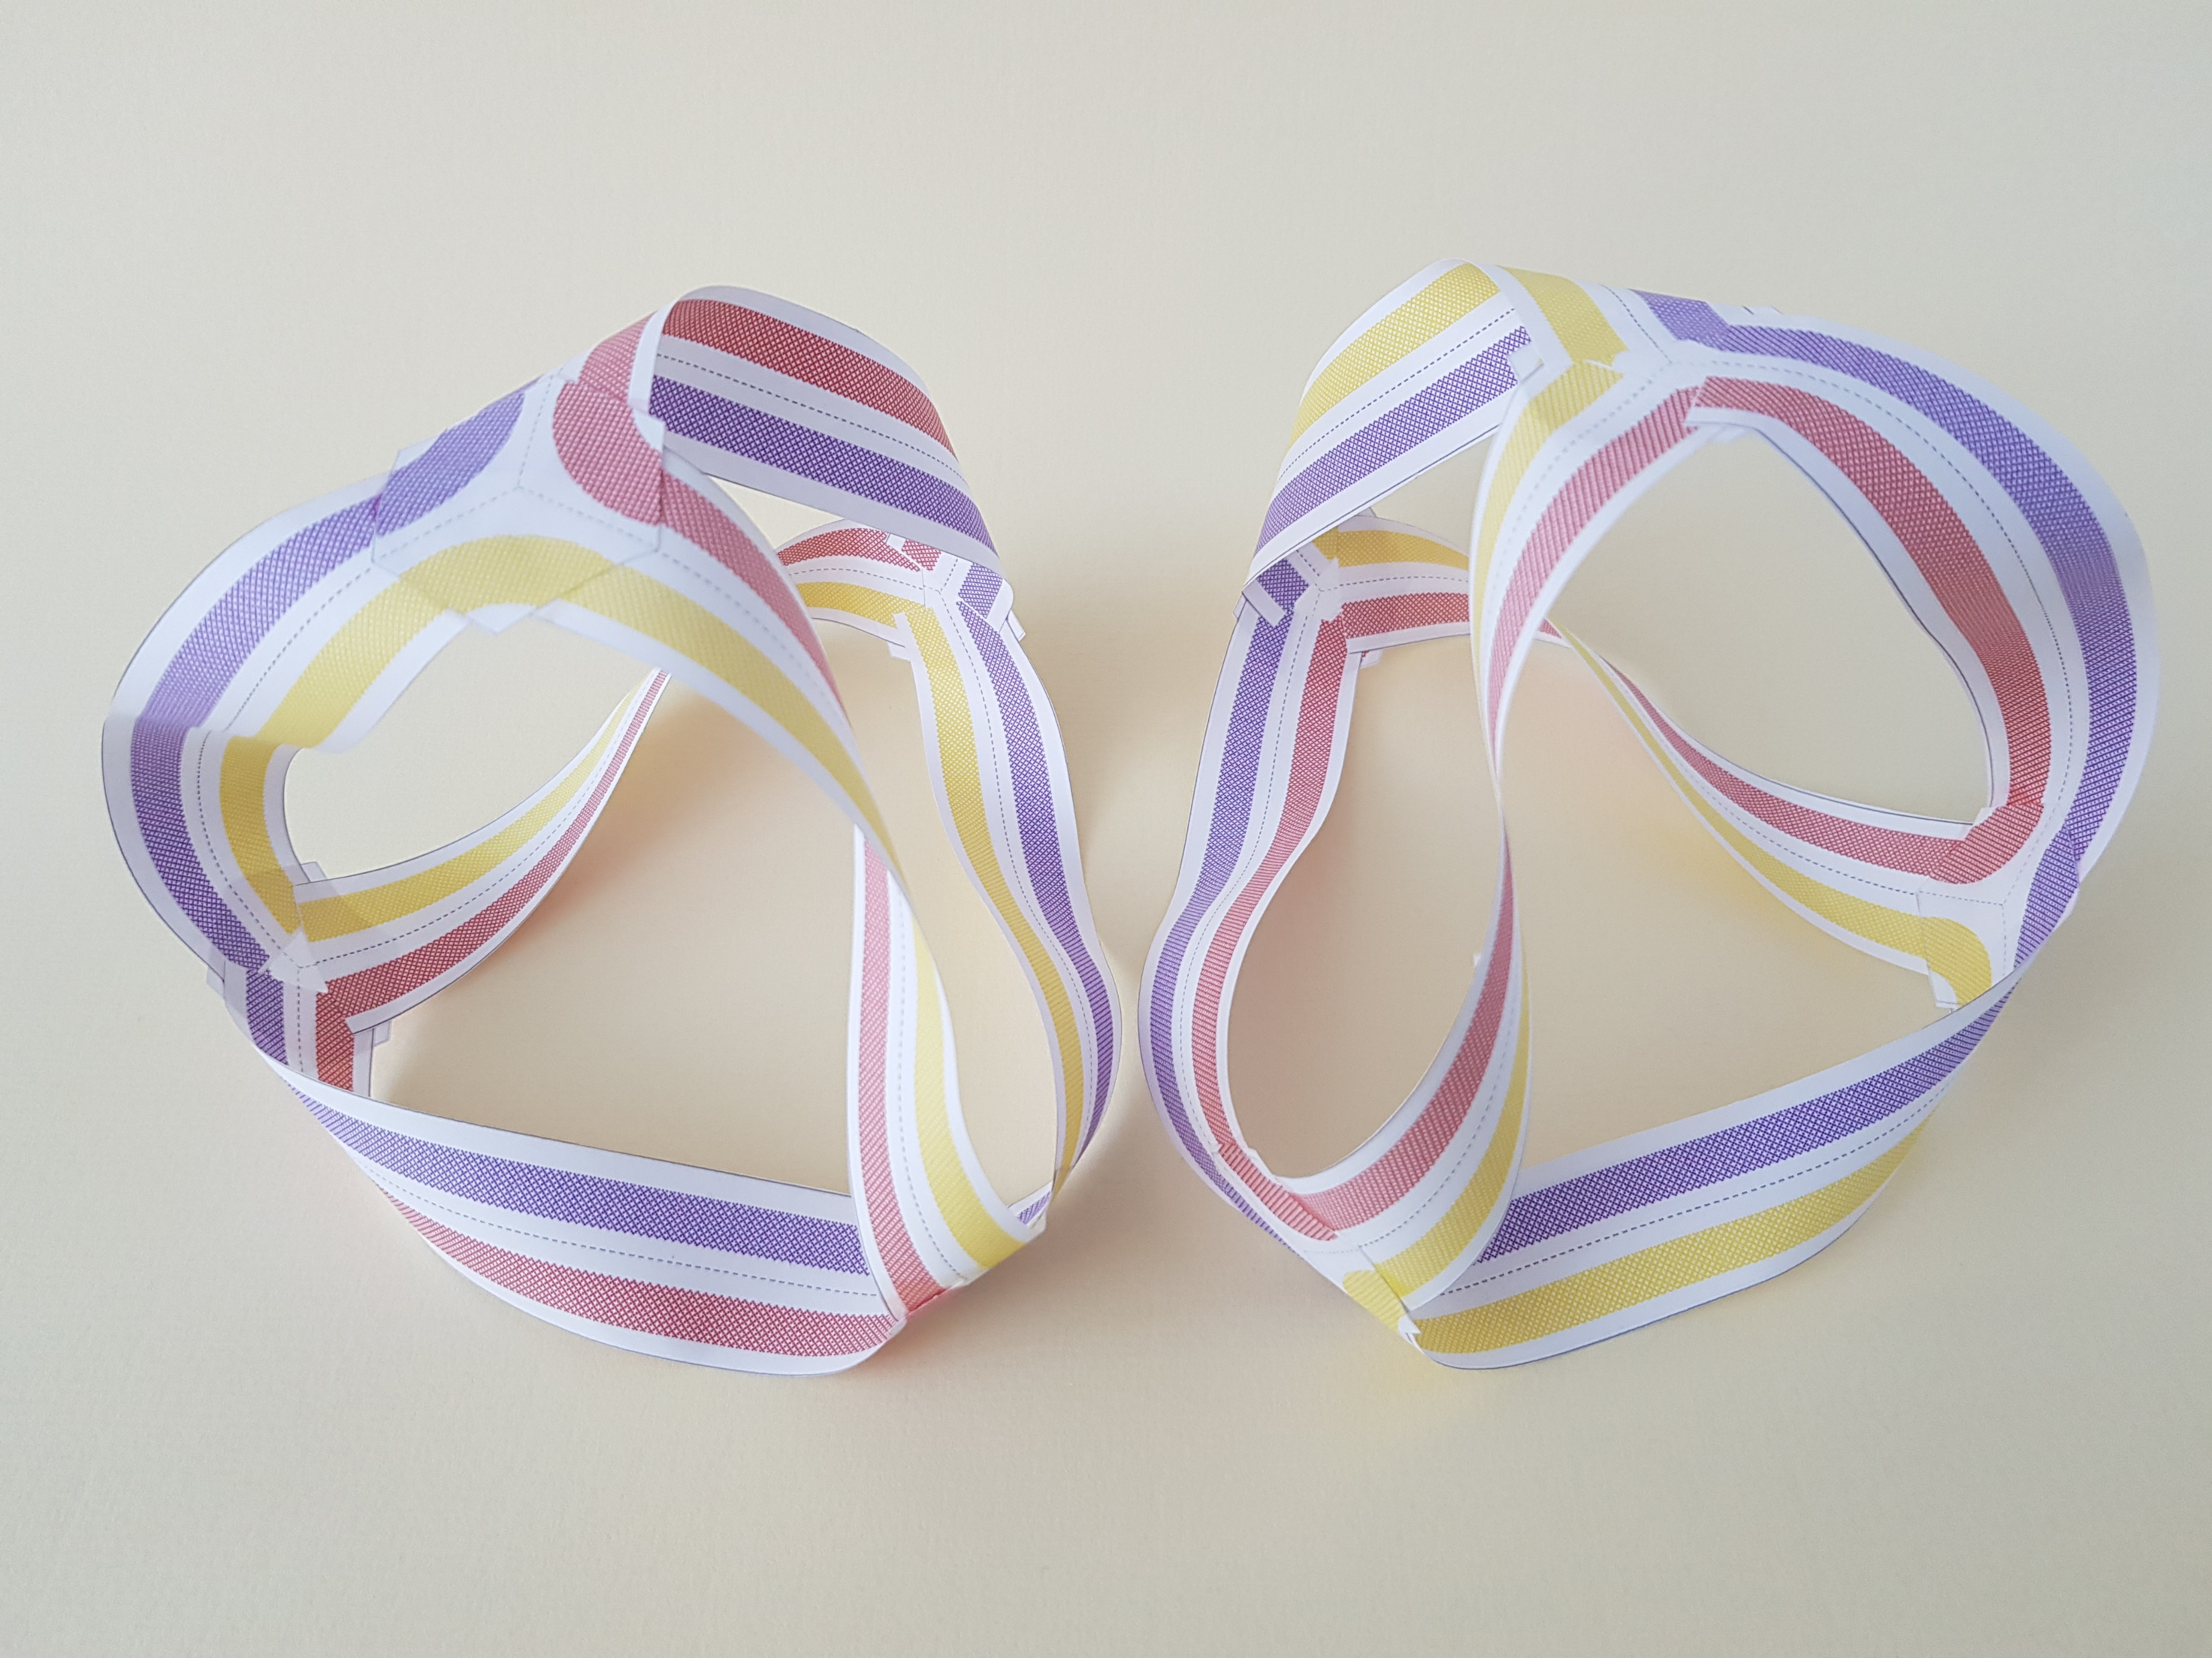
Right & Left hand Tetrahedral Möboids

Slide 4
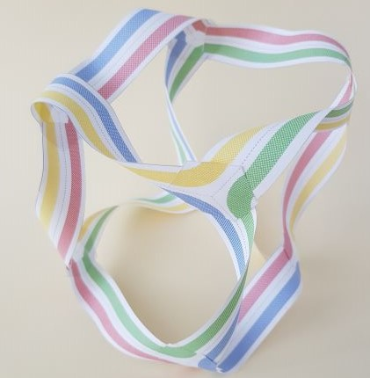
Cubic Möboid

Slide 5
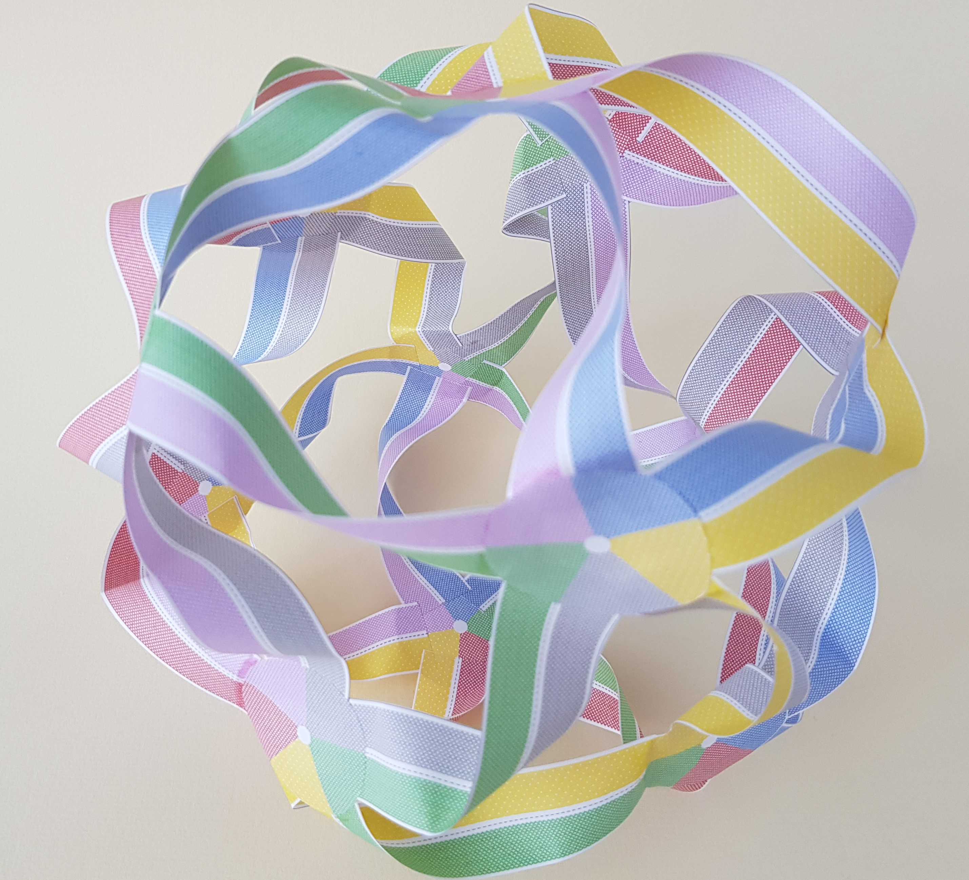
Icosahedral Möboid

Slide 6
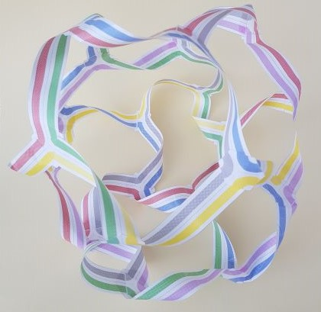
Dodecahedral Möboid

Slide 7
Relationship between rings

Slide 8
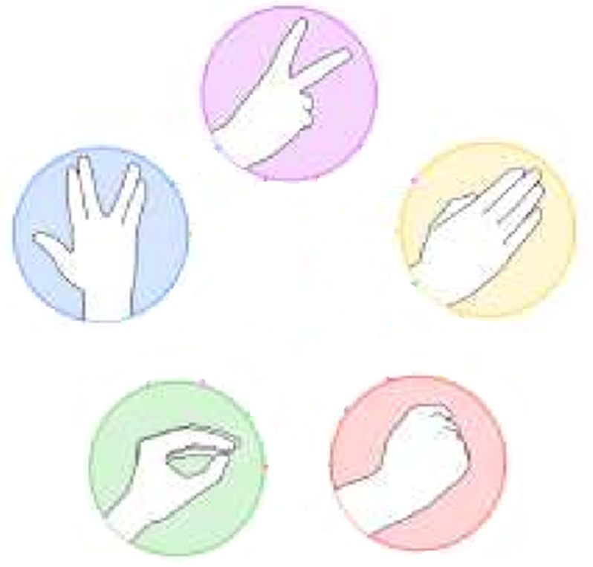
From “Rock-Paper-Scissors Meets Borromean Rings” Chamberland, M. & Herman, E.A. Math Intelligencer (2015) 37: 20. https://doi.org/10.1007/s00283-014-9499-4
Rock Paper Scissors Lizard Spock

Slide 9
Barromean Rings

