Slide 1
Piet Hein - Pirate
Mike Frost

Slide 2
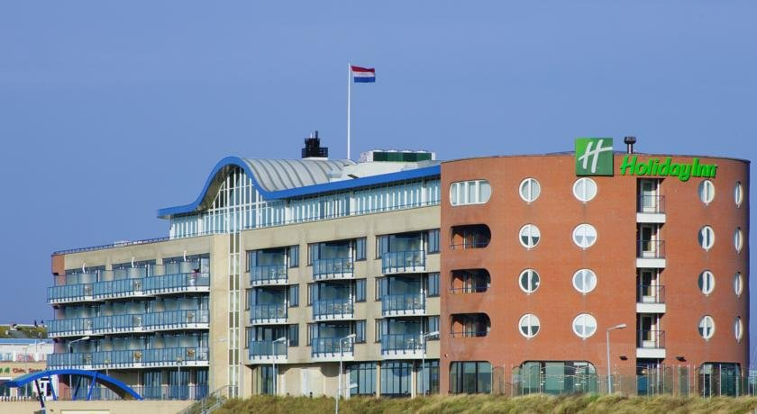
IJmuiden Holiday Inn
The conference room was named for Piet Hein
One establishment of higher learning is the
Escola de Minas, or School of Mining (centre)

Slide 3
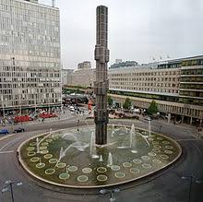
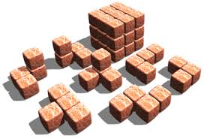
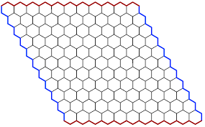
Piet Hein invented:
The Soma Cube
The Superellipse
The Game of Hex
Also Tangloids, TacTix, the Superegg, and more ...

Slide 4
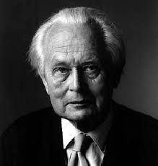
Piet Hein, 1905–1996
Born 16 Dec 1905, Copenhagen
Studied at the Institute for Theoretical Physics, Copenhagen
Niels Bohr was a colleague and friend
During WW2, when Germany invaded Denmark, Piet joined the Resistance
He published “Grooks”, aphoristic poems, under a pseudonym
CONSOLATION GROOK
Losing one glove
is certainly painful,
but nothing
compared to the pain
of losing one,
throwing away the other,
and finding
the first one again.
In later years, involved with home styling design and town planning
So what was in the Conference Room?....

Slide 5
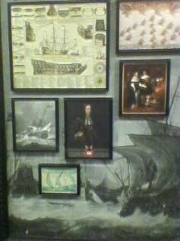
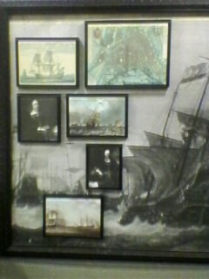
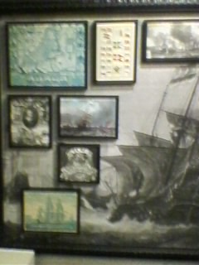
Not quite what I expected!

Slide 6
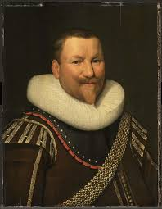
The other Piet Hein…
Piet Pieterzoon Hein – born 25 Nov 1577, Delft
Admiral and Privateer …
In his 20s, captured by the Spanish
Spent 4 years as a Galley Slave
Became a Captain in the Dutch East India Company,
Then an admiral in the Dutch West India Company
Captured the Brazilian city of Salvador
In 1628, captured a Spanish Treasure Fleet
Died in battle 26 March 1629
The Danish Piet Hein was a
linear descendent ….

