Slide 1
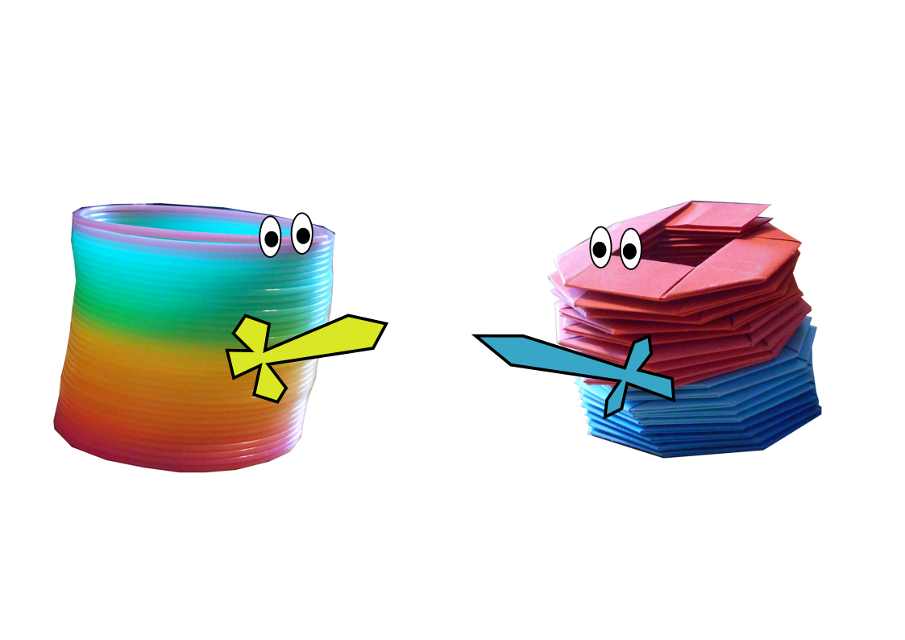
Battle of the Slinkies
Paper
vs
Plastic
Sam Hartburn

Slide 2
Origami slinky designed by Jo Nakashima
jonakashima.com.br
Instruction video on YouTube

Slide 3
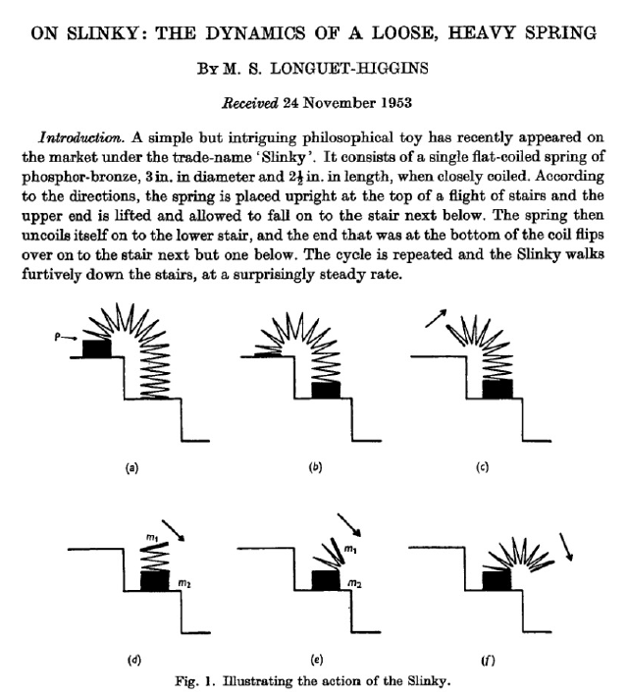

Slide 4
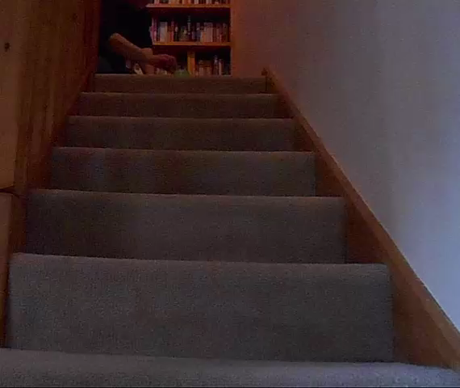
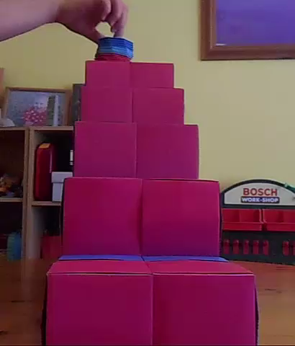

Slide 5
Elegant
Fast
Recyclable
Robust
Good sound
???
Choose own length
Can make matching stairs

Slide 6
