Slide 1

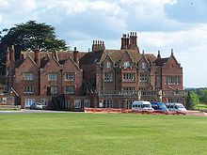

Royal Institution Primary Maths Masterclasses
The Power of Pictures and the Compassionate Statistician
Image credits:
Notes:
Title slide, nice pictures to show what’s coming!

Slide 2


Slide 3
Florence quote:
Her enjoyment (of numbers) was so immense, she found the sight of a long column of figures "perfectly reviving".
Notes:
List is not easy to analyse: going to try a different approach

Slide 4
Florence found that the hospitals weren’t keeping good records
She started to insist that proper records were kept, just like she had done for her vegetable garden.
This helped her to discover people were dying in large numbers…
Notes:
List is not easy to analyse: going to try a different approach

Slide 5
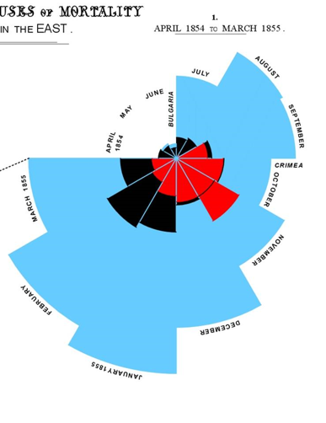
Florence used pictures to illustrate the problem. She invented this “Rose” diagram to help her show people the problem
Notes:
List is not easy to analyse: going to try a different approach

Slide 6
Florence found that diseases were spreading, just as in our game because of a lack of simple precautions and good nursing techniques
She set about introducing these good nursing techniques
She drew another diagram to show her results
Notes:
List is not easy to analyse: going to try a different approach

Slide 7
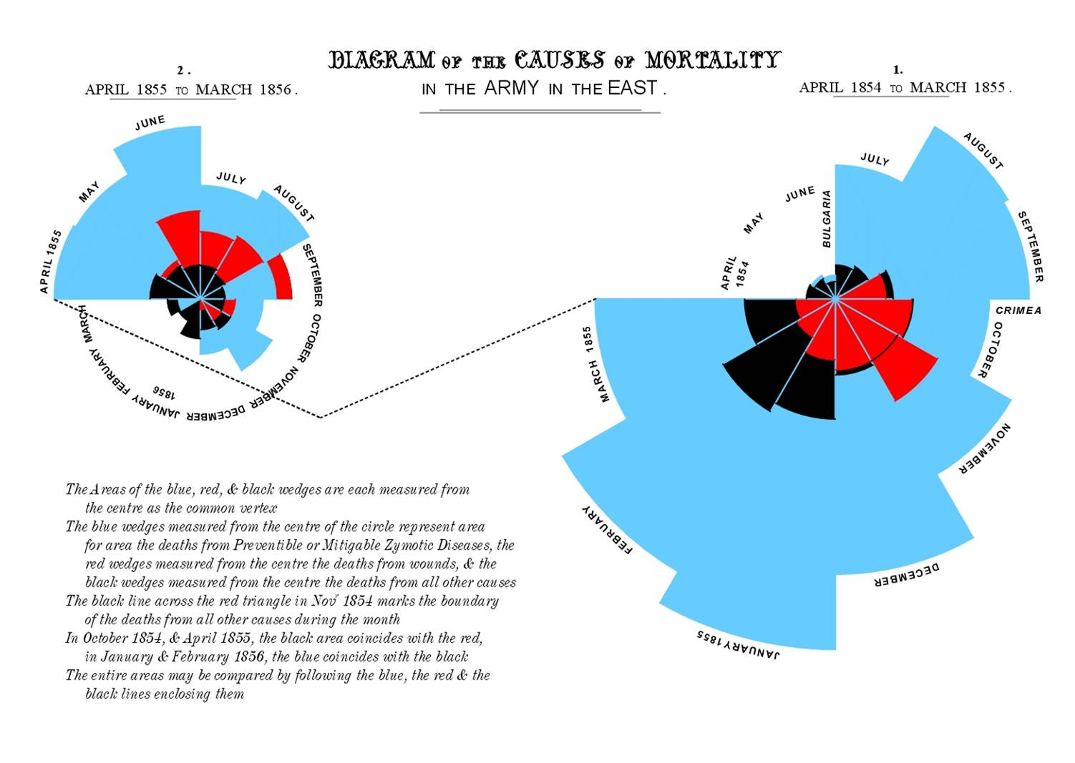
Florence drew another Rose diagram to show deaths in the following year of the war
Notes:
List is not easy to analyse: going to try a different approach

Slide 9
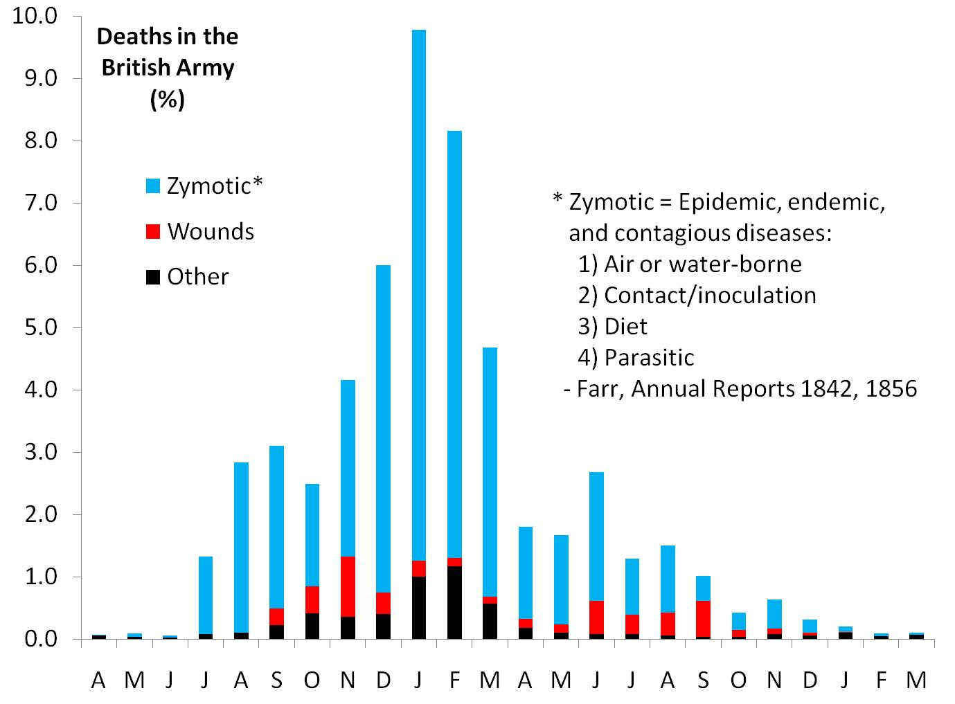

Slide 10
Florence’s work with numbers, and then her use of diagrams, saved thousands of lives in the war
Her work didn’t end there however
When she came home she used her diagrams to convince the government to apply her methods here
Notes:
List is not easy to analyse: going to try a different approach

Slide 11
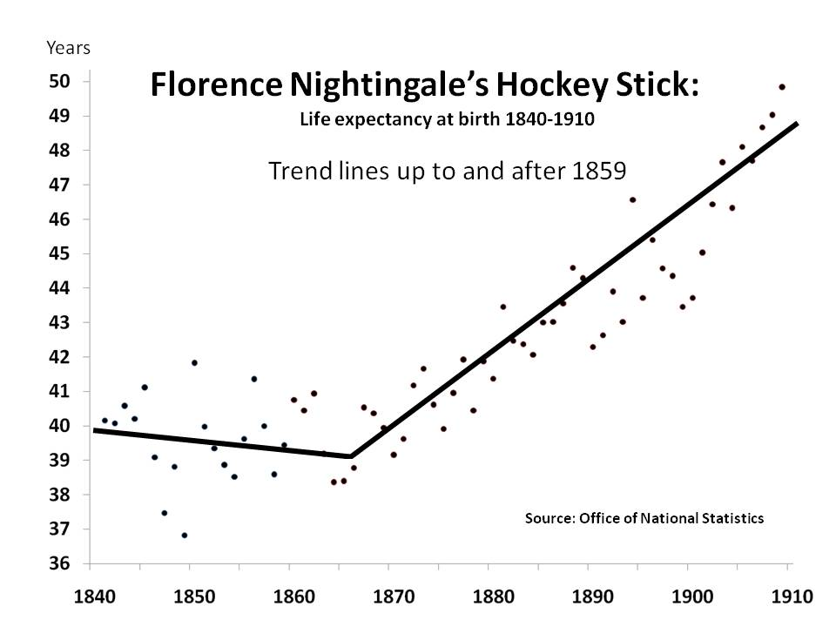
Florence’s work ultimately contributed hugely to the increase in life expectancy in Victorian times
Notes:
List is not easy to analyse: going to try a different approach

