Slide 1












Domino Knights
If chess pieces were domino sized….
… how would the knight move?

Slide 2
Domino Knights

Slide 3
Domino Knights

Slide 10
A
B
A
B
A
B
A
B
A
B
A
B
C
D
C
D
C
D
C
D
C
D
C
D
A
B
A
B
A
B
A
B
A
B
C
D
C
D
C
D
C
D
C
D
A
B
A
B
A
B
A
B
A
B
C
D
C
D
C
D
C
D
C
D
A
B
A
B
A
B
A
B
A
B
C
D
C
D
C
D
C
D
C
D
A
B
A
B
A
B
A
B
A
B
C
D
C
D
C
D
C
D
C
D

Slide 11
A
B
A
B
A
B
A
B
A
B
A
B
C
D
C
D
C
D
C
D
C
D
C
D
A
B
A
B
A
B
A
B
A
B
A + B > C + D
C
D
C
D
C
D
C
D
C
D
A
B
A
B
A
B
A
B
A
B
C
D
C
D
C
D
C
D
C
D
A
B
A
B
A
B
A
B
A
B
C
D
C
D
C
D
C
D
C
D
A
B
A
B
A
B
A
B
A
B
C
D
C
D
C
D
C
D
C
D

Slide 12
A
B
A
B
A
B
A
B
A
B
A
B
C
D
C
D
C
D
C
D
C
D
C
D
A
B
A
B
A
B
A
B
A
B
A + B > C + D
C
D
C
D
C
D
C
D
C
D
A
B
A
B
A
B
A
B
A
B
A + C > B + D
C
D
C
D
C
D
C
D
C
D
2A + B + C
> B + C + 2D
A
B
A
B
A
B
A
B
A
B
C
D
C
D
C
D
C
D
C
D
=> A > D
A
B
A
B
A
B
A
B
A
B
C
D
C
D
C
D
C
D
C
D

Slide 29
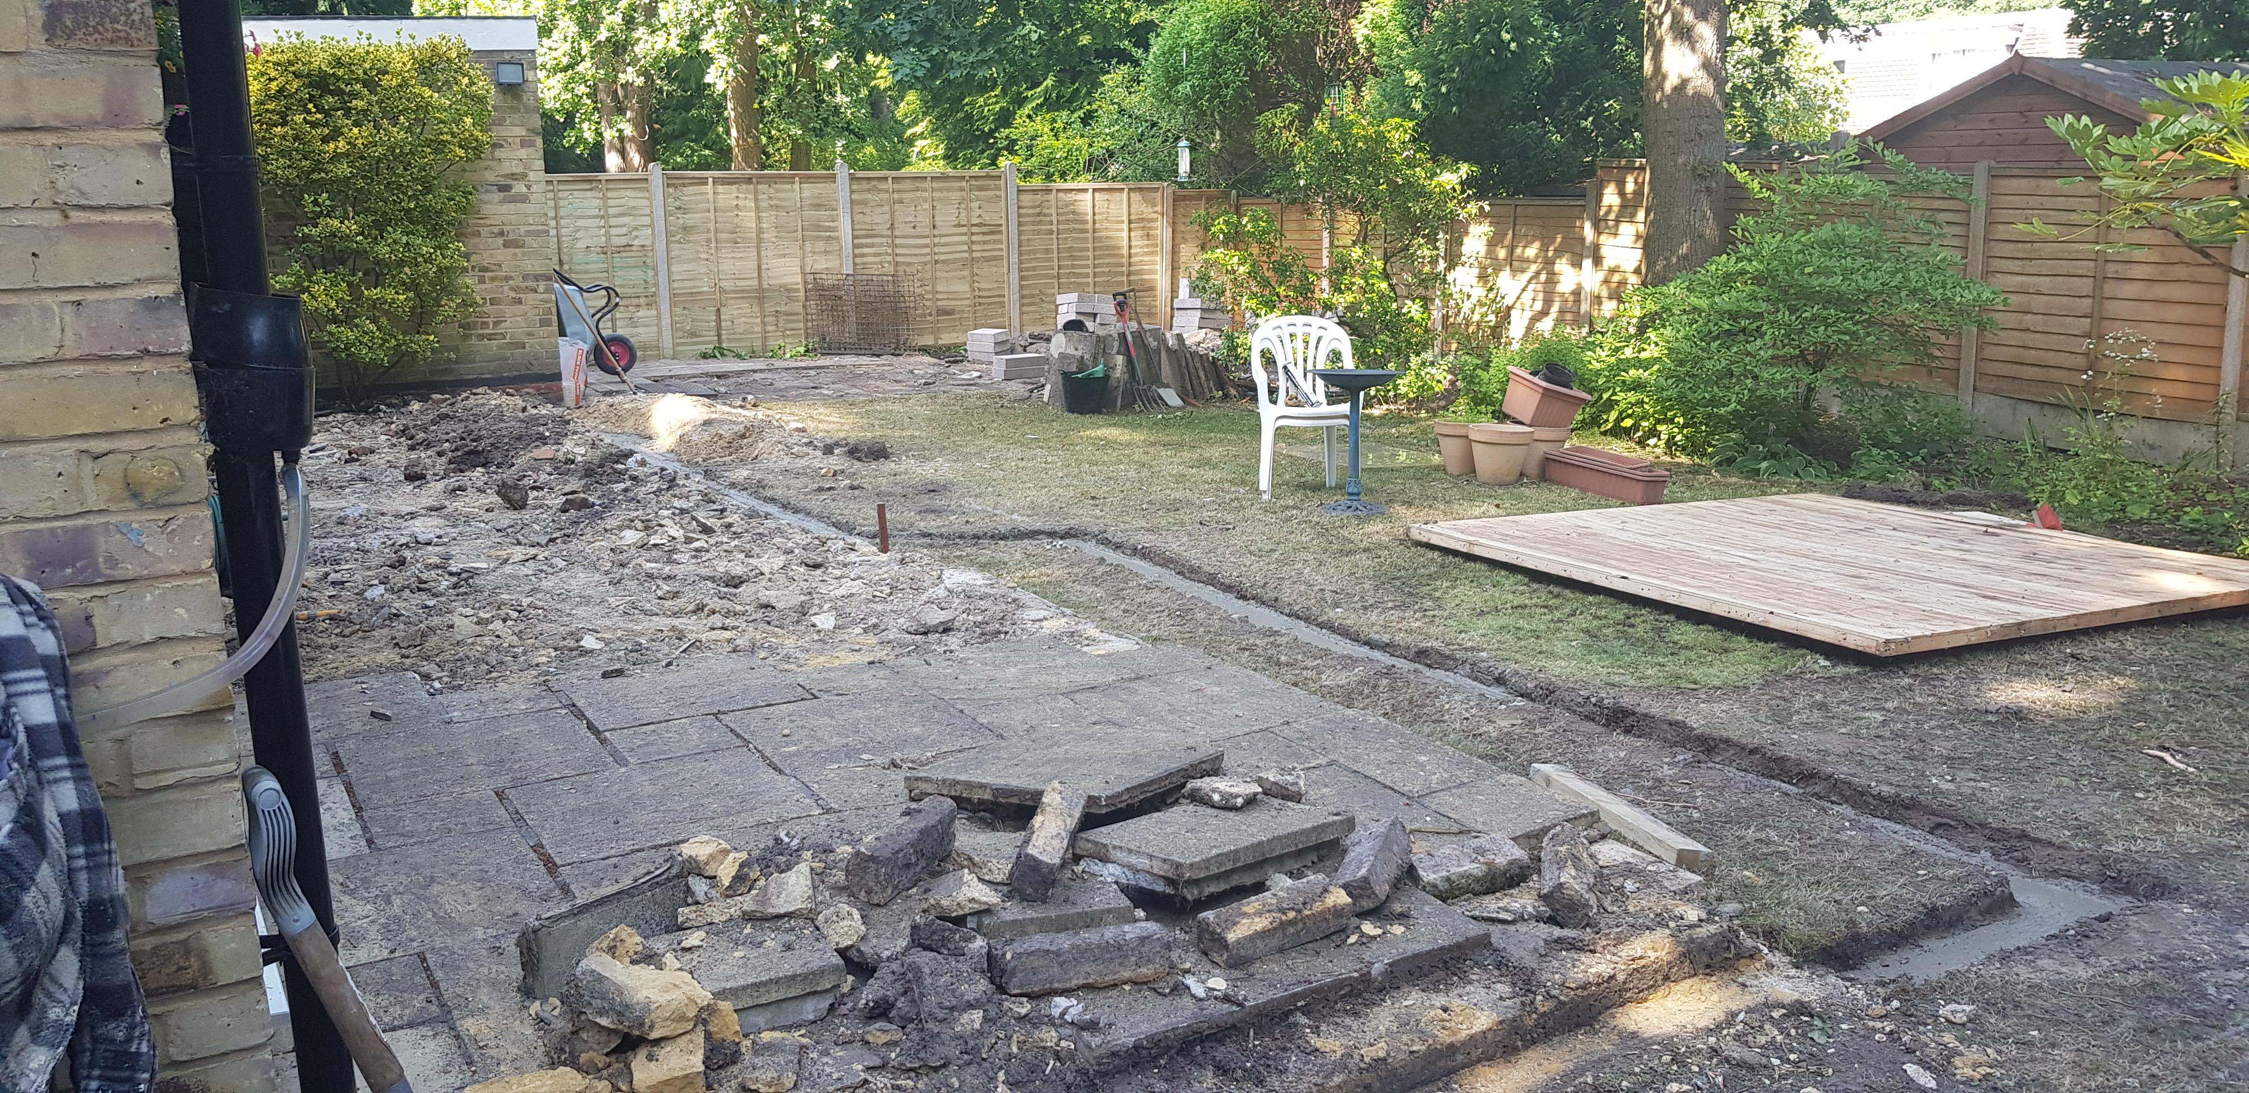

Slide 30
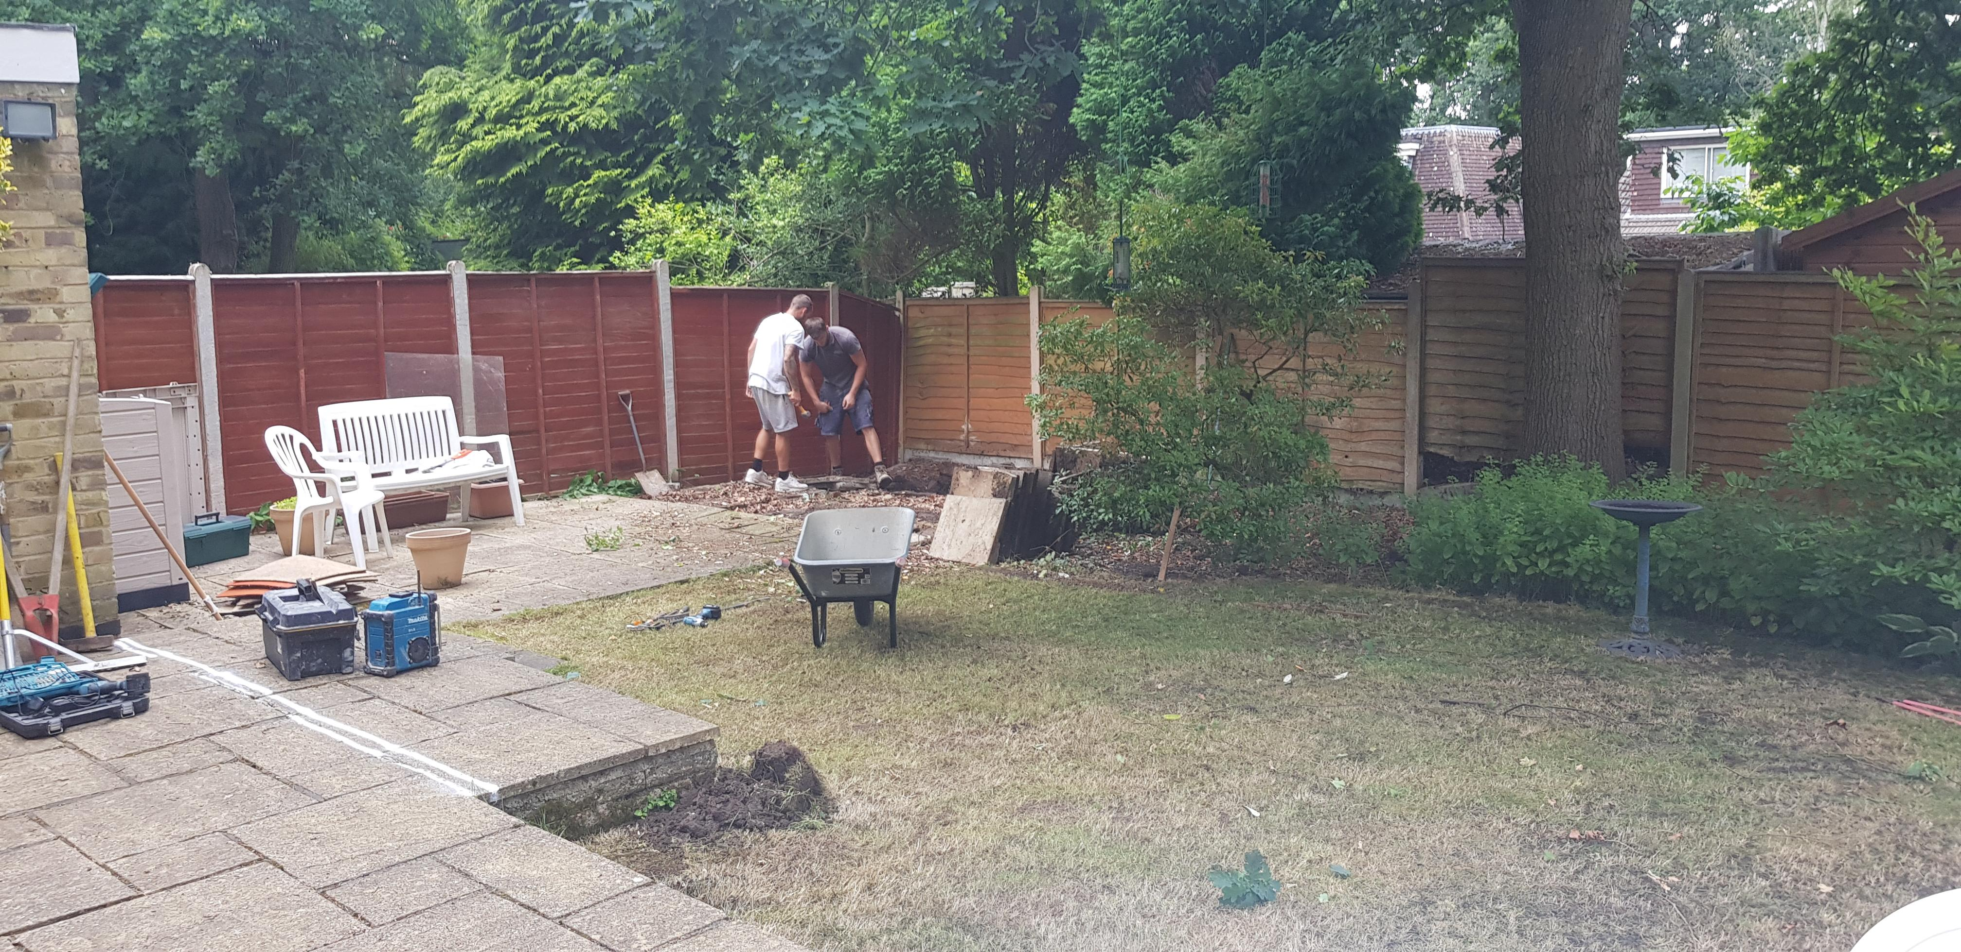

Slide 31
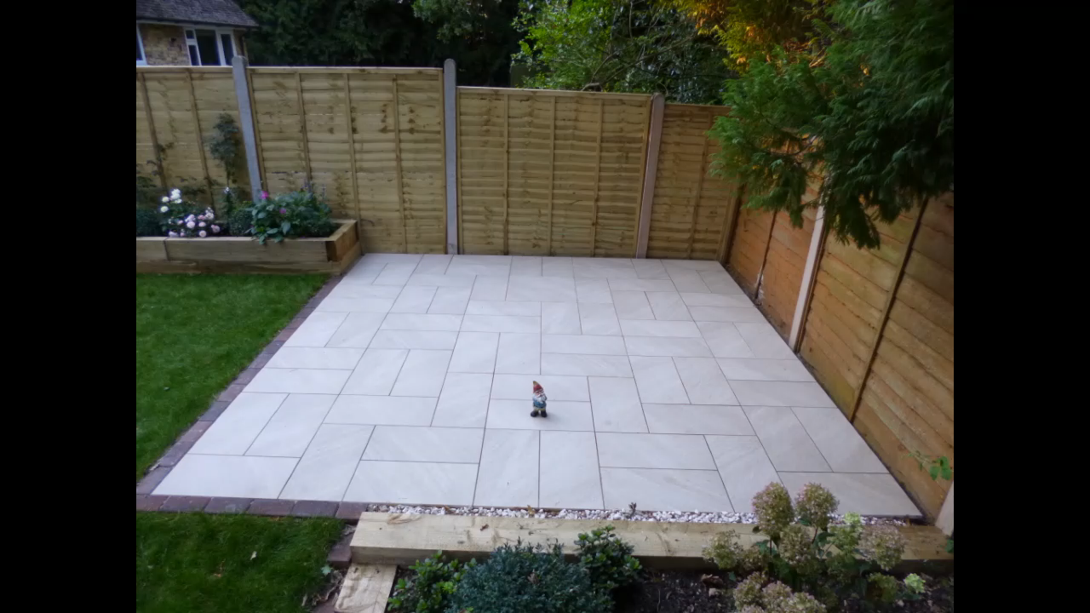

Slide 32
