Slide 1
On morning in a sleepy German village…
James Arthur

Slide 2
WARNING: THIS TALK CONTAINS FRENCH

Slide 3
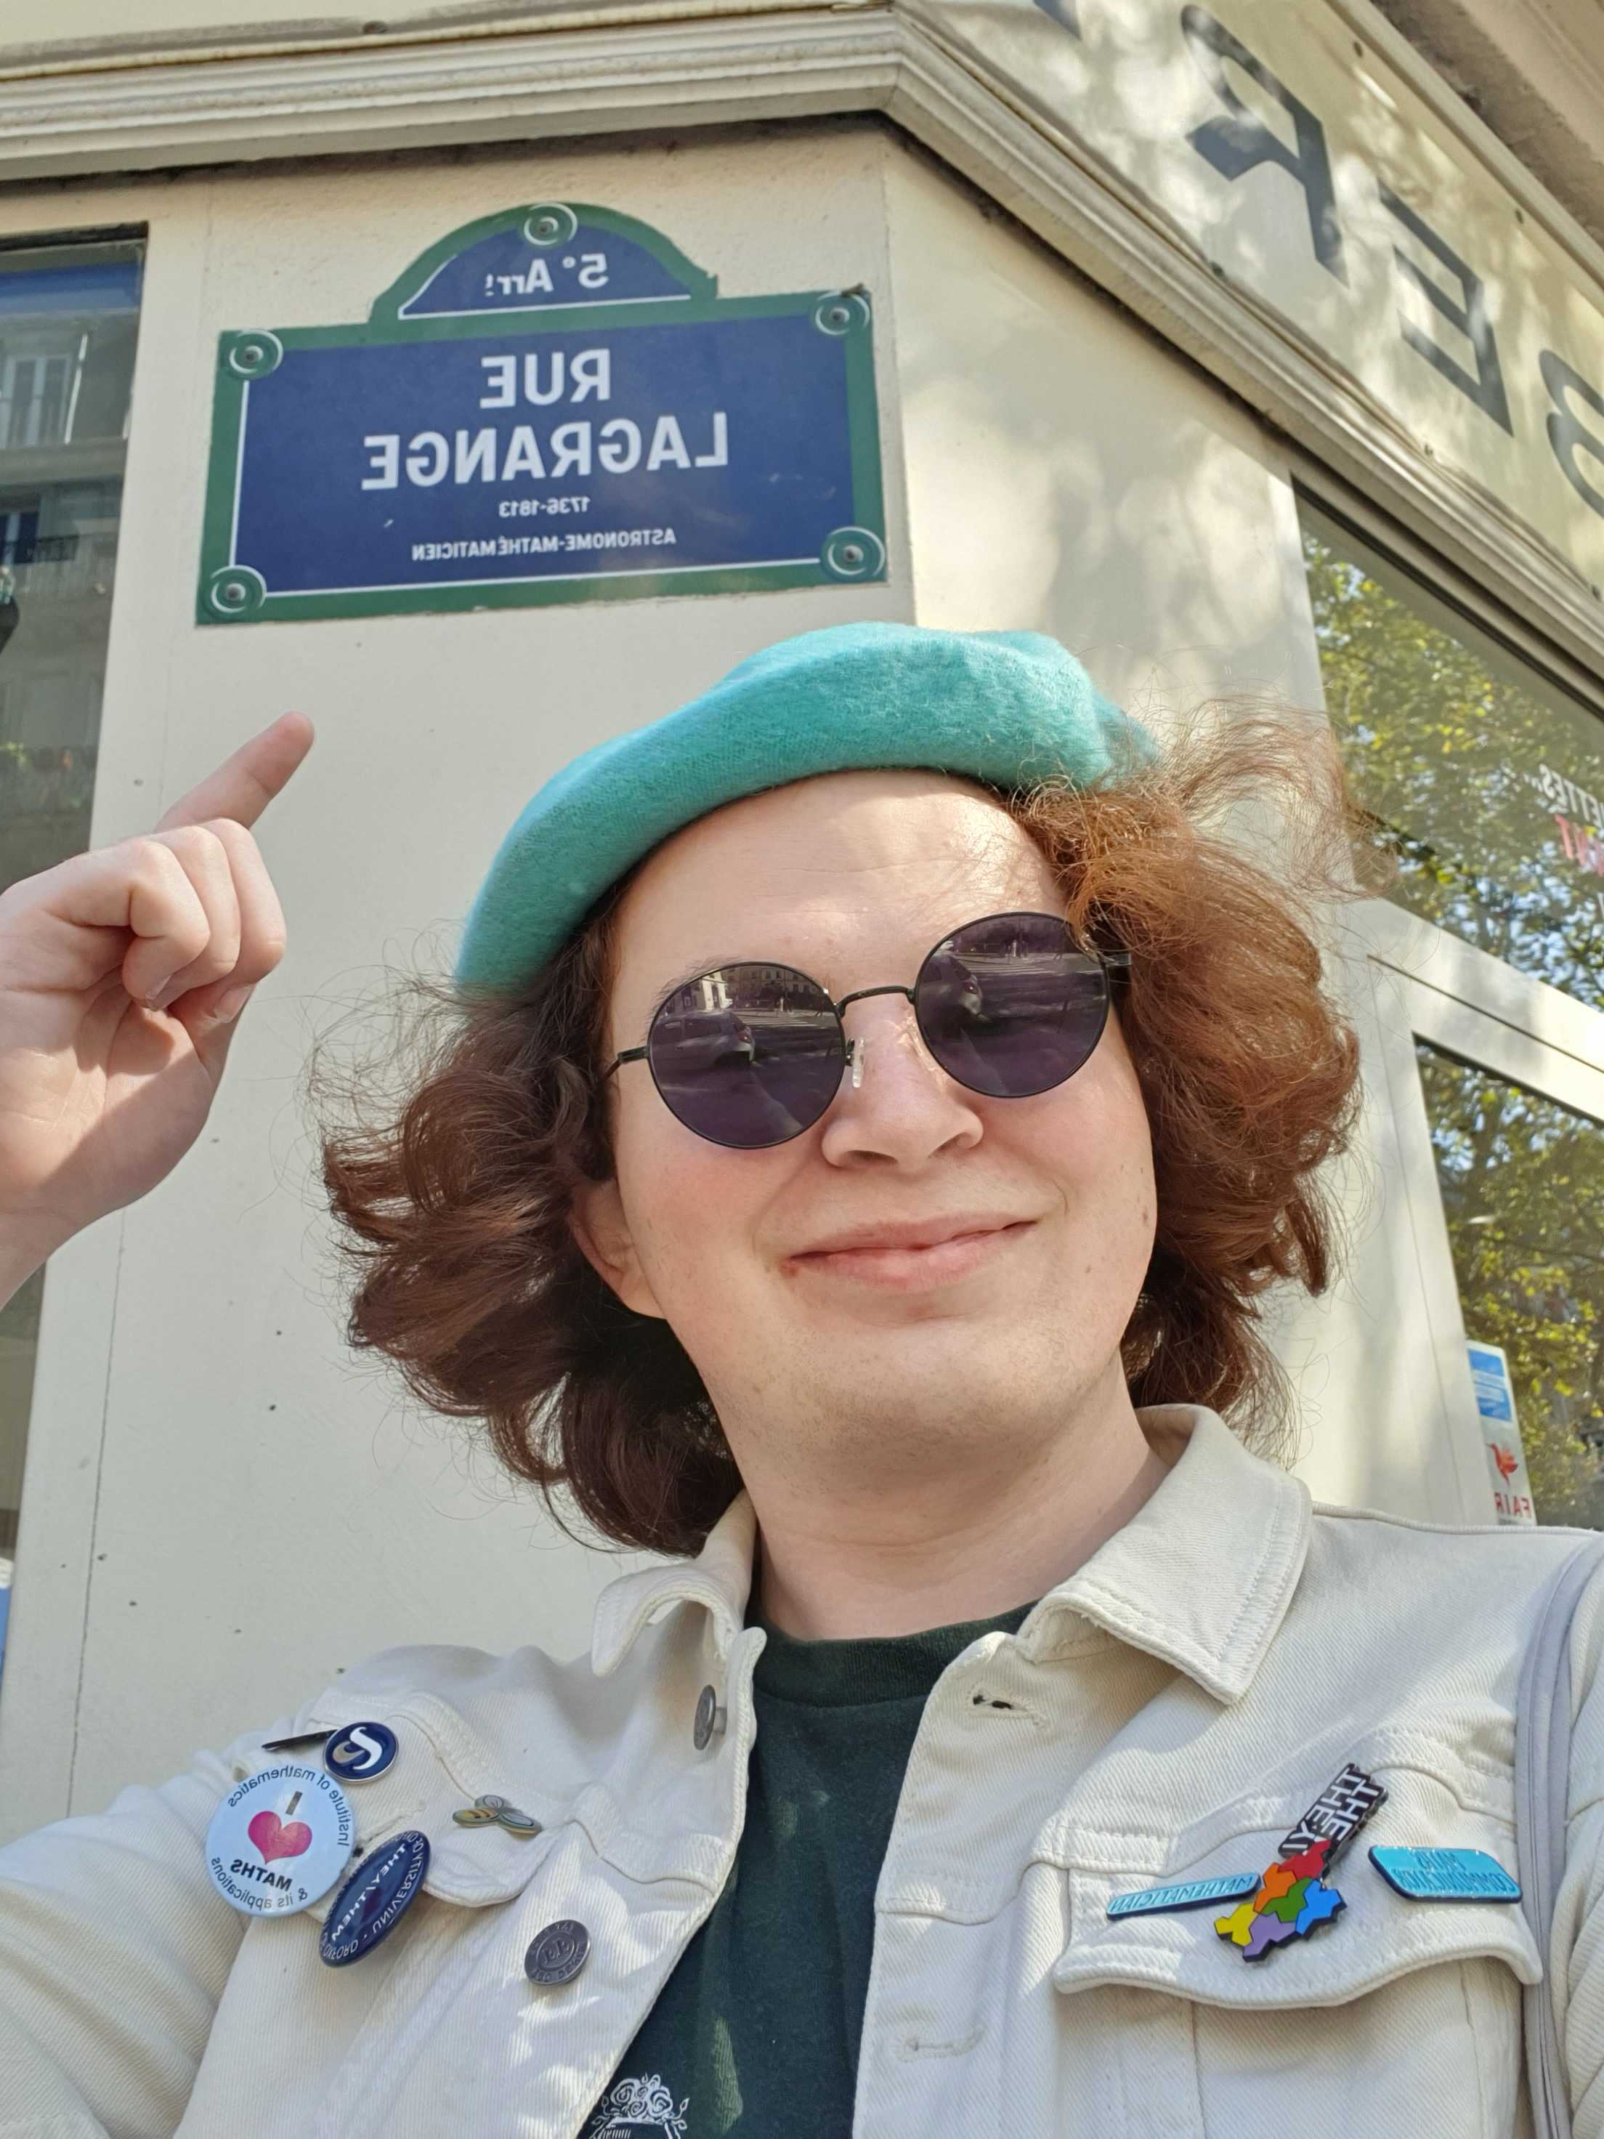
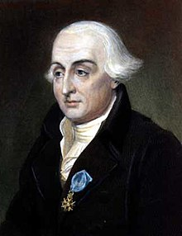
MIA (really really sad)

Slide 4
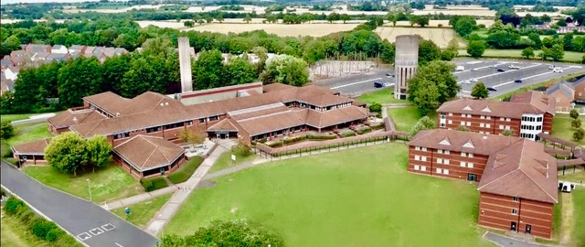

Slide 5
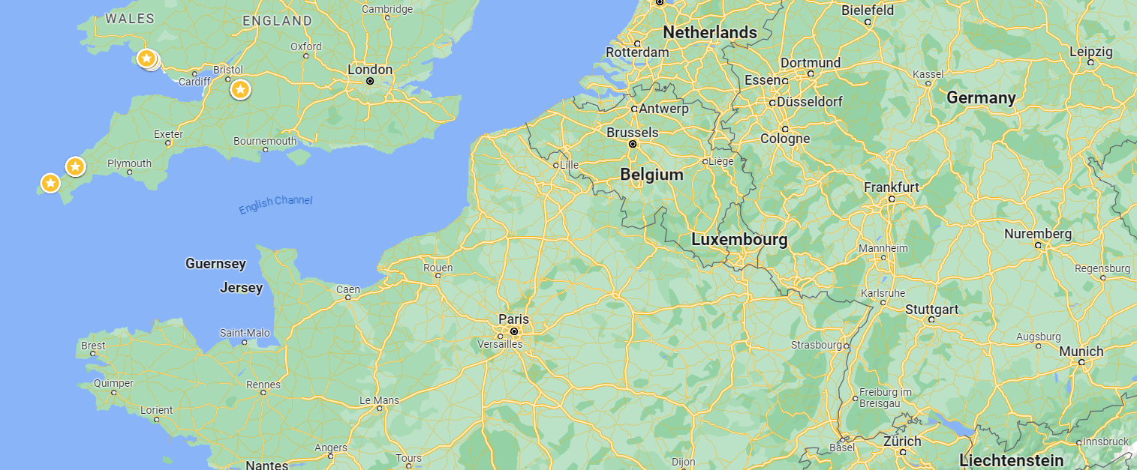
Zoom animation from Yarnfield to Strasborg

Slide 6
Zoom animation from Yarnfield to Strasborg

Slide 7
Zoom animation from Yarnfield to Strasborg

Slide 8
Zoom animation from Yarnfield to Strasborg

Slide 9
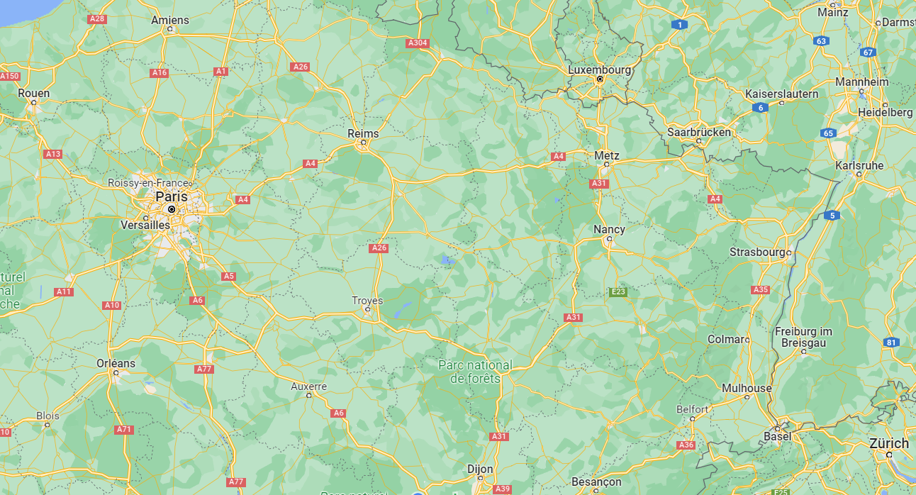

Slide 11
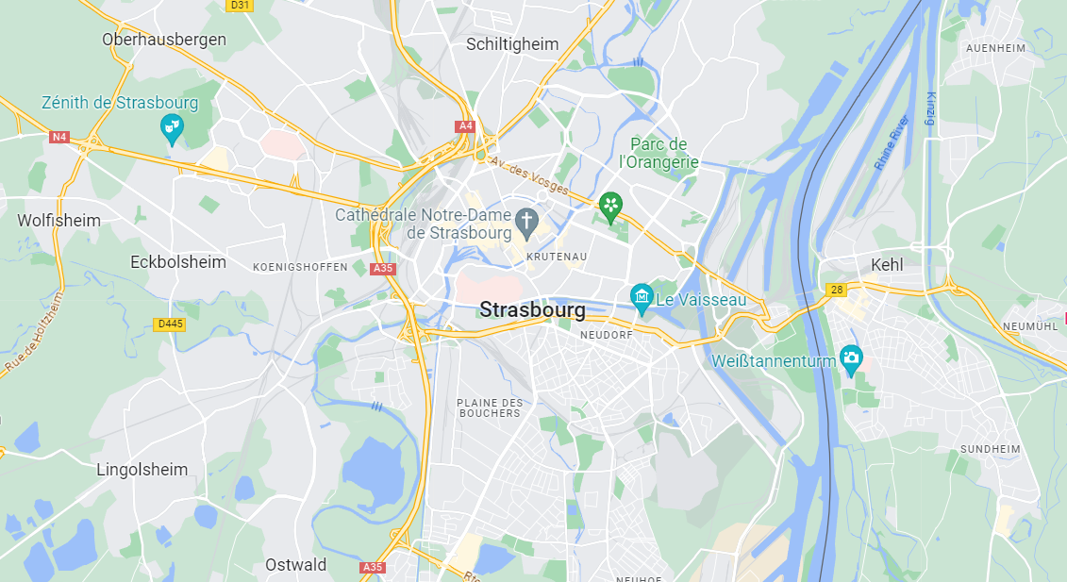
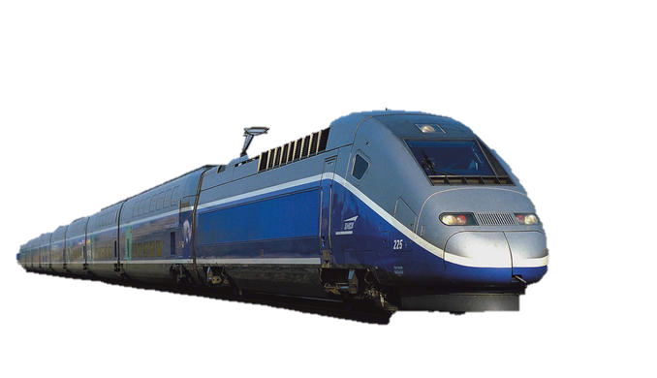
Ceci n’est pas un train

Slide 12
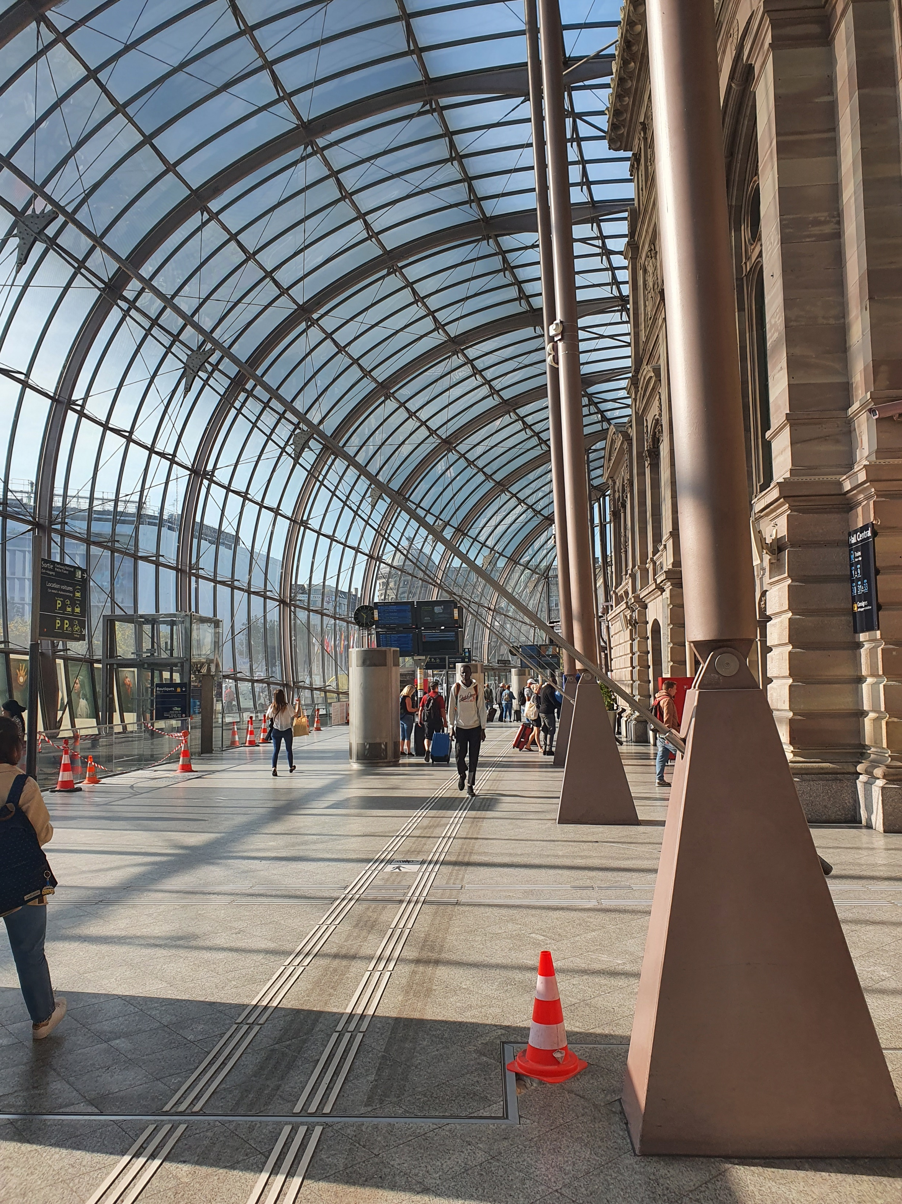

Slide 13
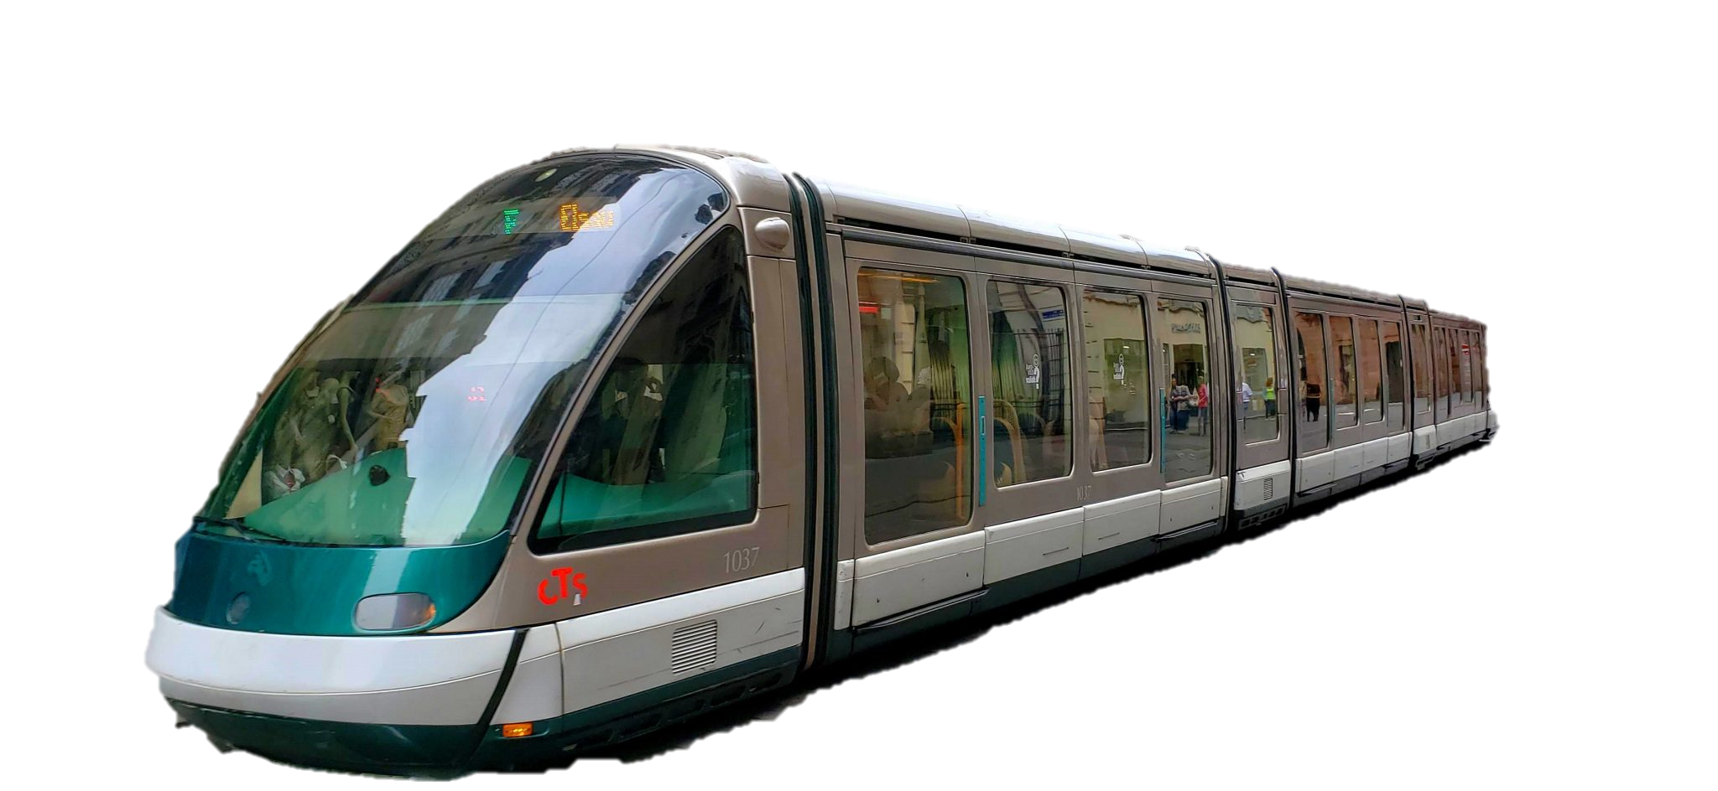
Ceci est un tram

Slide 14
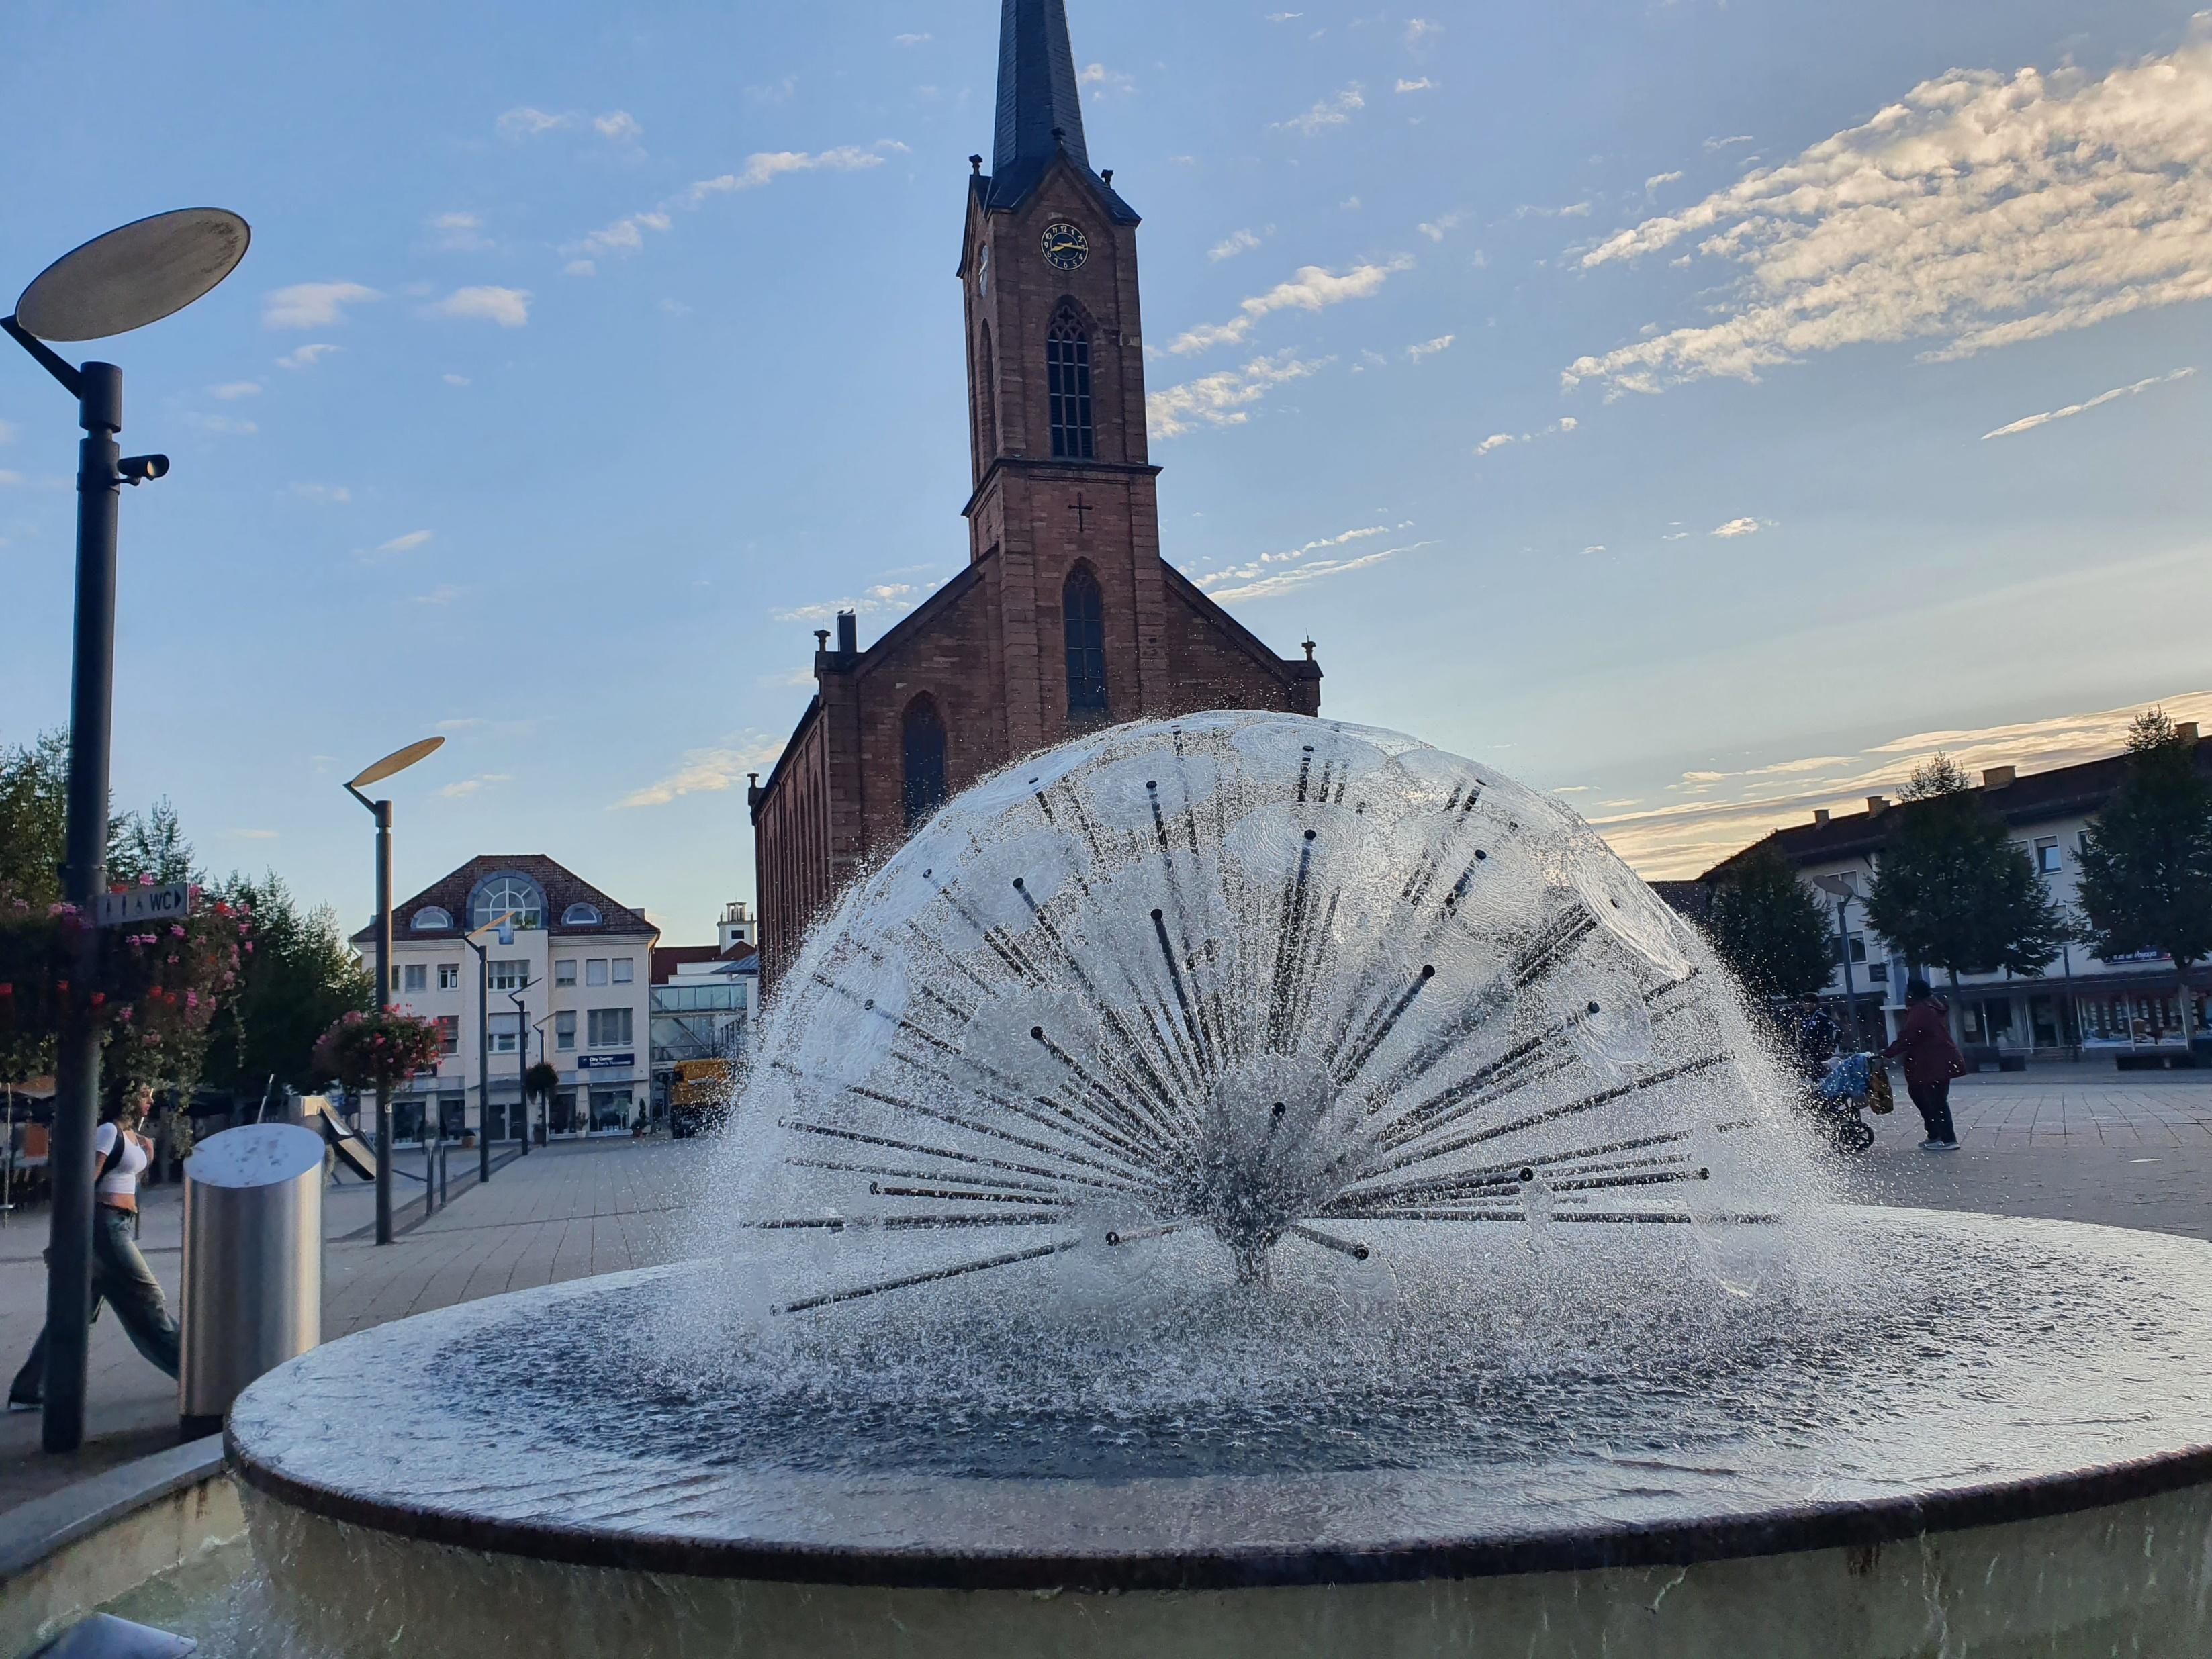

Slide 15
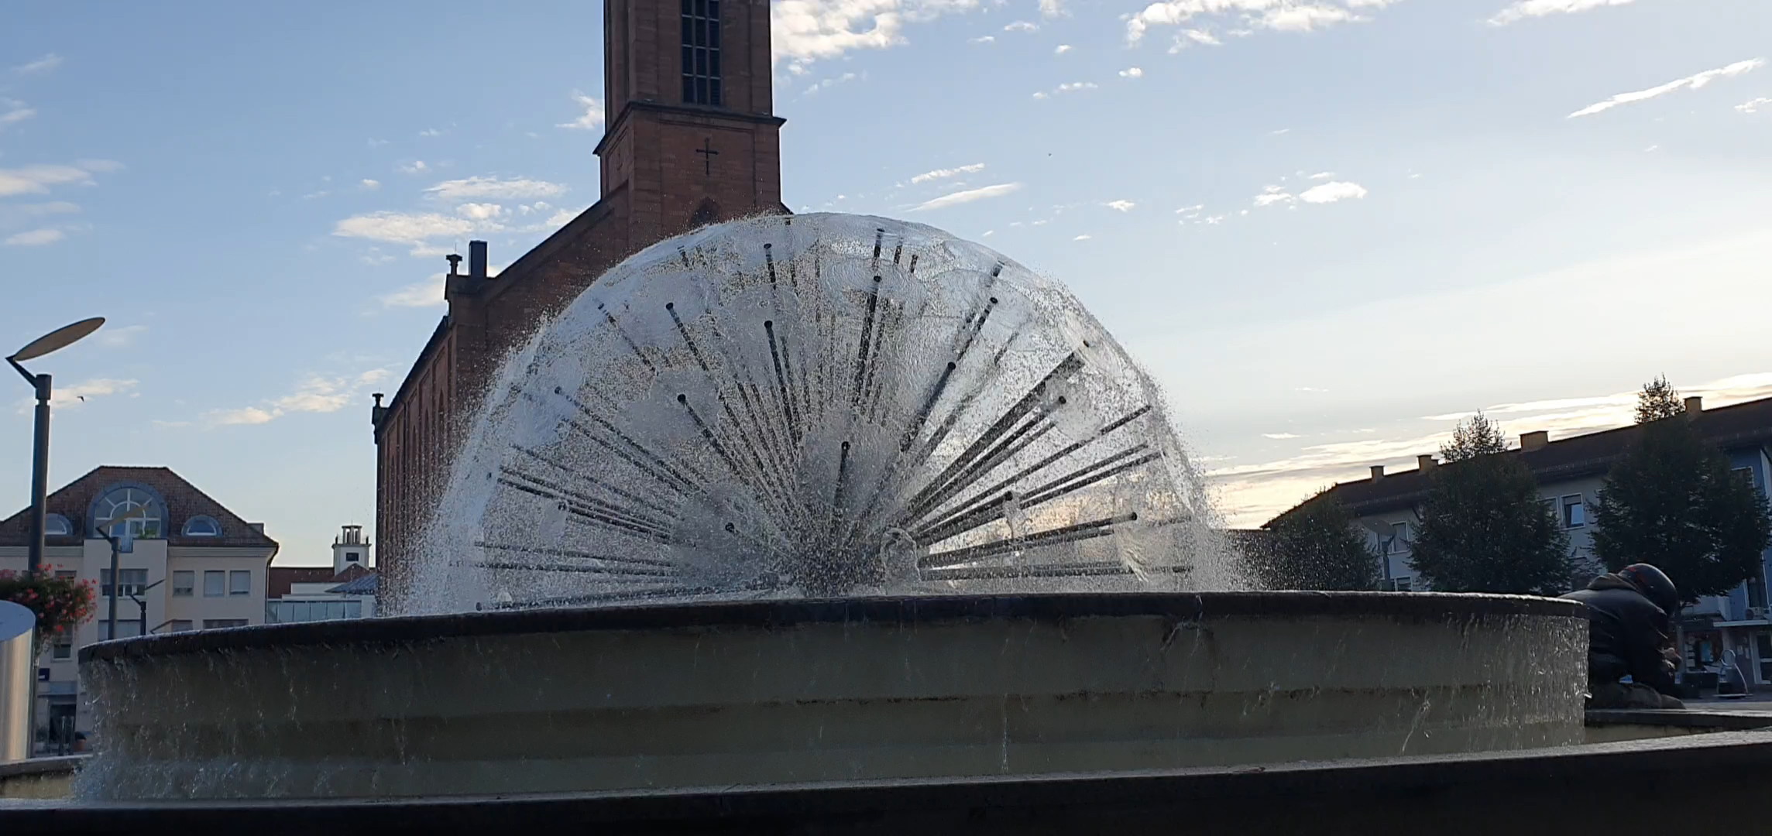

Slide 16
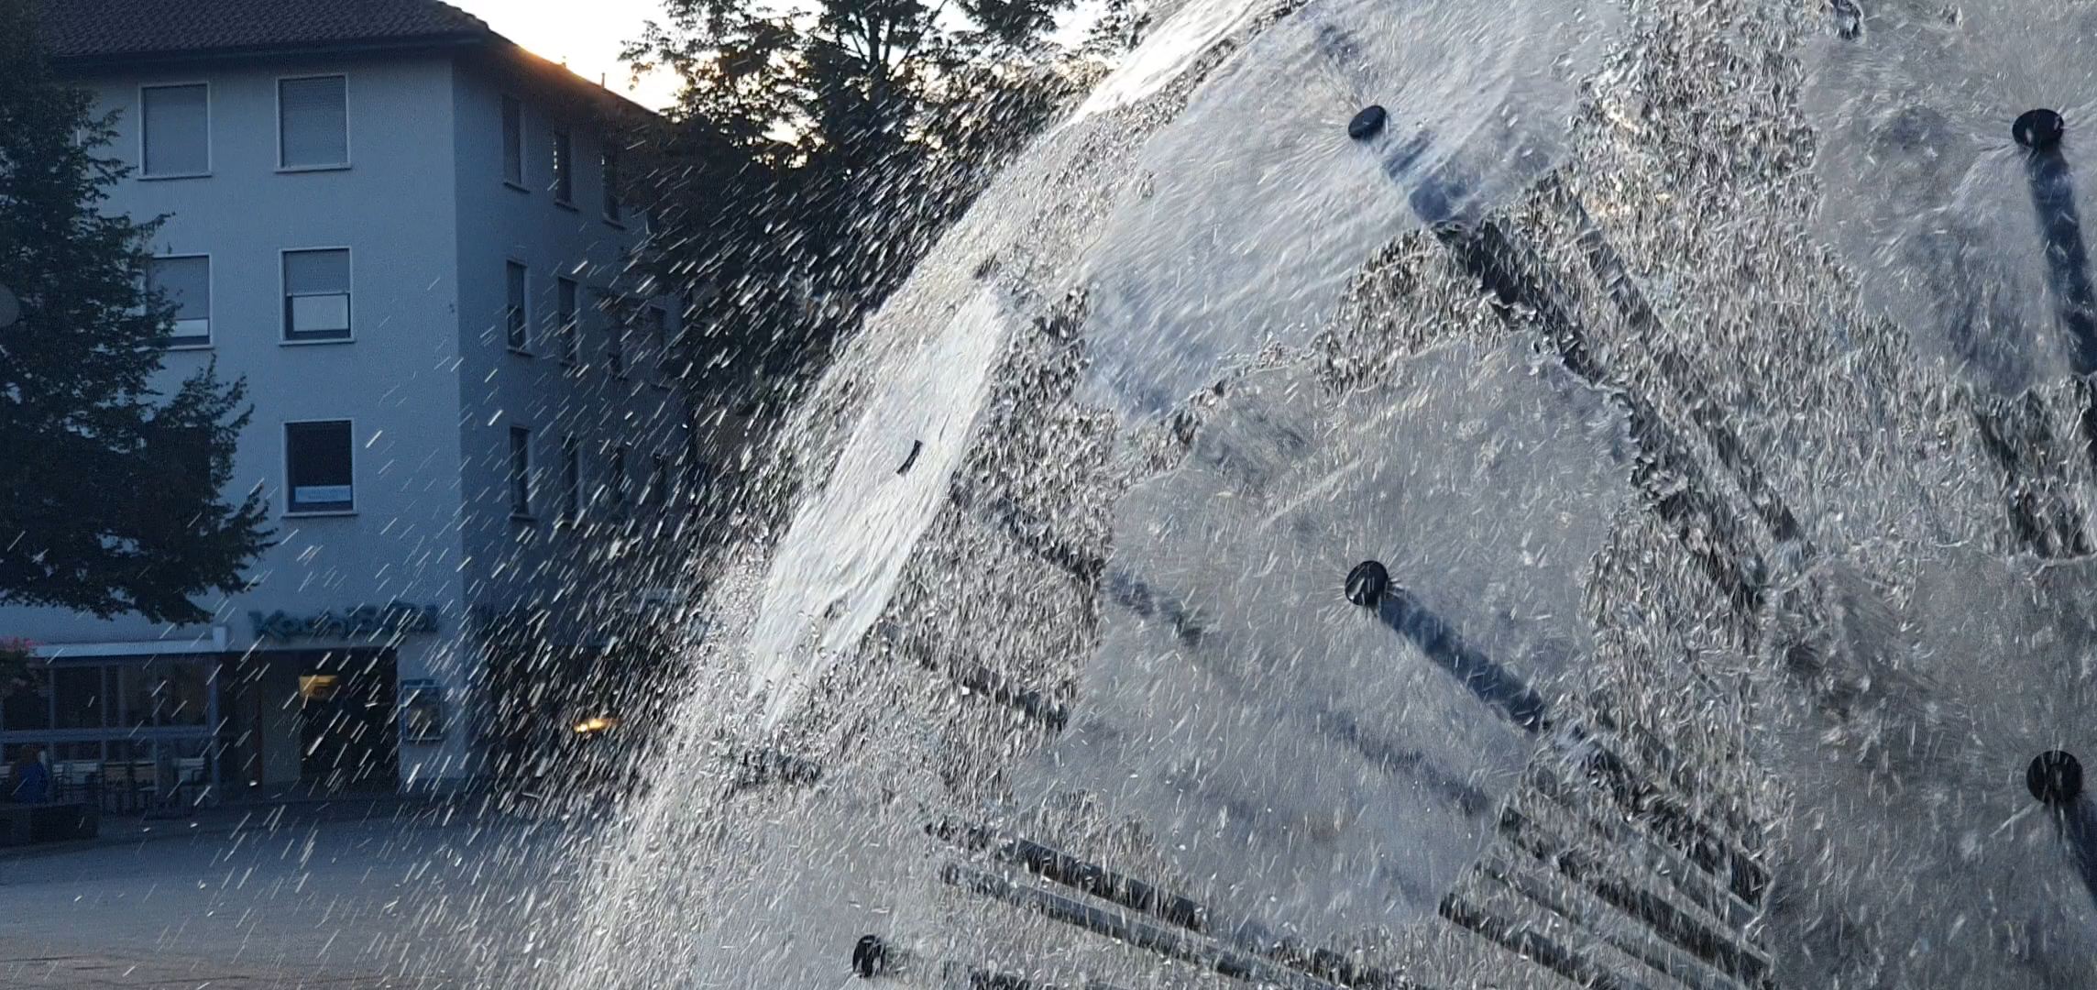

Slide 17
How do we talk mathematically about this fountain?

Slide 18
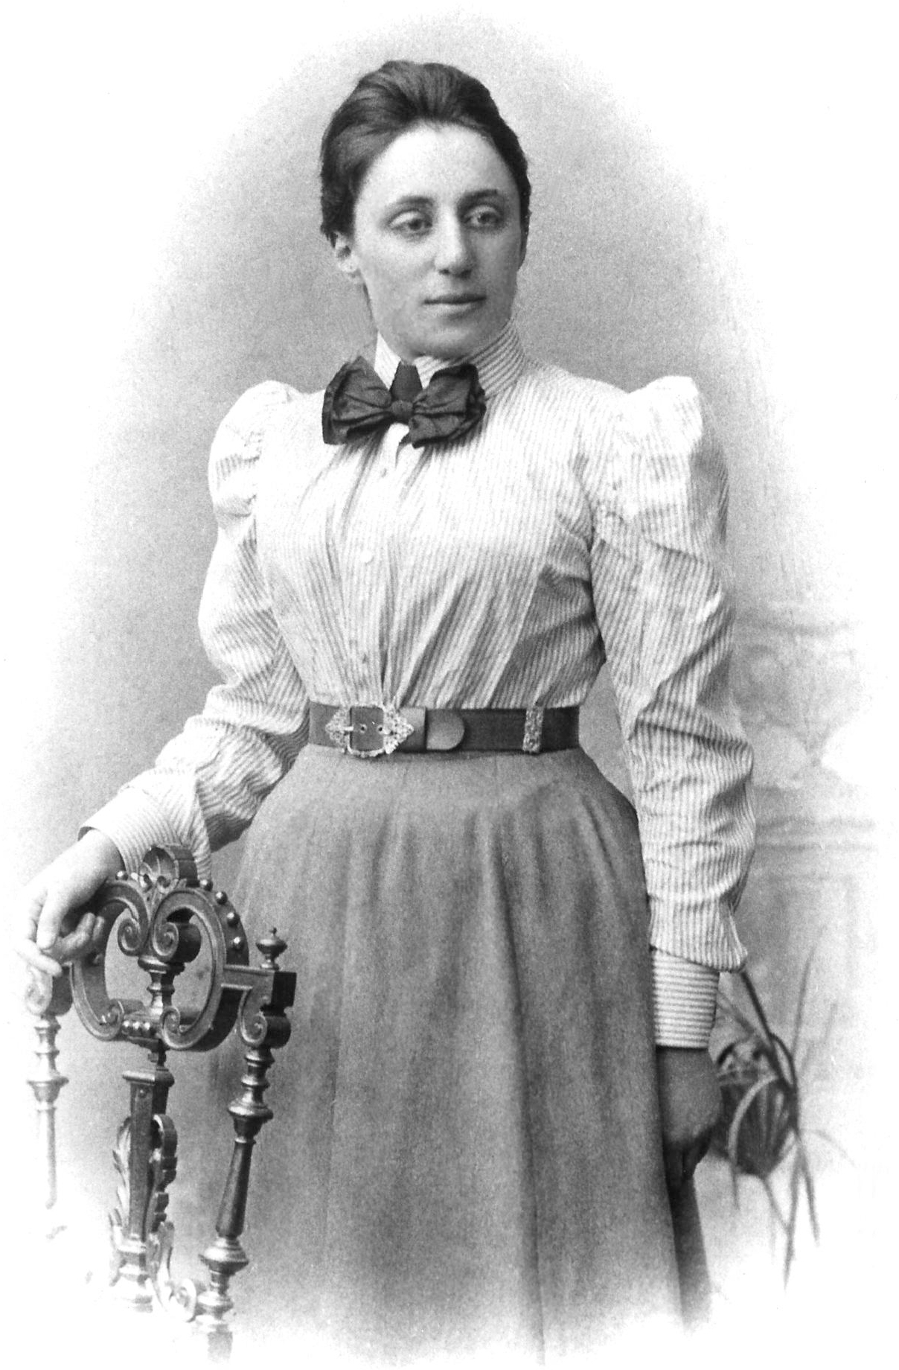
Symmetry!

Slide 22
3D System
2D System

Slide 24
PROJECTILE MOTION!

Slide 25
Complicated
System
Simple System

Slide 26
Symmetry
Systems

Slide 27
Hotel
Trivago
Other comparison sites are available

Slide 28
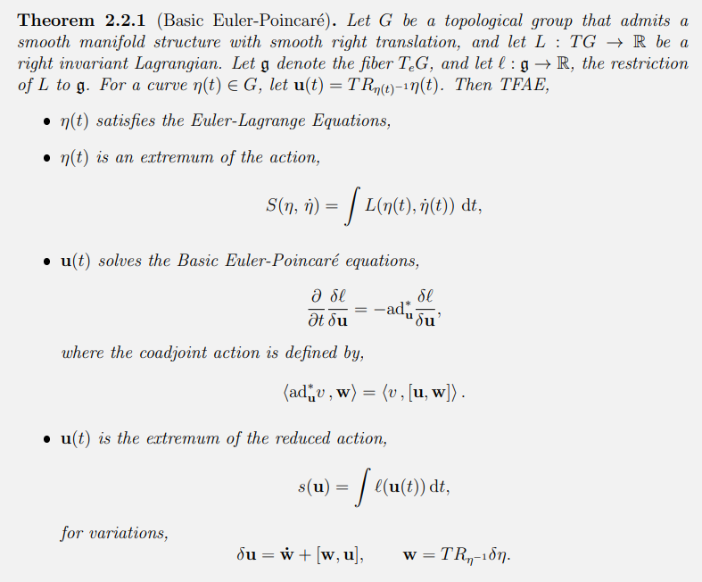
Euler-Poincaré reduction
Reduction!

Slide 29
+ Hamiltonian Mechanics

Slide 30
Pretty Pictures!

Slide 31
