Slide 1
How to avoid Zombies
David Hartburn
(what is my twitter, if I remember to look at it)
Notes:
I wanted to share what I have found to be an interesting way to look at the world for a particular problem and invite you all to try it next time you are out and about.

Slide 2
The problem……
Add picture of Whitstable sea front…..
Notes:
I’ve recently started running again and noticed curious problem.
This is a big wide path where there should be room for a lot of people to pass without you having to slow down and stop.
Sometimes you can have two or three people on the path and you pass them no bother, there is plenty of room
Other times you can have the same number of people of the same size and the path feels full. Why?
This is especially worse when there are zombies on the path.

Slide 3
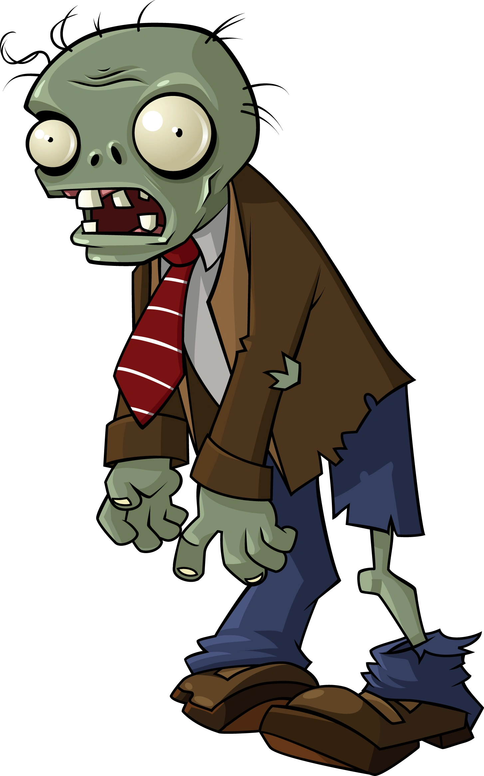
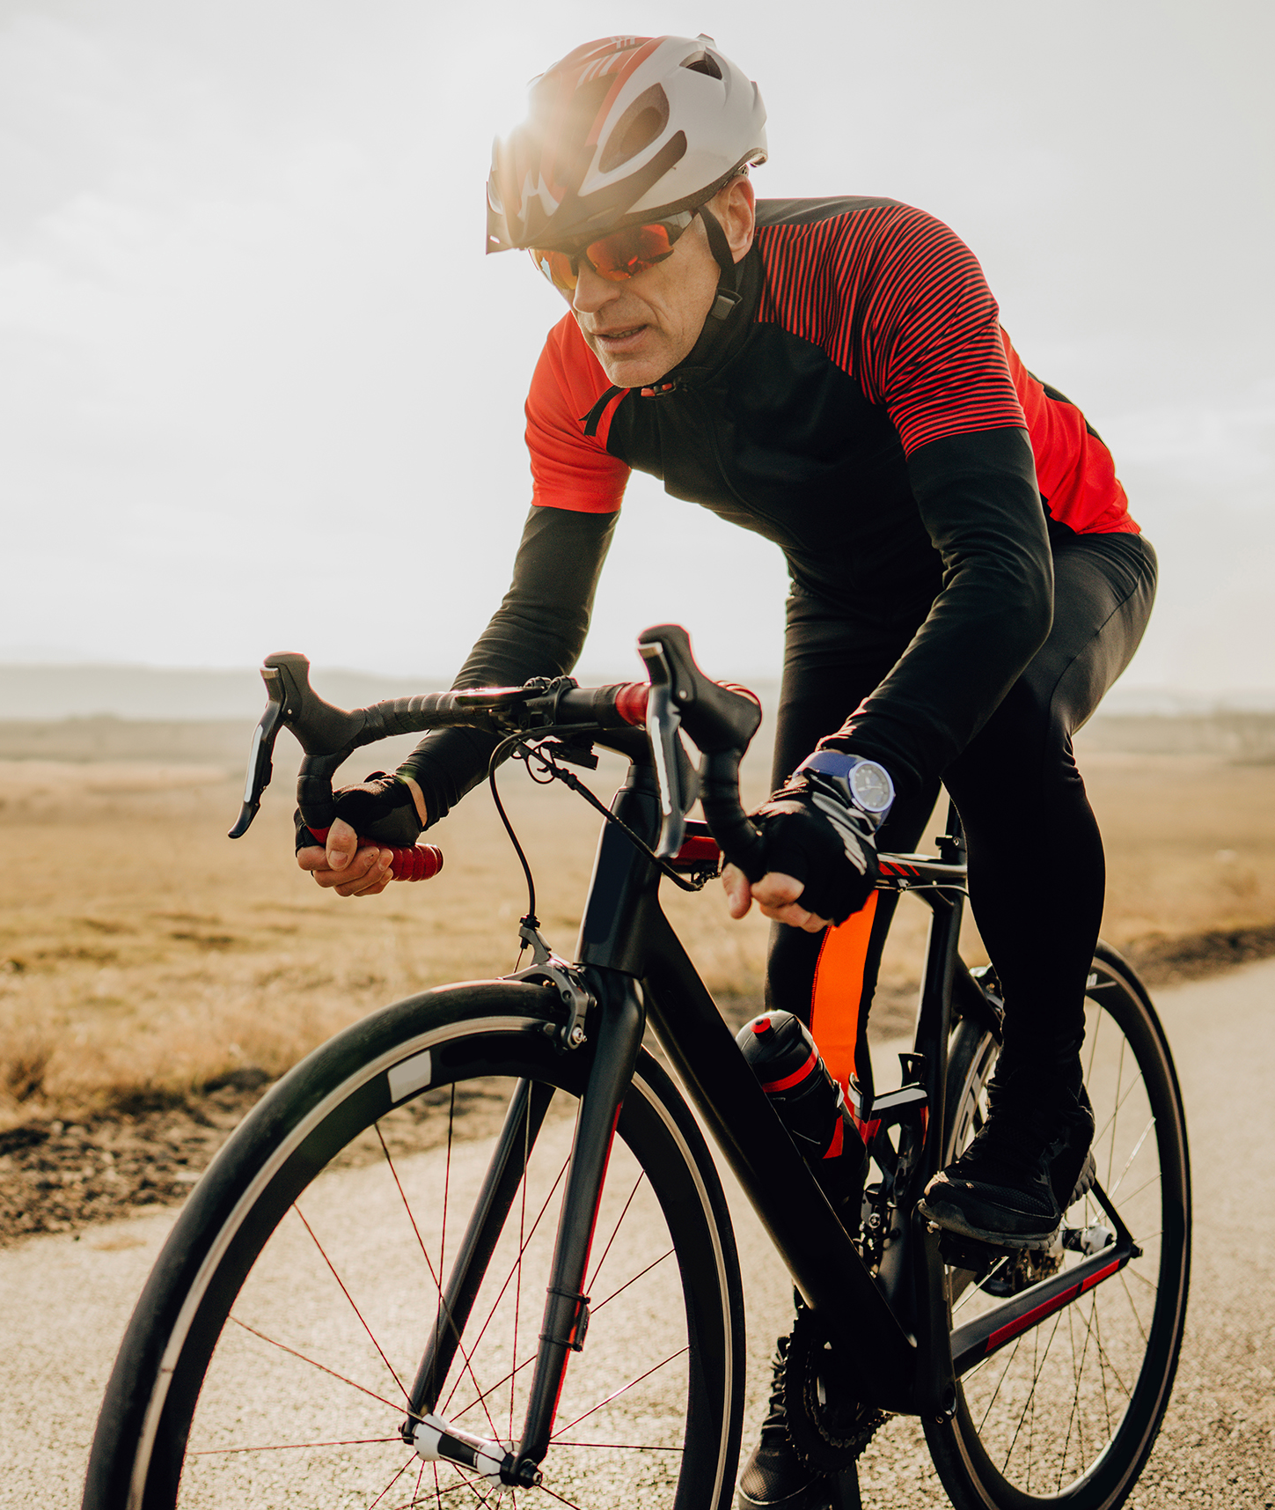

Traditional zombie
Phone zombie
Cyclist
Notes:
I should explain
This is our traditional zombie, slow, lumbering and just wants to eat your brains
The modern zombie is also slow, lumbering, all over the path and is out looking for likes
Then you might have a cyclist on the path, who is faster and more of a danger but surprisingly easier to deal with
When I started to think about it, I thought how will automated cars and robots deal with this sort of thing, where they have to deal with people in four dimensional space
So I started picturing myself as if I were a robot, like a delivery robot. I don’t go around imagining I’m a dalek

Slide 4
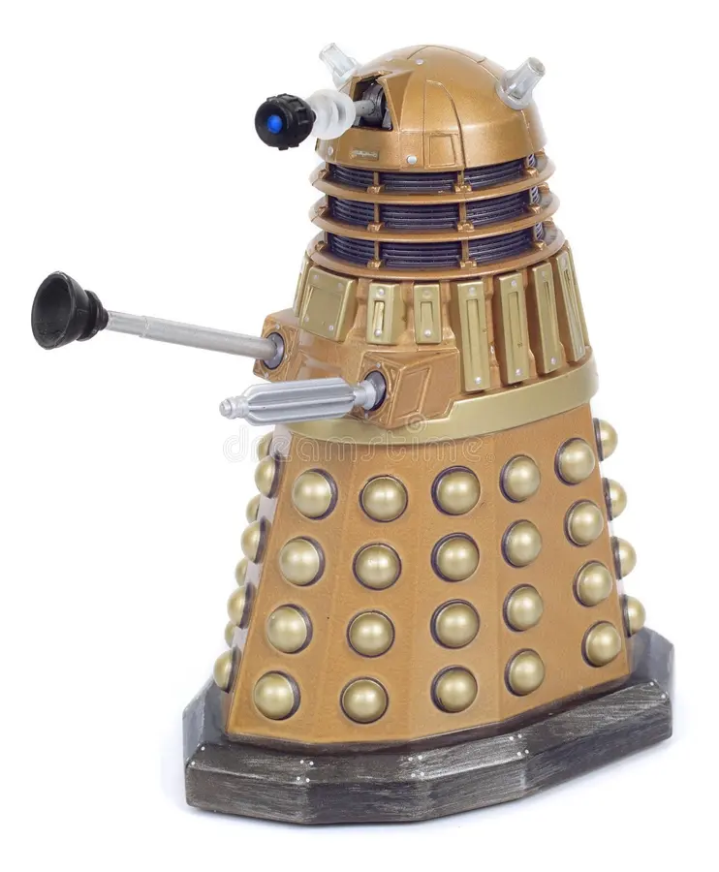
I know.
NOT a robot.

Slide 5
Diagram it out
Zombie
Couple
Me
Cyclist
Notes:
The first thing to do is diagram out the problem. This has to be in your head…….doesn’t work in real life
Stop thinking of people as people, think of them as objects and assign properties to them.
First thing is they have a position or set of coordinates. As humans we are very good at judging that providing we know what is very small and what is far away.
We can be fairly certain where they are but if this was a computer, we would be drawing a wider ring around to reflect the level of uncertainty.
This might feel like the natural path to take but it just doesn’t always seem to work like that

Slide 6
Assign size and politeness
Zombie
Couple
Me
Cyclist
Notes:
Everyone has a size. Some people are bigger but if someone is walking with their arms swinging we consider them a bit bigger
The couple are a pair with linked arms so we consider them a wide object and the cyclist is quite long.
Then we can assign an area of politeness around them, which is just how close it is considered to get to them without being inpolite.
This is a softer property, it might change depending on how crowded it is, or just how generally annoyed you are feeling.

Slide 7
Add a velocity
And a history
Zombie
Couple
Me
Cyclist
Notes:
Add in a velocity.
That is a vector of speed and direction so the bigger the arrow the faster they are going.
And we have an observed history.
The cyclist is going straight, the couple are starting to head to the middle of the path having just passed to the right of the zombie
And the zombie has been weaving all over the path oblivious of anything

Slide 8
Predicting the near future
Zombie
Couple
Me
Cyclist
Notes:
This is where it starts to get interesting
We can use the history to predict where each person is going to be in the next 5 to 10 seconds.
The history shows the cyclist to be going straight so we can be fairly certain they will continue speeding down that path and the orange in front shows where they are likely to be. It gets less certain as we go further into the future, but we can think of that zone of future uncertainty like a spotlight coming out the chest of each person. For the cyclist we know just to avoid that part of the path.
For the couple they are drifting slowly into the middle of the path and we are less certain, they might straighten up now they are away from the edge or they might continue going to the other size.
The zombie we have no idea, they might change direction again, they might continue coming towards us but they are much slower so there are of uncertainty is shorter.
We also have our own area of where we might go or at least want to go. We are a bit more certain because we are in control of that.

Slide 9
Where now?
Zombie
Couple
Me
?
Cyclist
Notes:
To be sure we avoid anyone, we want to plan a route which avoids our future position crossing with their future position and now we can suddenly see why a fairly empty path looks very congested.
If we were a robot, where we are less certain of the current location, less certain of the history and are not as good as picking up on visual clues in human behaviour, then these zones become much larger and the path becomes very difficult to navigate. A robot will have to be more assertive with some sort of noise.
That is it really something for you to think about when you are next trying to navigate a crowd.

Slide 10
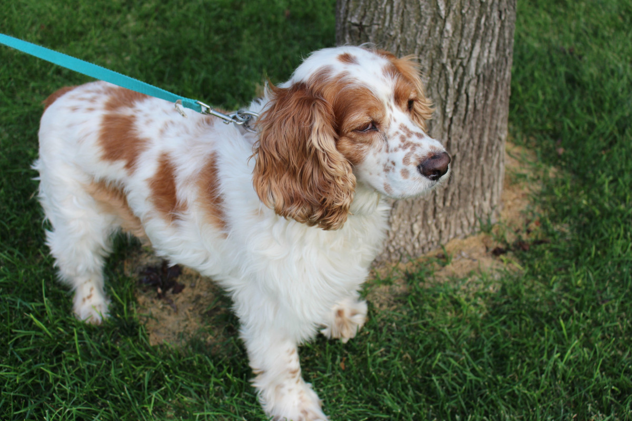
Most difficult object to avoid?
Takes up a lot of space
Erratic in movement
Thank You

